Slide 1
Andy Lulham (@andylolz)
Software Developer
Notes:
Hello I’m Andy from PWYF.

Slide 2
New Publish What You Fund strategy
Linking data use to real world issues (see: 2pm tomorrow!)
Expanding scope to include DFIs (just launched!) and Humanitarian (early 2019)
Building on Aid Transparency Index work to support the wider aid transparency movement (see: 4.30pm Thursday)
Notes:
We have a new strategy
* James, Rolf and USAID tomorrow
* Expanding scope to include DFIs (launched last week) and Humanitarian (to launch early next year)
* Building on our Index work and supporting the wider aid transparency movement (index is only a small part of what we do as an organisation; Gary will speak more about that on Thursday at 4:30pm)

Slide 3
Deciphering IATI
Andy Lulham (@andylolz)
Software Developer
Notes:
I’ve got 5 minutes to talk to you about “deciphering IATI”
I’m going to focus on deciphering one bit, and that’s organisation level information

Slide 4
NEWSFLASH! IATI comprises TWO standards
Notes:
So newsflash: IATI has two standards!
The activity standard
And it’s forgotten sibling, the organisation standard

Slide 5
What’s in the IATI organisation standard?
Budgets!
Past expenditure (added in v2.02)
Organisation level documents
(country; region; organisation; by budget lines…)
Notes:
Budgets! That crucial piece of the puzzle, that has been at the heart of IATI since its inception, borne out of a partner country level requirement
Broken down in various ways
Past expenditure, which is important for measuring coverage
Documents: Annual reports; sector strategies; country audits
Okay great, it’s important! So how do you access it?

Slide 6
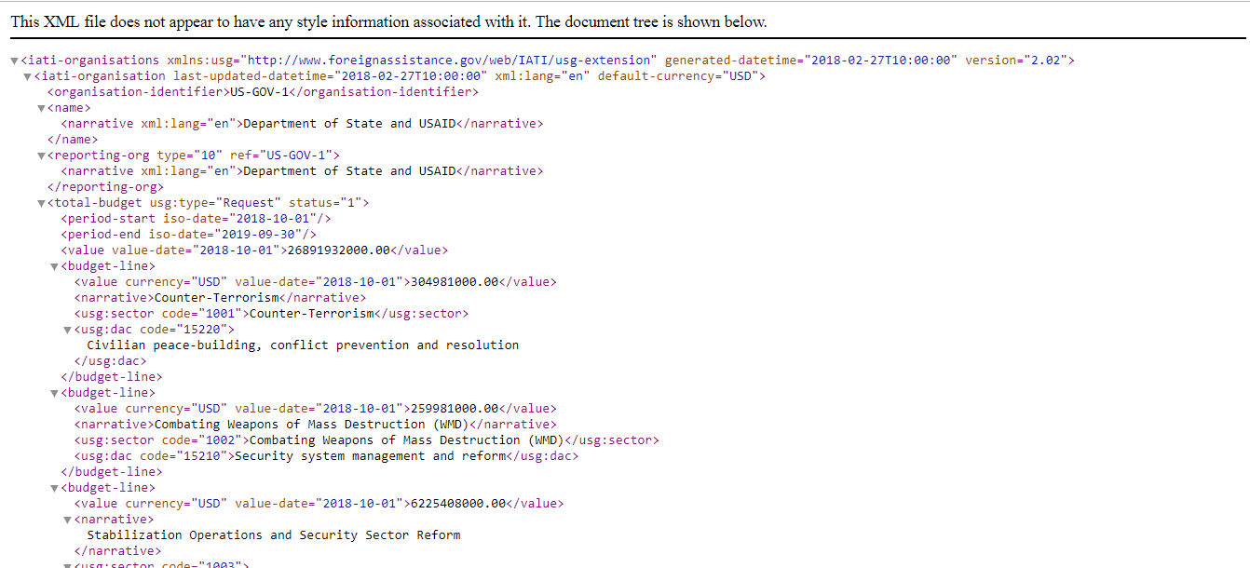
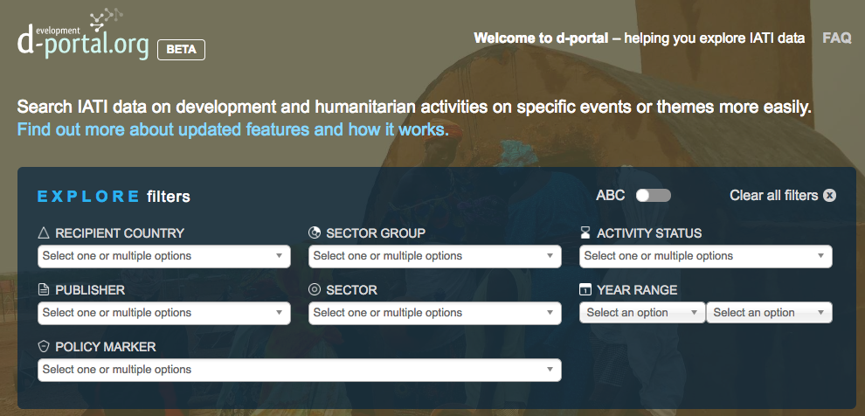
How do you access it?
Notes:
You’d be forgiven for assuming it’s via our good friend d-portal
But it isn’t! d-portal doesn’t display data published using the organisation standard

Slide 7
Introducing: IATI Decipher
Notes:
That’s where we come in!
New tool – browser extension that allows the user to visualise live organisation file data
Chrome, Firefox, and experimentally as web service

Slide 8
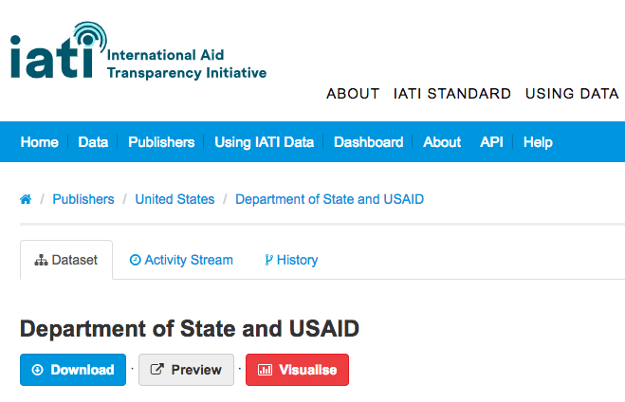
Notes:
Once you install the plugin
And visit an organisation file on the registry
(here, State and USAID)
You’ll see a new button

Slide 9
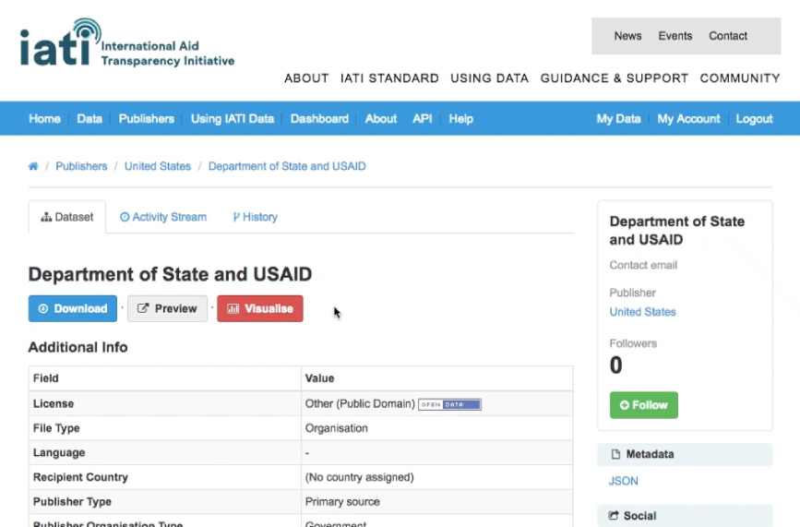
Notes:
Video!
Loads live data from the org file, (i.e. no database)
Total budgets over time
Disaggregate by sector

Slide 10
Please try it out
Download at: https://iati-decipher.publishwhatyoufund.org
Or search chrome / firefox webstore for “IATI decipher”
There’s more to do…
For me: Add graphs to compare country budgets; sector budgets…
For you: Check the data! Provide feedback to publishers!

Slide 11
Thanks!

