Slide 1
Tracking food security and food quality interventions in light of SDG 2 “End Hunger”
IATI TAG Kathmandu, Nepal
13 - 15 November 2018
Silvia Missiroli
FAO, Economic Stastics Division

Slide 2
Outline
Background: FAO and IATI
Gaps identified in CRS classification
FAO proposal to OECD–DAC to amend CRS classification
FAO as an example of synergies between different kind of aid expenditures reporting
Questions for you

Slide 3
Background: FAO and IATI
Oct 2016
Dec 2016
Early 2016
FAO joins IATI. Gaps in CRS classification identified.
FAO inter-department IATI Task Team established.
Gates funds FAO Statistics Division to improve Agriculture Statistics (quality, coverage, interoperability, open-ness).
April 2017
Jan 2018
FAO publishes1000+ projects to IATI, including all the basic variables (i.e. CRS purpose, Policy Markers etc..).
FAO submits the proposal to OECD-DAC.
2018
FAO quarterly publishes projects to IATI, refining elements and procedures. 3700 activities published. FAO reports ODA activities to OECD in June.
2017
FAO quarterly publishes projects to IATI; Consult with internal experts, OECD, WFP, IFAD, nutrition NGOs about a proposal to OECD-DAC to amend CRS classification.

Slide 4
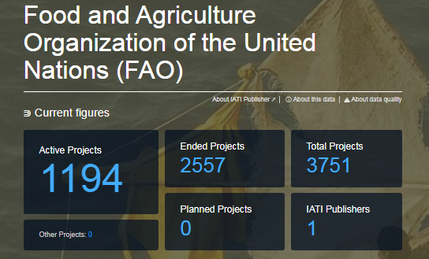
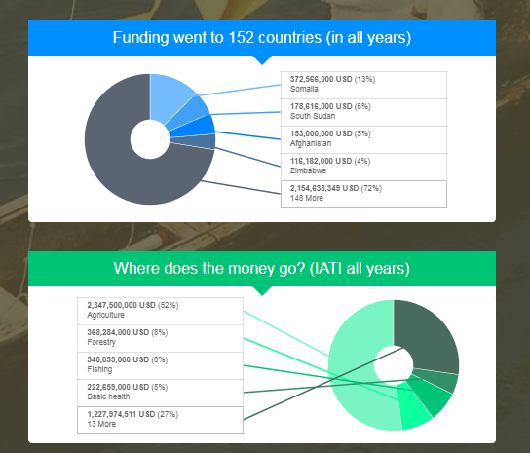
Background: FAO and IATI
IATI D-Portal: FAO main results

Slide 5
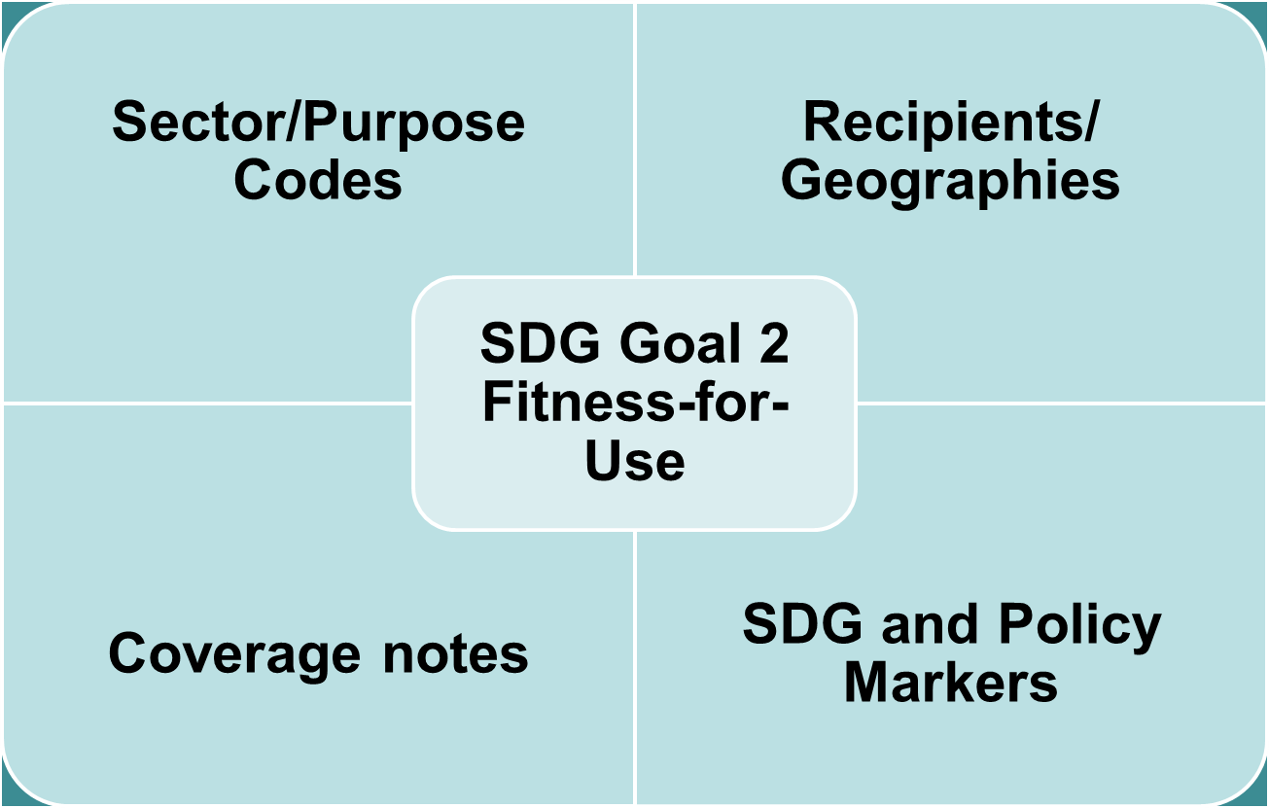
Gaps identified in CRS classification
Project Manager comments on use of CRS codes
I am also the LTO for a food safety project in Palestine .... However I could not see this on the list. → absence of information
While I agree that the project primarily relates to the health sector and thus is rightly coded to Sector 122, I consider this Food safety project having more to do with Infectious disease control than Nutrition. Thus in the absence of any Food safety purpose, I have proposed to change the Purpose code to 12250 (Infectious disease control). → confusion

Slide 6
Gaps identified in CRS classification
The magnitude of the gaps
Food security (including food loss and waste)
$4.2 billion dollars, 1.1% of sector allocable aid (2013-2015).
42 donors
Food safety and quality
$0.3 billion dollars, 0.07% of sector allocable aid (2013-2015).
30 donors
3,400 activities
Identified across 97 purposes
500 activities
Identified across 39 purposes
Notes:
. Food security is defined as “a situation that exists when all people, at all times, have physical, social and economic access to sufficient, safe and nutritious food that meets their dietary needs and food preferences for an active and healthy life.” As such, food security is multi-dimensional and multi-sectoral, and impacts activities that range from agricultural production to storage and food processing; from food safety to reduction of food loss and waste; from investments in transportation infrastructure, such as roads and ports, to marketing and food security marketing campaigns.
Food loss and food waste refer to the decrease in the quantity and quality of edible food intended for human consumption. Food loss occurs prior to the retail level, largely due to managerial and technical issues, such as lack of: proper storage facilities, cold chain, proper food handling practices, infrastructure, packaging, efficient marketing systems and so on. Food waste refers to removal of food, by choice, from the food supply chain while it is still fit for human consumption. This can occur when food that is still good is thrown out by households or restaurants, or after food is spoiled or expires due to poor stock management at retail levels
Aid interventions supporting food safety and quality are significant and growing. Food safety refers to “the absence, or presence in acceptable levels, of microbiological, chemical or physical hazards in food to prevent risks to the health of the final consumer.” At present, the absence of a purpose code for such activities results in inconsistencies and challenges to FAO and other donors and multilateral agencies in coding these interventions, such as support of the Codex Alimentarius, and support to developing countries to improve food safety and/or food quality standards for both domestic consumption and international trade.
This proposal recommends to address this gap through a new purpose code in the “Other multisector” (code 430) entitled Food safety and quality, as presented in the table below, in order to take into account that food safety and quality interventions occur across the agri-food value chain in multiple economic sectors, including health, water and sanitation, agriculture, fisheries, agro-industry, etc.
United States, EU Institutions and Germany are the main donors for food security
United States, EU Institutions and International Development Association are the main donors for food safety and quality

Slide 7
GAPs identified in CRS classification
It is not recommended to create a new purpose under Sector 520
DAC 5 CODE | CRS CODE | DESCRIPTION | Current additional notes on coverage
520 |  | Developmental food aid/Food security assistance
 | 52010 | Food aid/Food security programmes | Supply of edible human food under national or international programmes including transport costs; cash payments made for food supplies; project food aid and food aid for market sales when benefiting sector not specified; excluding emergency food aid. Report as multilateral: i) food aid by the EU financed out of its budget and allocated pro rata to EU member countries; and ii) core contributions to the World Food Programme.
Objective:
Propose CRS changes to OECD-DAC to fill SDG Goal 2- which aims to end hunger, achieve food security and improved nutrition, and promote sustainable agriculture.
Notes:
It is not recommended to create a new purpose under Sector 520 because:
it falls outside the sector allocable codes;
it was historically developed to enable coding of non-emergency food supply by EU institutions and the core contributions to the World Food Programme (WFP).
Sector allocable: till 400

Slide 8
FAO proposal to OECD–DAC to amend CRS classification: Principles Followed
(a) Minimize reporter burden
(b) Ensure reporting feasibility
(c) Ensure data relevance
(d) Minimize structural breaks
(e) Ensure alignment with recently accepted proposals
(f) Ensure internal balance
Notes:
In examining the gaps in the existing CRS system, the principles followed in proposing and evaluating solutions/options are the following:
A - ensure the feasibility of reporting by DAC members and other providers;
B - minimise the burden on reporters/data producers in implementing changes;
C - maximise the relevance for data users and aid tracking;
D – avoid structural break unless they are necessary; some break ae necessary
E - e.g. COFOC and ISIC
F – not creating small category but very meaningful or with negligible expenditures
ensure alignment with recently accepted proposals, such as the Nutrition
proposal initiated by Action Contre la Faim.

Slide 9
FAO proposal to OECD–DAC to amend CRS classification
Revise Sector Code 430 (Other Multisector)
Add new purposes in this revised sector
Food security policy and administrative management
Food safety and quality
Ensure alignment with nutrition proposal

Slide 10
Fill gaps with new PURPOSES
DAC 5 CODE | SECTOR | PROPOSED CRS CODES | PROPOSED DESCRIPTION | PROPOSED COVERAGE
430 | Other multisector | 430XX | Food security policy and administrative management | Food security policy, programmes and activities; institution capacity strengthening; policies, programmes and activities for the reduction of food loss/waste; household food security programmes and activities; school feeding; food security information systems, data collection, statistics, analysis, tools, methods; coordination and governance mechanisms; other unspecified food security activities.
430 | Other multisector | 430YY | Food safety and quality | Food safety and quality policies, programmes and activities, including food inspection and certification; strengthening food safety/quality capacities and development of standards along the value chain; monitoring/surveillance and laboratory capacities; and delivery of information, communication, education.
Notes:
Food security by its very nature is multi-dimensional and multi-sectoral. If the activity pertains to a cross-sectoral food security policy and programme and not sector specific, then it should be coded under 430XX by default; else if the intervention occurs say in the agriculture sector with the aim of addressing food security, then it should be coded under Agriculture (e.g. 31110). The principle for using code 430XX follows the same principle for reporting environmental protection sector code 410- “Sector specific environmental protection activities should be included in the respective sectors, and the environment marker checked. Multi-sector/cross-cutting includes only environment activities not allocable by sector”.

Slide 11
Modify/clarify existing descriptions
* Proposal on Basic nutrition aligns with the proposal of Action Contre La Faim which was consulted with the SUN network
Notes:
The proposed new 430XX code includes “Household food security programmes” that were previously the focus of the code 52020 approved at the July 2017 WP-STAT meeting (but not yet in effect). The change in the sector category addresses the concerns expressed by some members about the exclusion of this code from the CPA calculation. Including “Household food security programmes” in the proposed new code 430XX and deleting the code 52020 would resolve this issue.

Slide 12
Other proposed changes
Update coverage notes on Agriculture, Forestry and Fisheries purposes (not revised since 1999)
A new policy marker for Food Security
Add a set of SDG fields to allow the allocation of aid expenditures against a maximum of at least 3 SDG targets (withdrawn)
Notes:
As Members were generally cautious about the introduction of new policy marker, referring in particular to the ongoing review of the policy markers, the introduction of a new policy marker on food security is put on hold pending the outcome to the ongoing review process.
This proposal recommends to include a new policy marker for Food security. As defined in paragraph 10, Food security is both multi-sectoral and multi-dimensional, and includes availability, access, utilization and stability of food. A new purpose code to cover Food security program and policy administration is essential to address the significant aid flows in this domain, but will not cover all the requisite dimensions nor the increasing interest in Food security world-wide.
28. Efforts by the G77 focused on development of a Food Security indicator for aid flows by aggregating aid under relevant purpose codes (e.g. agriculture, fisheries, agro-industries, transportation, food aid, etc.) or aggregating relevant observations using semantic searches (e.g. food security, rural roads, etc.). A superior approach is to create a policy marker that identifies interventions across sectors and dimensions that have a food security objective.
29. As such, this proposal recommends the introduction of a Food Security policy marker, as follows: Food Security Policy Marker • Principal (marked 2) means that food security is the main objective of the project/programme and is fundamental is its design an expected results. The project/programme would not have been undertaken without this objective. • Significant (marked 1) means that food security is an important and deliberate objective, but not the principal reason for undertaking the project/programme. • Not targeted (marked 0) means that the project/programme has been screened against the food security marker but has not been found to target food security
_________________________________________________________________
Agenda 2030 increases the need to track aid expenditures in support of the 17 SDG goals and its 169 targets. Monitoring external aid in support of the SDG targets is essential to compare progress, or its lack, across countries, and identify funding opportunities and challenges.
The mapping between CRS purposes and SDG targets, however, is problematic due to difficulties in one-to-one mapping, which is necessary in order to enable monitoring of aid flows to SDG targets, in the current CRS system, while ensuring no double counting and ensuring aggregatability

Slide 13
FAO as an example of synergies between different kind of aid expenditures reporting
IATI Reporting (quarterly)
OECD Reporting (yearly)
FAO extra budgetary expenditures and Technical Cooperation Programs (TCPs).
FAO core budget expenditures on development assistance (ODA), including TCPs.
What do they have in common?
They both require to classify expenditures according to the OECD-DAC Creditor Reporting System (CRS) classification
They have a common part (TCPs projects)
They are managed by the same people
Possible synergies and integration

Slide 14
Questions for you
Is it difficult to report food security and food safety interventions or other kind of aid activities?
Can the proposed changes be useful for you?
How relevant is a food security policy marker in your opinion?
How can better synergies be obtained in diverse reporting at international level?

Slide 15
First version of FAO proposal to OECD can be found at:
http://www.fao.org/3/BU481en/bu481en.pdf
For more information, please contact:
FAO Statistics Division
Silvia Missiroli, Statistician: Silvia.Missiroli @fao.org
Mukesh Srivastava, Team Leader of the Economics/Statistics Team: Mukesh.Srivastava@fao.org

