Slide 1
Behind the scenes of the 2018 Aid Transparency Index
Gary Forster, CEO

Slide 2
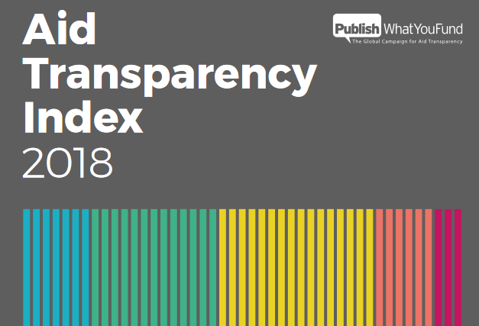
What is the Index
The only independent measure of aid transparency among the world’s major development agencies. It measures transparency according to:
Organisational planning and commitments
Finance and budgets
Project Attributes
Joining up development standards
Performance

Slide 3
The Index is a giant data quality check
Six months of work
45 agencies
At least 18,900 data fields/documents manually checked
A team of seven people
35 indicators
42 independent reviewers
Notes:
The Index process is by far the most major assessment of data comprehensiveness and quality within the aid transparency space.
And this is ignoring the fact that the Aid Transparency Tracker runs automated tests on all data published to the IATI Registry by all 45 organisations.

Slide 4
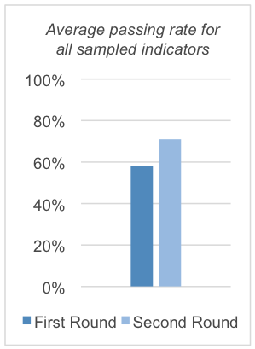
The Index is a feedback, engagement and improvement tool
The consultative, two-stage nature of the process arguably represents the only feedback mechanism for donors, at present, regarding the quality and accuracy of their IATI and other aid transparency data.
The chart to the right, showing the impact of this feedback in the 2018 Index process, is compelling.

Slide 5
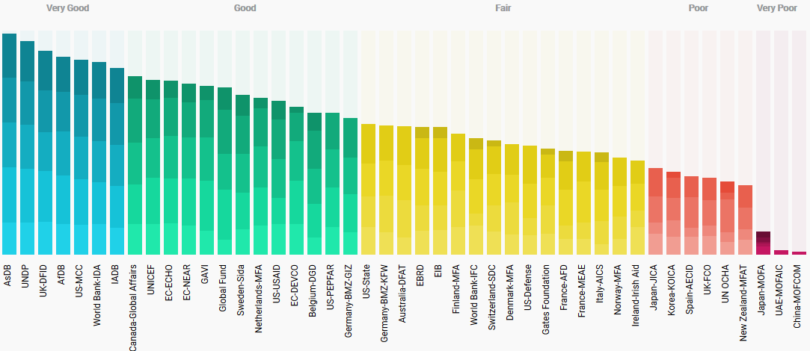
The Index is also, a ranking

Slide 6
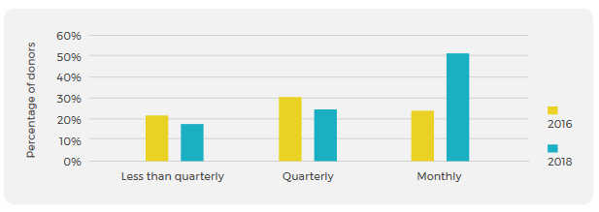
Index 2018 – Timeliness
Notes:
Unprecedented amounts of timely aid and development data are available in an open and comparable format:
75% of organisations assessed now publish information on a monthly or quarterly basis
50% of them publish on a monthly basis, which is up from 25% in 2016.

Slide 7
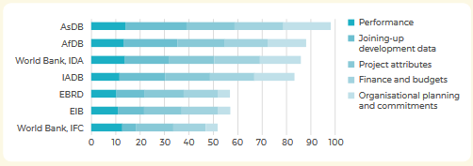
Index 2018 – DFIs
Notes:
In order to improve effectiveness and be accountable to their constituencies, all aid and development actors, regardless of their business model or size, can share quality information on their work.

Slide 8
Index 2018 – The Basics
Too many organisations fail on basic data quality issues:
Incorrect activity dates and statuses
Missing or invalid country codes
Misleading transaction information
Noisy data
Units of aid

Slide 9
Index 2018 – Results
The pieces of information critical to assess project and donor impact are the most difficult to find – if available at all
Collectively, donors only score 27% on average for the performance component.

Slide 10
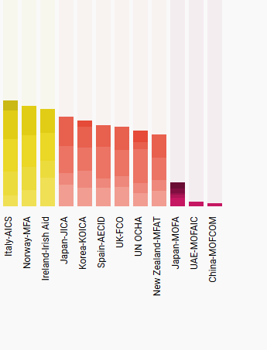
Index 2018 – Poor performers

Slide 11
Takeaways
The Index is not primarily a ranking, it’s first and foremost a feedback tool and a quality assurance mechanism
It’s not perfect but considering the variety of organisations it has to assess it’s pretty close. We’re continually accepting feedback on the methodology so please raise concerns with us if you have them.
We’ll be announcing before Christmas the dates for the next Index including all of the pre-engagement we’ll do via GitHub etc.
The Index is a key part of our strategy, but you’ve also heard about our work on US Foreign Assistance, IATI Decipher, DFI transparency, Humanitarian data needs etc.

Slide 12
The 2018 Aid Transparency Index
www.publishwhatyoufund.org/the-index/2018
gary.forster@publishwhatyoufund.org
@garyjforster @aidtransparency

