Slide 1
IATI website
Members Assembly 2018
Kate Hughes
07.07.2018

Slide 2
Why does a website matter?
It is the platform for all of our technical services
It underpins all of our five workstreams
Notes:
Workstreams are:
data use,
data quality,
the Standard,
outreach and comms,
governance

Slide 3
Why does a website matter?
18 organisations contact us every week about publishing
Approx 70 emails a week are sent for basic support questions
2-3 days per week of BA time on average is spent answering these basic questions
That is 141 days a year
Notes:
The website is our primary communication tool. Having a good website is crucial to the success of IATI. Both aidtransparency.net and iatistandard.org have over 1000 visitors every week. However, our website isn’t working hard enough for us. The aidtransparency.net homepage has no description of what IATI is, it takes quite a bit of digging to find a simple explanation, the guidance section is not solving users questions.

Slide 4
“
Explaining IATI
“IATI is a global initiative to improve the transparency of development and humanitarian resources and their results to address poverty and crises.”
Notes:
This is our new “tweet” length description of IATI for the homepage.

Slide 5
Live demo: http://iatistandard.org/en/

Slide 6
Explaining our process
User centred design...
100 interviews, usability testing and focus groups
10 key persona’s
30+ key tasks
3 rounds of user testing
Agency to help with the user research and design
Agency to help with copywriting and edit

Slide 7
Daniel Abeasi
Small publisher from an NGO
Goals
To publish as quickly as possible with the least effort.
Learn how to publish to IATI
Report their publishing to donors.
Motivations
Publishing to IATI makes a real difference.
The data demonstrates our ability to change things.
Compliance funding confidence donor is happy with me.
Required by donors to publish to IATI but without additional guidance.
Behaviours
Publishes enough to comply with donor requirements.
Looks at peers and what they are doing.
Juggles time spent publishing with activities.
Seeks support from someone who has done this before.
Questions the need for publishing and level of detail required.
Searches for funding for compliance.
Barriers / pain points
Would rather focus on activities that will offer direct benefit to their NGO beneficiaries.
Website is too technical.
Lack of clarity of what they are expected to do.
Concerned that publishing data may be a comms/political risk.
Concerned about time needed to collect data + publish to IATI.
Doesn’t know what data to publish.
Lack of understanding of XML. Data currently in Excel/External database.
Not sold on the benefits of transparency “just another reporting requirement”, “not related to my job”.
Who is funding the time spent publishing.
Opportunities
Enable them to raise awareness of their organisation and their work.
Provide simple support and signposts to get started.
Daniel works at a small NGO in Nigeria, and he’s tasked with publishing their data as a condition of receiving donor contributions.
He is also a board member of other Civil Society Organizations/NGOs.
“
I have to publish our data, but I’m not sure what to publish and have limited time.
Notes:
Meet Daniel

Slide 8
User journey - KT14 - Read about what benefits and opportunities are available to an IATI member.
List of members
Home
Membership benefits
Quotes and case studies
CTA to join if not signed in as a member
Links to benefits accessible online.
I’ve joined what does that mean?
An organisation has joined IATI due to reporting requirements made by a major donor. They want to find out what the benefits are of being a member of IATI.
They visit the IATI homepage and get their bearings. They look for references to members or memberships.
They read the information about membership benefits and click through to any that are accessible online. If they are not signed up/in then they will see prompts to sign up as a member.
Depending on how motivated they are, they may engage with the community and read more about IATI or they may just move on with their day.
Costs
Data publishers
Who does and doesn’t need to be a member?
Data users
Comparison table of what is accessible to members and non-members
Governments
Notes:
As we are at the MA, let’s look at the journey where Daniel might want to explore membership.

Slide 9
Technically better

Slide 10
A huge undertaking:
1 full time BA
2.2 developers full time
0.5 of my time

Slide 11
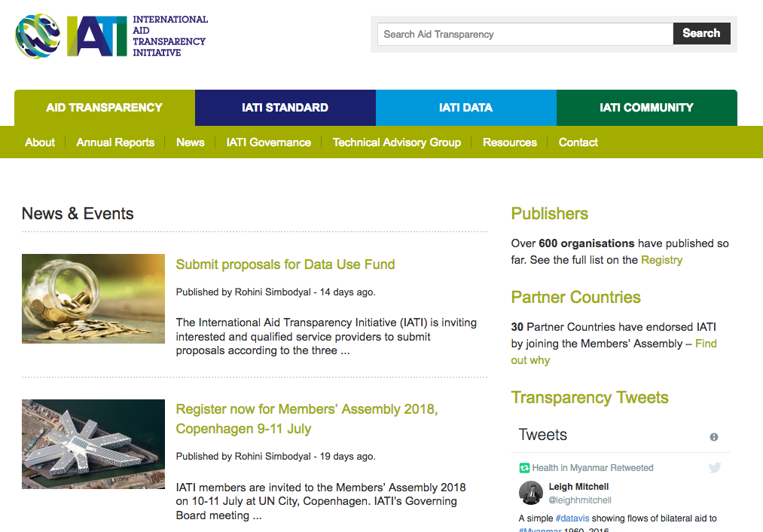
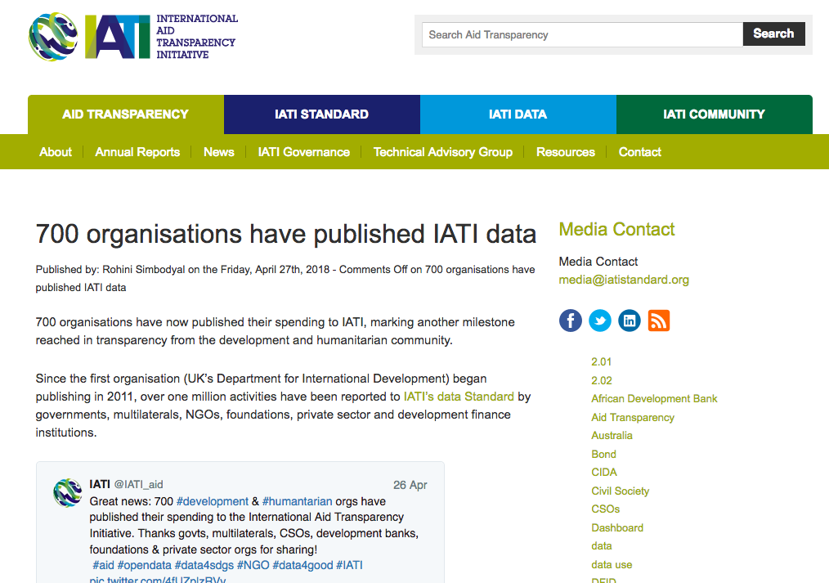
On the old website, nothing was dynamic, so we quickly ended up with errors
Notes:
This is just one example, of many. If you look around the new website you’ll see how our development team have worked to make as many things dynamic as possible.

Slide 12
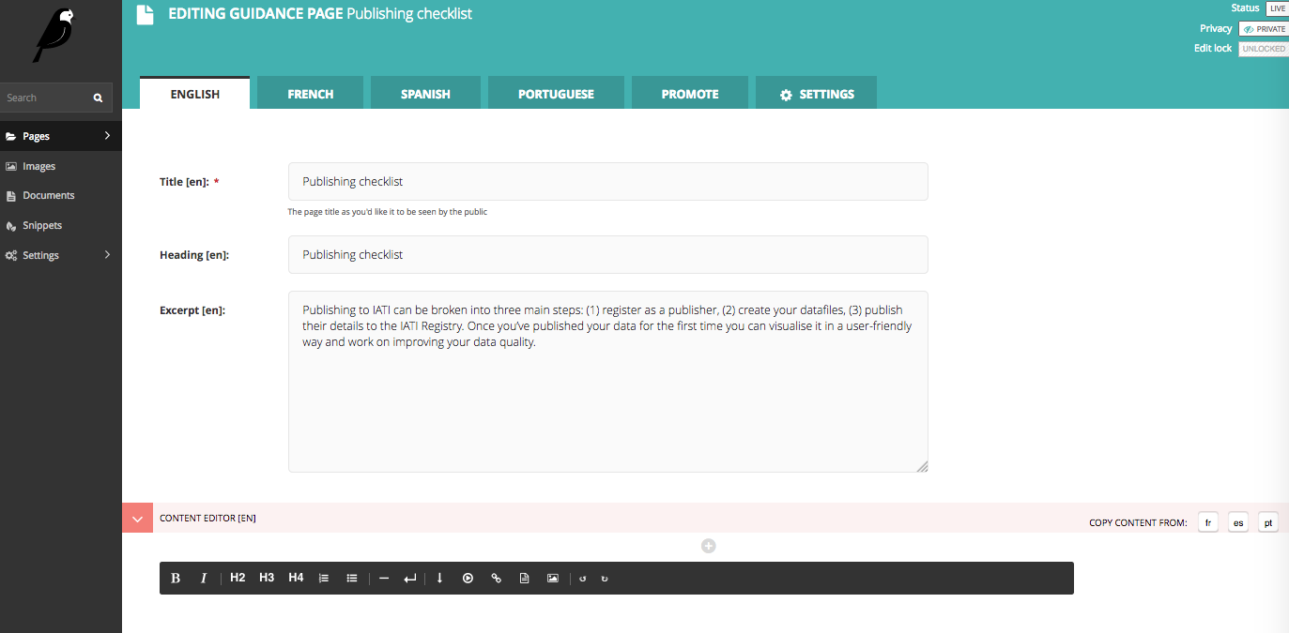
Ready for the future
We’ve set the website up so that in the future IATI can be multilingual
Notes:
This isn’t something we are ready to launch yet, but we’ve built the website so that we can add French (reflecting the board decision in Jan) and could also add Spanish and Portuguese if we wanted to

Slide 13
Phase 2...
IA v2.0
Notes:
As you can see from the IA there is still more work to do on the website.
Long term we would like to bring the standard and the registry all under this domain.
We want to add guidance on specific thematic areas and expand the section on data use.
The data use section has some additional page designs that will improve the navigation, we will update this soon.

Slide 14
IATI quiz
Notes:
https://docs.google.com/document/d/1a31hOZVP0P0-1AzNu98badbHlfCYemb3EamahdzNJxs/edit?ts=5b28ed98

