Slide 1
IATI Data in Use

Slide 2
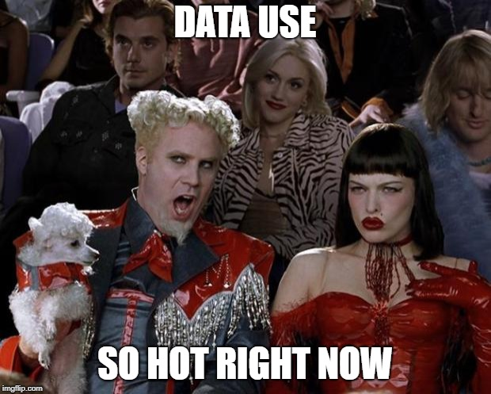

Slide 3
Winnie Kamau | Association of Freelance Journalists
Horia Sohir Debbiche | African Development Bank
James Coe | Publish What You Fund
Aria Grabowski | Oxfam America
Thea Schepers | Plan Nederland
…and YOU

Slide 4
Notes:
1000 guest came.

Slide 5
Promoting IATI Data
@ World Press Freedom Day (WPFD)
Accra, Ghana

Slide 6
D- Portal an easy access and a source of data
The D-portal can help aid in investigative stories
By ensuring journalists have access to IATI for their investigations, authorities can be held accountable for where development resources go and how effectively they are being used to achieve sustainable development.
This was an ideal forum to promote the use of IATI data to help deliver sustainable development outcomes and share the US$145 billion of development spending published to the International Aid Transparency Initiative (IATI).

Slide 7
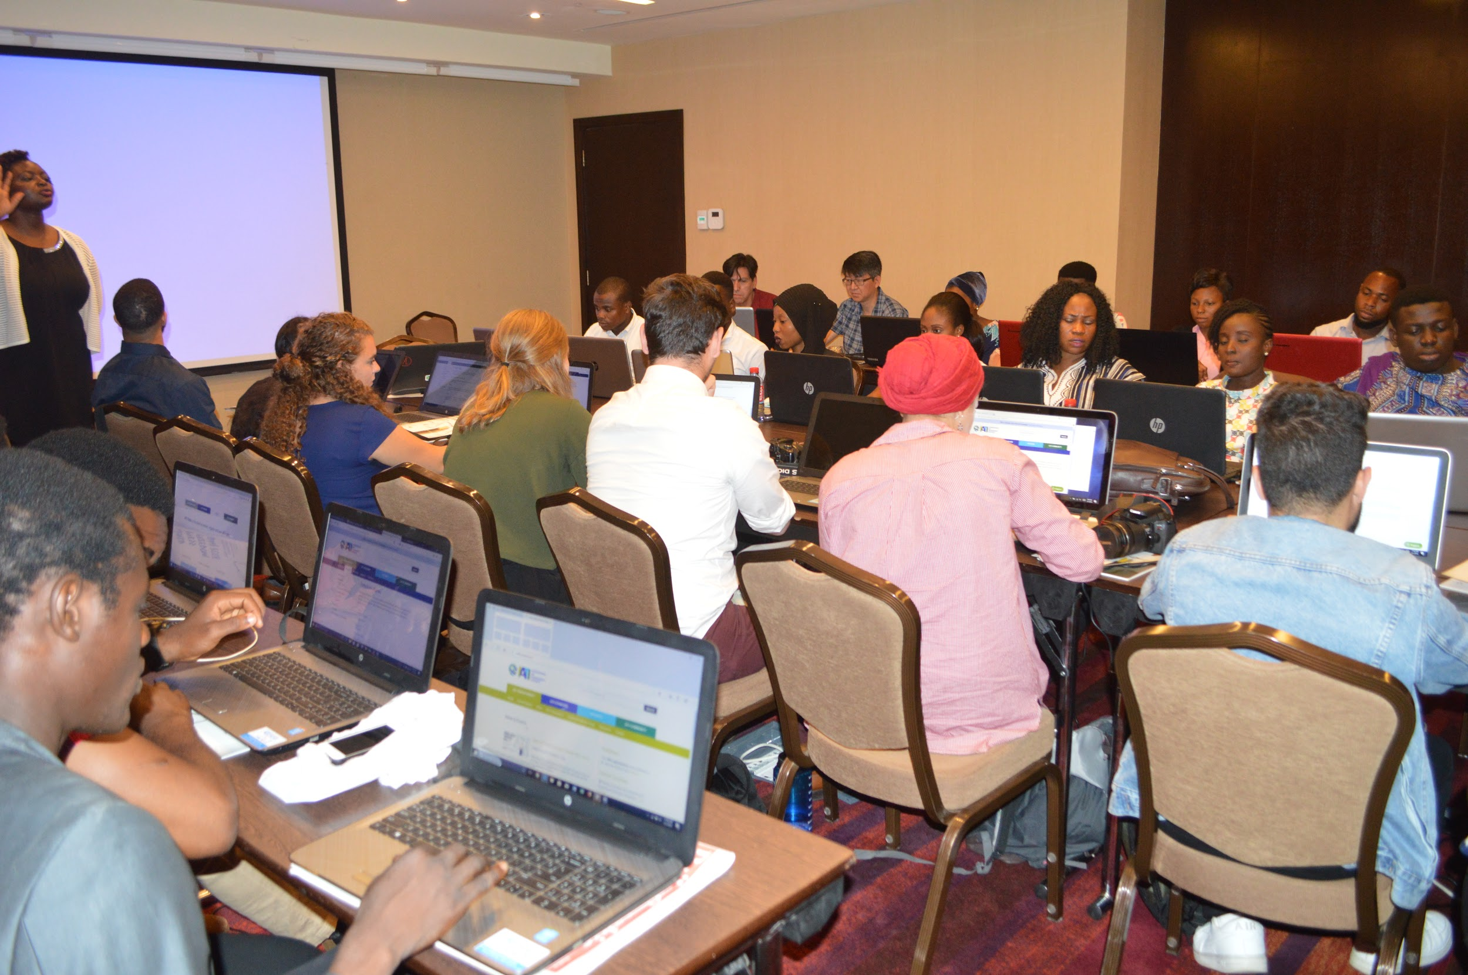

Slide 8
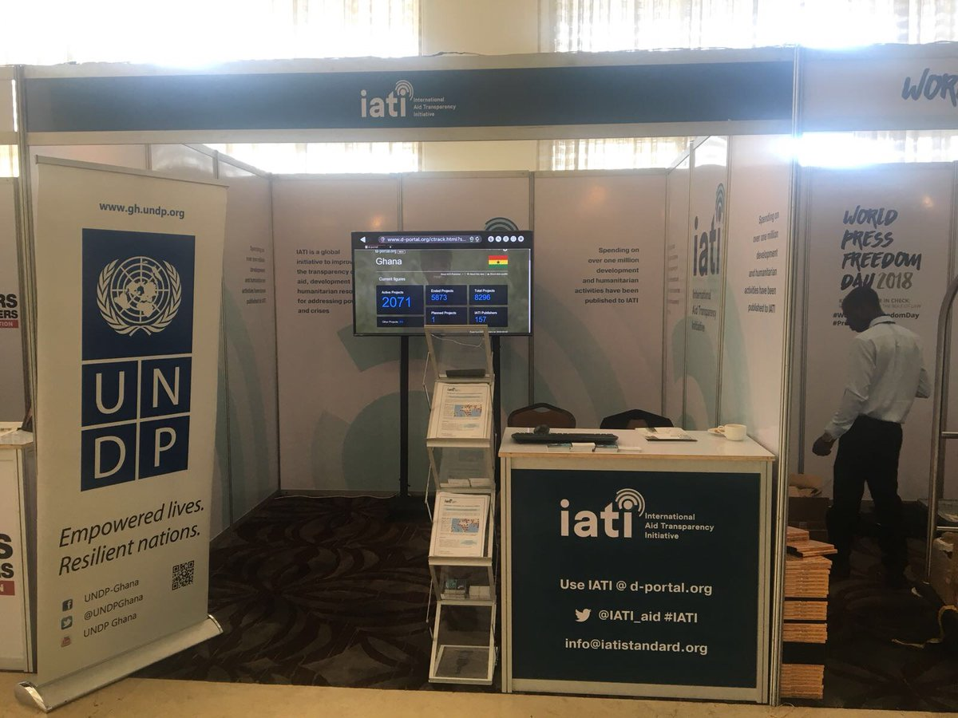

Slide 9
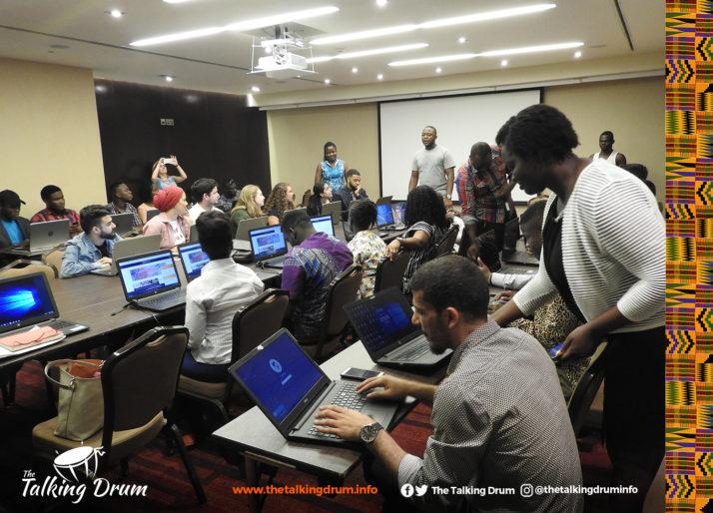
#IATI4Journalists
Winnie Kamau
President
Association of Freelance Journalists
&
Lea Zoric
UNDP
Notes:
On 1st of May Labour day we had a training

Slide 10
Projects data portal
ALL information on Bank’s projects in ONE single place

Slide 11
AfDB Projects Data Portal
ALL information on Bank’s projects in ONE single place, useful for staff, internal and external stakeholders
Access to data and documents for over 4200 projects with just a click
Search function: Ability to browse data by Country, Year, Status, Sector and Sources of funding from 1967
Data downloadable in Excel and CSV format
Notes:
Where does the money come from?
Where does the money go?

Slide 12
Why the Use of IATI data?
Data is already structured and harmonized
Data published is of better quality
To ensure consistency with MapAfrica
There is a semi automated process in place ensuring a monthly publication
Data is comprehensive, easy to use and comparable.​

Slide 13
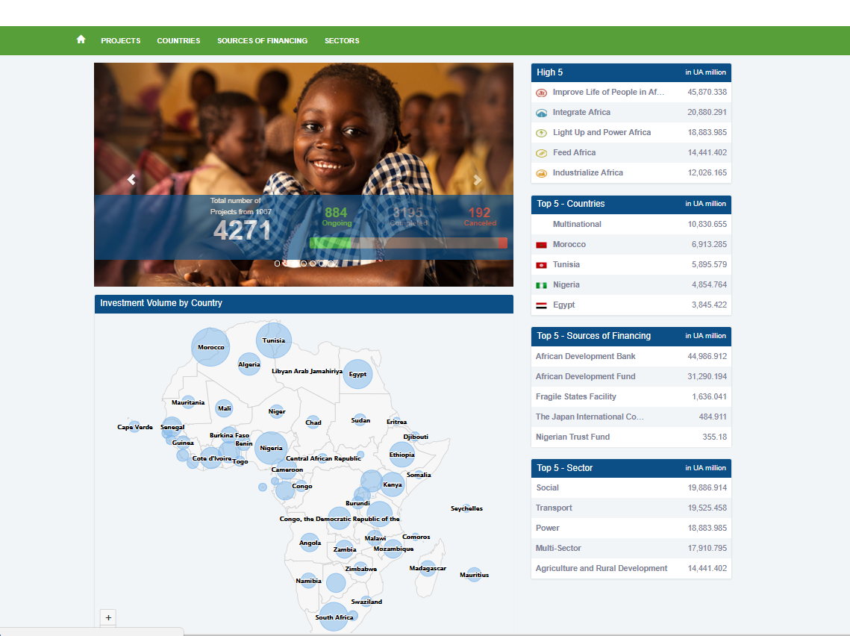
http://projectsportal.afdb.org/dataportal/?lang=en

Slide 14
MapAfrica
From 2.0 to 3.0

Slide 15
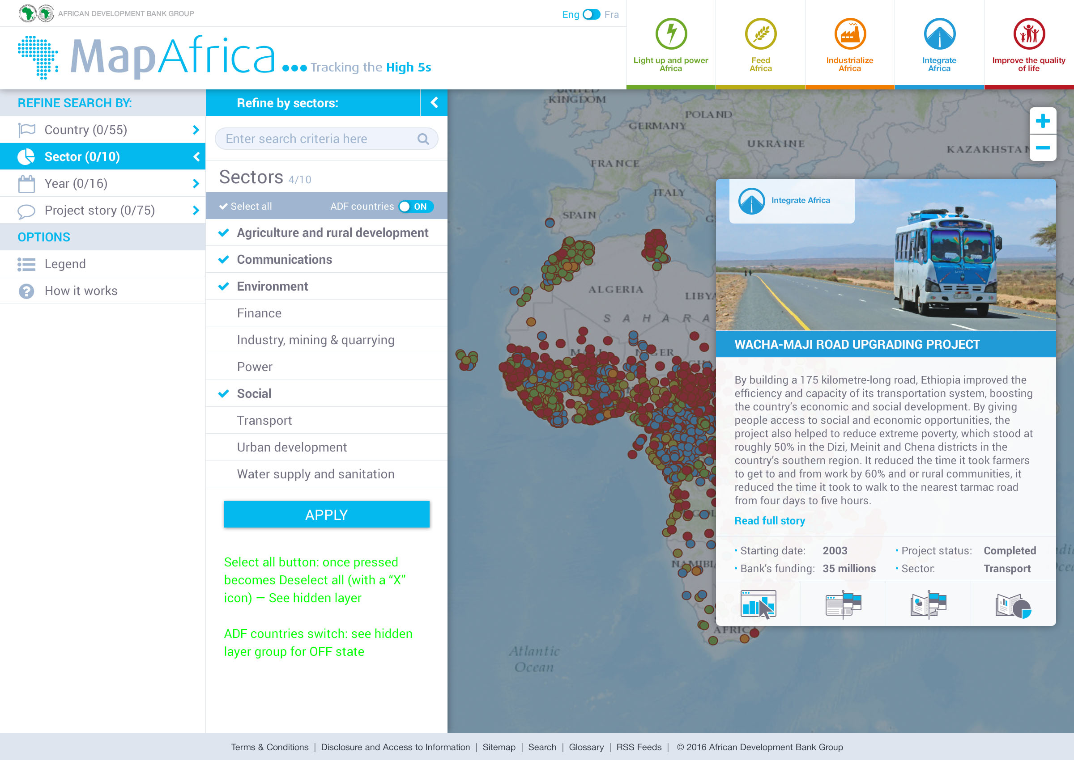
NEW DESIGN
https://mapafrica.afdb.org/

Slide 16
US Foreign Assistance Study: Preliminary IATI findings
10 July 2018

Slide 17
Overview
Objectives:
To use available aid data, alongside in-country research, to assess the potential impact of the FY ‘19 budget request on US foreign aid.
To develop insights and recommendations on how to improve aid data after having used it ourselves.

Slide 18
How did we use IATI?
One of many sources. IATI was one piece of the puzzle, alongside DAC, AIMS, economic data, World Bank development indicators, independent indices etc.
Landscape analysis. Who is doing what, how does each donor approach differ from the others?
Library. IATI is more than data, it is a central repository of useful documentation.
Budget information and strategic documentation. Sometimes available in the organisation file.

Slide 19
Strengths of IATI…
A constant: Regular first port of call, and a constant source of data I could turn to.
Timely: Despite gaps, it offered a window into what is happening now.
Project level insights. We could not aggregate the data but it was a fast and relatively reliable source of project level information.
Time-saving: When donors get it right, it saved time by enabling a swifter analysis.

Slide 20
Cambodia: AIMS & IATI

Slide 21
Cambodia: AIMS & IATI

Slide 22
Cambodia: AIMS & IATI
Note: China disbursed $231bn in 2017.

Slide 23
Some reflections…
Data gaps are problematic, however, this doesn’t remove the usefulness of the project level data. How can tools make accessing this information easier?
The inability to aggregate data partly stems from missing donors. How can we re-engage major donors?
Should tools allow more specific filtering (ODA, private finance, grant / loan, CSO, Donor)?
Hierarchies are creating ‘noise’ when visualising the data. How can we fix this?

Slide 24
US Foreign Assistance Study
www.publishwhatyoufund.org/projects/us-foreign-assistance/
@aidtransparency

Slide 25
Using Aid data in Uganda
An adventure in introducing IATI to civil society and media in Uganda
Aria Grabowski
July 10, 2018

Slide 26
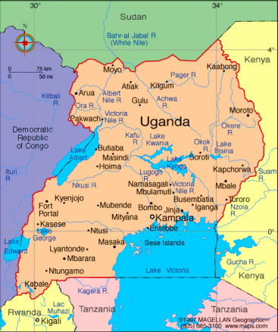
Background
In May I went to Uganda to Civil Society and Media to IATI and to and train people how to find and use the information (using D-portal).
The reason for the training was based on the belief that this information is useful for their work and that people currently are unaware of the types and kinds of information that have been made available through the aid transparency movement.

Slide 27
Exciting News
Training Participants were really excited about the information available.
Even if they had heard of IATI
they had no idea how much useful
information was available.
While the training was still on going
participants started to search for projects
they had heard of and were curious about.

Slide 28
Feedback
Not all publishers are created equally. Training participants want detailed information on project, so publishers that shared more detailed documents were more helpful.
They also quickly noticed inconsistencies.
There was also a lot of demand for the ability to filter by loan or grant.

Slide 29
What can we do?
Data Use Task Force is working on raising awareness and finding a way to allow for users to flag where things don’t make sense.
All Members can work to encourage awareness among their own organizations and partners.
Think about if you used the data for learning, coordination, and accountability what information would you need, are you publishing that information, do you have a plan to improve to that?

Slide 30
IATI in Power BI
Using IATI files to create an Alliance dashboard in Power BI

Slide 31
Yes I Do Alliance
The alliance fights child marriages, FGM, teen pregnancy
Five Dutch aid organisations
One organisation has three country offices publishing their own IATI files
35 activities (projects) in 7 countries
Combined budget of 14 million euros

Slide 32
Approach
Use IATI files:
Standardised
No need to collect info: IATI files are already online
Use Power Bi:
The lead partner used it already
Affordable
Refresh is extremely easy
Notes:
Standardised: IATI has enforced a template, and you make use of that template.
Collection info: Before, it was an endless drama of collecting Excel files, making sure definitions are aligned, lots of copying and pasting of information. The Alliance desk sometimes had an extra person to deal with reporting. IATI was a godsend in that respect.
Refresh: can be automated, or a click of a button.

Slide 33
Demo

Slide 34
Lessons learnt
Unify the choices between partners (indicator periods, etc.)
Difference in files was not as big a problem as we feared: there was a solution for every issue
Only do it yourself with an in-house data analyst; get help from an IT partner or Power BI specialist if you’re stuck
Notes:
Get help: data analysis can get complicated and XML files are a tricky beast in Power BI.
Unify: agree between partners how often to measure actuals (once per quarter, once per year, whichever, but ideally don’t mix them up), same goes for budgets
Fixing data issues: there will be small issues on data: some organisations don’t fill in information that others do, which leads to different data models in the XML. In our experience, every issue can be fixed in Power Bi. Don’t ask partners to fix small issues

Slide 35
How about you?

Slide 36
Questions?

