Slide 1
Outreach and Engagement
IATI Members’ Assembly 2018
Day 2: Wednesday 11 July
Annelise Parr, IATI Coordinator

Slide 3
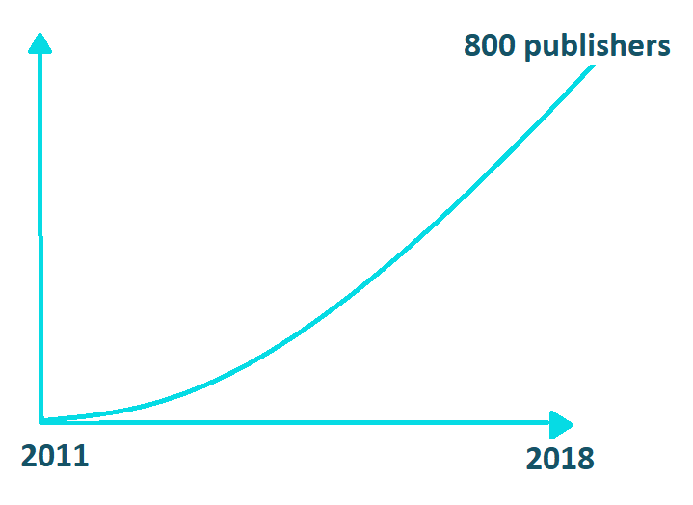
What has outreach and engagement helped to achieve ?
90 members
2008 - 2018
Notes:
When IATI was established 10 years ago, the priority of IATI’s outreach work was to convince donors, partner countries and CSOs to become signatories and get the initiative off the ground.
Once the Standard was agreed in 2011, the priority was to secure a critical mass of publishers, and to demonstrate that many different types of organisations could publish to IATI.
As the number of publishers and the volume of data available increased, improving data quality became a key priority. Once IATI had reached a ‘tipping point’ in terms of data availability, we recognised that although there was still work to be done to improve quality, our focus should increasingly turn towards data use.

Slide 4
Objectives
1 - Increase awareness of the benefits of using IATI data
4 - Convert more publishers into IATI members
2 - Persuade senior decision-makers to invest in improving their organisation’s data quality
5 - Support fundraising as necessary
3 - Strategic increase in number of IATI publishers
6 - Sustain and expand political commitment from global networks and IATI members
Notes:
For today’s sessions, we want members to share their top three objectives for the next 18 months as outlined in ‘Paper E, Outreach and Engagement Priorities’. As you will note from the table on page one, there are a range of audiences that could be targeted under each objective and in our discussion we are looking for an indication of who to prioritise.
Data use
The first objective is to increase basic awareness of IATI and the benefits of using IATI data. This is a vital first step in convincing data users to begin exploring the data.
Publishing data
The second objective is to persuade high-level decision-makers to invest time and resources into improving their organisation’s data quality. This is because higher-level decisions may be required to permit technical staff the time and resources to implement changes in data quality. As we know, there are many aspects of improving data quality and specific options are listed on the paper.
Strategic increase in number of IATI publishers Another focus of Outreach and Engagement activities could be to convince a targeted list of organisations to become IATI publishers. This list could focus on the top ten largest donors to IATI’s partner country members who are not yet publishing or to focus on other areas, such as humanitarian or south-south providers.
Convert more publishers into IATI members A potential new direction for IATI could be to focus on converting more publishers into IATI members. As well as increase the credibility and momentum of IATI, this could help expand and diversify the voices within our governance.
Support fundraising as necessary
We could also use engagement with target members to increase fundraising efforts if required.
Influence relevant global and regional political processes
Finally, the sixth objective is on influencing global and regional political processes that are relevant to achieving IATI’s vision and mission. Specifically, we could focus on raising awareness amongst key political stakeholders, encouraging them to use IATI to capture resources relating to the Sustainable Development Goals

Slide 5
Potential tactics by all IATI stakeholders
IATI hosted receptions
Consultations, reports,
outcome documents
Direct letters to target audiences
IATI speakers /content /communications support at other side-events
Board members to hold bilateral meetings at events
TAG community offers one day of technical advice/support in-kind to target audiences
Encourage IATI members to directly campaign
Notes:
To achieve the Outreach and Engagement objectives set over the next 18 months, all key IATI stakeholders are encouraged to play their part in raising awareness and influencing target audiences.
Potential tactics for the Board, Secretariat, Membership and TAG community are outlined in the paper. They include:
Board members requesting bilateral meetings at events;
The Secretariat providing a new speakers kit and membership pack;
Members’ doing presentations to staff within their organisations;
Or TAG members’ offering a day-in-kind of technical support to newcomers
Members are invited to make comment on the tactics and actions outlined on the paper and/or provide other suggestions on how to effectively engage target audiences.

Slide 6
Next steps…
Volunteer to join a outreach and engagement working group
Share info on upcoming events, consultations and opportunities on the IATI Yammer Group
Gain materials and briefings from IATI’s Secretariat to help spread awareness
Notes:
To ensure all members’ are able to contribute to Outreach and Engagment, we want to set up a working group with members. The Secretariat will set up regular calls to plan and coordinate our efforts. Please let us know if you want to hear more about being involved.
They will also be setting up a yammer group to provide an online forum for members to share information on what events or opportunities we could engage in the future – please engage with this.
Finally the Secretariat will be sharing a new speakers’ kit to equip you with presentations and briefings to spread the word!

Slide 7
Discussion
What are your top three objectives?
Which audiences should we be focusing on within the chosen objectives?
What tactics or activities should we focus on?
Notes:
For this session’s discussion, I invite members to share your thoughts on your top three objectives, target audiences and any tactics or events that are not included in the paper.
Members are also invited to indicate their priorities by sticking the dots they have on the tables on the priorities and audiences sheet. We will collect these at the end.

Slide 8
