Slide 1
Workstream 5:
Governance
Financial overview for Year 5
Budget proposal for Year 6
11 July 2018

Slide 2
IATI performance 2013 - 2018
2. Year 5 income and expenditure
3. Financial position and Budget of Y6
4. Revision schedule for Year 6 budget

Slide 3
1. IATI performance 2013 - 2018
IATI is financed through membership contributions, with some complimentary voluntary contributions
In the previous years cash receipt was instable and hence challenges of implementing the scope of the workplan and now IATI is in a better financial situation
Members are required to pay the annual membership contributions at the beginning of the project year
Notes:
- The cumulative amount of income received by UNOPS for IATI between September 2013 and 31 May 2018 is $10,509,782
- in addition IATI income, accrued interest (up to Dec 2017) $44,280;
- this brings the total IATI income by 31 May 2018 to $10,554,062;
- Out of this, $170,000 are received as advance payments for the implementation of the IATI year 6 workplan and budget.

Slide 4
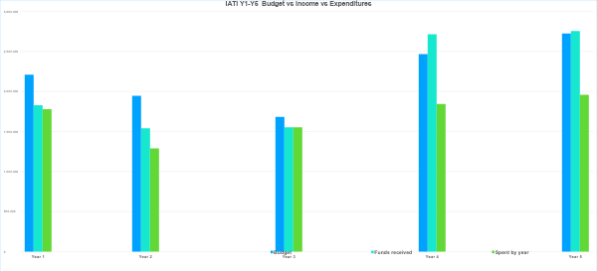
1. IATI performance 2013 - 2018
Notes:
Chart showing the comparison between the approved budget – annual income – and annual expenditures from the pool funding;
In the first years challenges are shown on funding the annual budget (the income is less than the approved budget therefore the expenditures had to be adjusted to implement only priorities and to keep the lights on);
In Y4 the main challenge was receipt of the funds in a timely manner, to allow proper planning for the implementation of the approved workplan;
The Y5 shows an improvement of the budget and income received.
In general, from the total amount received IATI has spend 81% (against the approved budget).

Slide 5
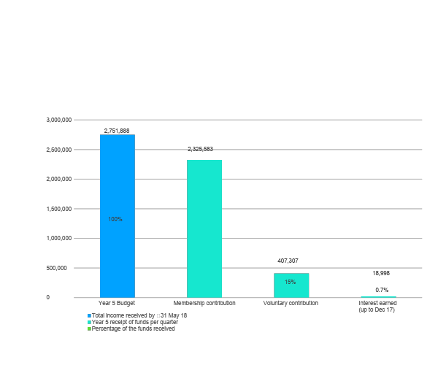
2. Year 5 income and expenditure
By 31 May 2018, $2,751,888 has been received in contribution income and interest
By end of Year 5, $250,000 of outstanding fees are due
Notes:
The presented graph shows the IATI Y5 funds received per contribution and until 31 May the Y5 budget is funded by the following breakdown:
-85% membership contributions (membership contributions are increasing)
-15% voluntary contributions (Voluntary contributions are decreasing as per the funding model, in favour of a full fee model which has successfully been operationalized)
- 0.7% interest earned (in year 2017)

Slide 6
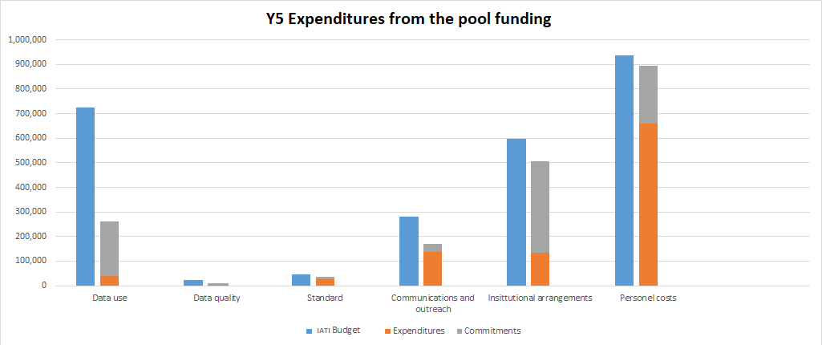
2. Year 5 income and expenditure
Notes:
Chart showing the budget – expenditures and commitments from the pool funding per Strategic Element
In March 2018, the Governing Board approved a revised budget for Year 5, a 19.5% increase compared to the June 2016 approved budget
By 31 May 2018, the IATI pooled fund expended $1,056,733 and $901,559 are committed to be implemented. This represents a total expenditure of 72% of the revised Year 5 budget.

Slide 7
3. Financial position and Budget of Y6
Year 6 total contributions to be received $2,488,100
Year 6 presents an opportunity to harmonize the IATI programme year with the calendar year in Year 6 through a “transitional budget” of 16 instead of 12 months
Year 6 funds carried over projected to be $2,214,786 and the funds will enable the harmonization of the IATI programme year with the calendar year. Also, will enable the funding of the additional activities that may arise due to the institutional review
Notes:
1. Anticipated membership fees to be received is USD 2,488,100 is based on the following:
the assumption that all members who paid their fees in full in Year 5 will do again in Year 6
the membership fees will remain at the same level for each constituency.
2. The 2.4mil, does not include the Members that have not paid the full membership fee 3. Members that have not fulfilled their commitments in the previous years have not been included in the calculation.
4. The main reasons for the rolled over amount come from the Year 4 implementation:
- Voluntary contributions of over $560,000
- Additional financial support from UNDP
- Data use fund allocation rolled over
Year 4 Members’ Assembly held in Year 5
Year 5 implementation:
-Voluntary contributions of over $400,000
-Continued financial support from UNDP
-Capital expenditure for the datastore due in Year 6
-TAG meeting due in early Year 6

Slide 8
IATI Year 6
Workstream | Activity costs | Staff Costs | Sub-total
Data Use | 450,981 | 172,120 | 623,101
Data Quality | 96,667 | 379,569 | 476,236
Maintaining the Standard | 305,553 | 331,788 | 637,341
Outreach and communications | 212,854 | 267,036 | 479, 890
Governance | 210,540 | 352,802 | 563,342
Totals: | 1,276,595 | 1,503,315 | 2,779,910
Total Personnel In Kind Contribution: | - | 308,124 | 308,124
Management Fee: | 117,885
TOTAL with in-kind contribution: |  |  | 3,165,919
GRAND TOTAL (net budget): | 2,897,795
A programme year running from 1 September 2018 until 31 Dec 2019
An additional four months of work authorized by the membership
No additional charges to the membership, fees to remain at current level
Total cost of 16 months excluding in-kind amounts is $2,897,795
Requires $409,695 investment from the surplus
Year 7 and future programme years to be aligned with the calendar year

Slide 9
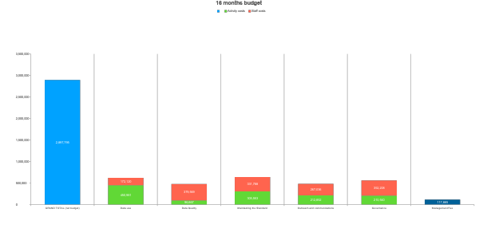
4. IATI Year 6 – 16 months
Notes:
Y6 budget, as per strategic elements.

Slide 10
THANK YOU

