Slide 1


UNDP China
Demand-Driven Data
How Partner Countries Gather Chinese Development Cooperation Information
IATI Steering Committee Meeting
December 3rd 2015
Niels Vestergaard Knudsen
South-South Policy teamleader
UNDP China
Notes:
UNDP China
Research, policy advice
Sometimes go forward alone to explore.
Thanks Zefania for translation and advice, Yvon/DRC and Bhuban/Nepal!!
In June 2015 UNDP China published the report: Demand-Driven Data: How Partner Countries are Gathering Chinese Development Cooperation Information. During the 2013 GPEDC Cooperation monitoring process, 11 partner countries reported on Chinese development cooperation data for the first time. The research paper seeks to better understand the determining factors and mechanisms behind the reporting, and shed some light on how to strengthen the data gathering process. The paper also highlights the importance of development cooperation data for partner countries and the importance of a demand-driven approach. More specifically, the paper identifies some important trends:
There is increased demand from partner countries for China’s development cooperation information;
China has become increasingly incentivized to provide information and have it positively reflected in partner countries’ annual reports;
For partner countries, some challenges exist with regard to accessing Chinese development cooperation data as well as integrating the data into national planning and budgeting processes.

Slide 2

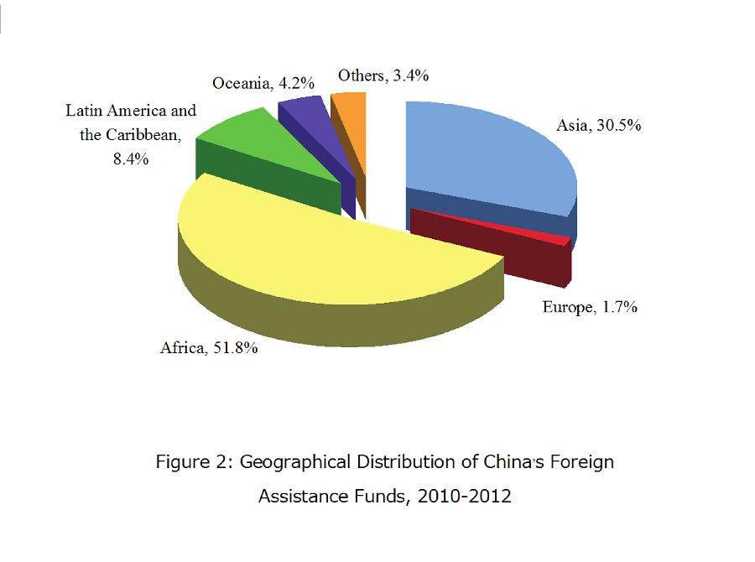

Facts on China’s development assistance
China continues to steadily increase its foreign aid
China's SSC also encompasses trade, technology transfer, investment in people, and action on global issues - including climate change, trafficking of goods, people and money, etc
Non-conditionality, non-interference and the respect for sovereignty, mutual benefit, “win-win cooperation”.
Often presented in a package of grant, non-concessional, concessional and investments.
Notes:
From 2010 to 2012, China appropriated in total 89.34 billion yuan (14.41 billion U.S. dollars) for foreign assistance in three types: grant (aid gratis), interest-free loan and concessional loan.

Slide 3

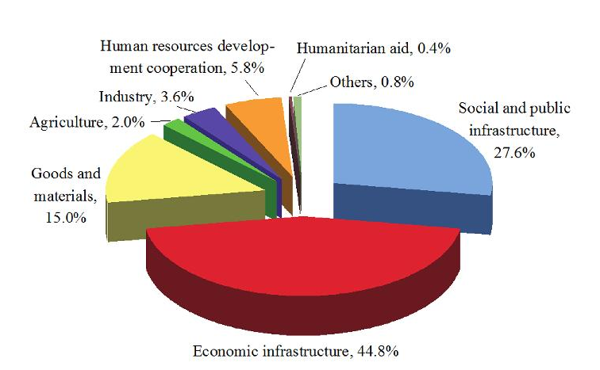
Facts on China’s development assistance
Distribution of China’s Foreign Assistance Funds
according to Projected Fields 2010—2012
Eight forms of development cooperation
Turnkey projects,
Commodity aid (goods and materials),
Technical cooperation projects,
Human resources development cooperation
Chinese medical teams,
Emergency humanitarian aid,
Volunteer programmes
Debt relief
Source: White Paper II (2014)

Slide 4
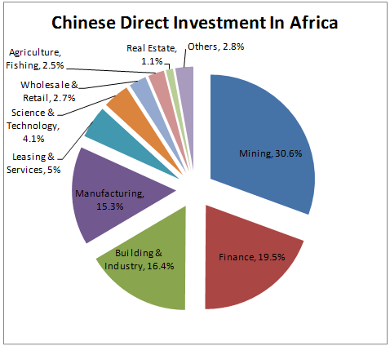
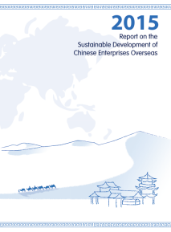
Goes beyond development assistance
Notes:
Thirteen case studies of Chinese companies’ practices, in particular cases where lessons have been learnt and improvements made are presented. Furthermore, analysis within the report highlights a variety of keys points including- that the government’s emphasis, institutional constraints, and penalties have been effective in regulating Chinese enterprises’ practices.
It is also revealed that the scale of an enterprise bears strong relevance to its sustainability performance overseas; and that the longer an enterprise operates overseas, the better its sustainability performance. Through knowledge-sharing and creating innovative mechanisms, UNDP believe that given time, the sustainable development of Chinese enterprises overseas will further improve.
Looking forward, the report identifies that companies will face major challenges in the future in trying to have a more positive impact on other countries, especially with regard to ensuring more use of local people, technology and services as well as environmental stewardship. These challenges vary across regions, and Africa and Asia will require particular focus.
Chinese government and enterprises have emphasized the importance of overseas sustainable development, as well as incorporating corporate resources and networks to achieve the SDGs
Helping Chinese companies going abroad deliver more sustainable business: As a result, funding will be provided to UNDP China to continue to produce annual reports on the topic in partnership with the government, and a programme of training for Chinese companies going abroad is likely to be developed in 2016.

Slide 5
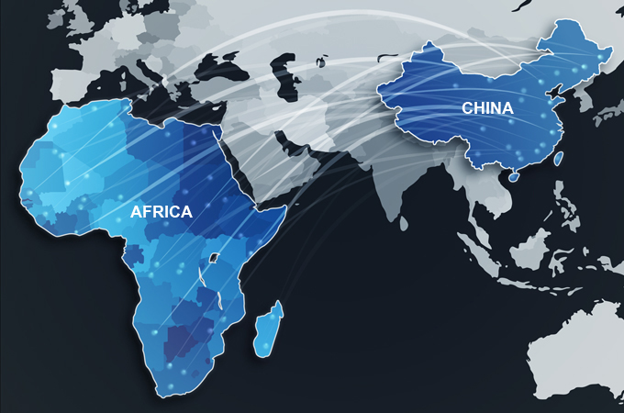
Notes:
Often question: GPEDC, IATI, etc. Transparency. White Paper but
Rather than focusing on China and the need for China to be e.g. transparent, we turned the focus on its head – focus on partner countries and their needs and experiences in terms of accessing information on China development assistance, partner countries’ demand for development cooperation data.

Slide 6
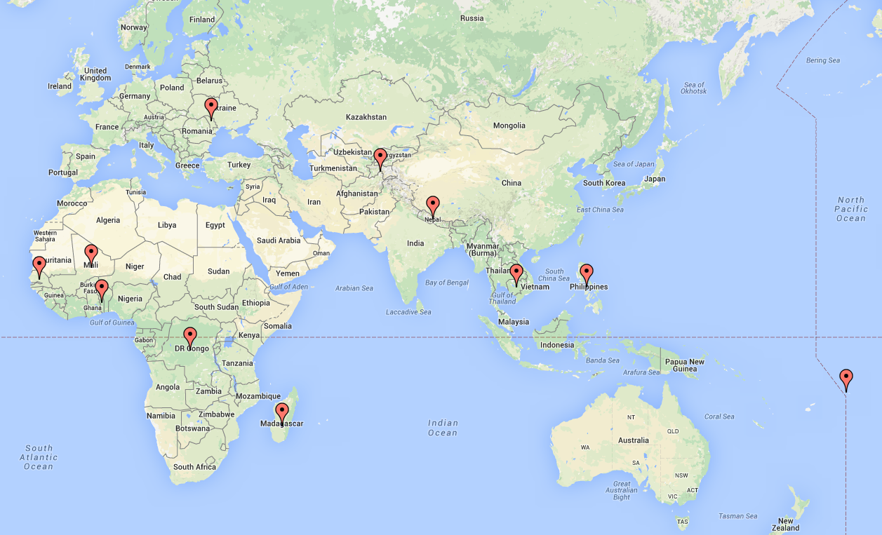
Cambodia
DR Congo
Madagascar
Mali
Moldova
Nepal
Philippines
Samoa
Senegal
Tajikistan
Togo
Notes:
For this reason we took point of departure in 11 countries that through the GPEDC monitoring framework released data on Chinese support.
First time so many countries released data.
We set out to find out if there are any lessons to draw from their experiences in accessing information on China’s development assistance. It turned out there are some valuable lessons, and some that IATI may draw on and build on, if approached in the right manner. I’ll get back to that.
Broad study – non-tech audience, light report

Slide 7
Reporting on Chinese development cooperation financial flows by the 11 countries in 2013 (USD million): total of US$700 million
Source: GPEDC (2014)
Notes:
The amount reported ranges from US$273.8 million for the DRC to US$1.2 million for the Philippines. The total amount of these 11 countries reached US$700 million for all the 11 countries.
ALTHOUGH NOT A GOAL of the report, how does this compare to China’s total funding for development cooperation? According to China’s second White Paper on Foreign Aid, China provided US$14.41 billion from 2010 to 2012, an average of US$4.8 billion a year. US$700 million would represent about 15% of China’s annual development cooperation commitment, which is not an insignificant portion.

Slide 8
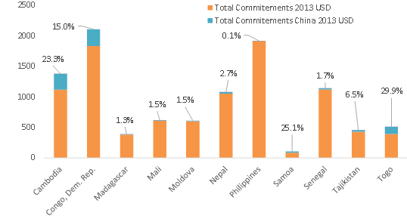
Figure 5: Share of Chinese development cooperation flows in total flows for the eleven partner countries
Source: GPEDC (2014)
Notes:
From 0,1% of flows in Philippines to almost 30% in Togo.

Slide 9
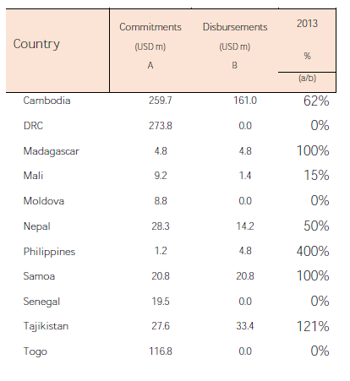
Mixed performance following GPEDC criteria
Indicator 5a:
Proportion of development cooperation funding disbursed within the fiscal year within which it was scheduled by cooperation providers
Source: GPEDC (2014)
Notes:
GPEDC indicators are not necessarily well tailored to SSC flows. We also do not know how validation was done, and with China.
China’s performance is mixed – just like many other providers.
For example, just look at this indicator which presents the amount of development cooperation China disbursed to the 11 countries. The table shows that there is wide variations in disbursements and commitments for all the 11 countries: in 2013, Mali received 15%, Nepal 50% and Cambodia 62% of total commitments from China. Meanwhile, the DRC, Moldova, Senegal and Togo received 0%. At the other end of the spectrum, Madagascar and Samoa received 100% of China’s commitments, Tajikistan 121%, and the Philippines even 400%, way more than what was committed at the start of the budget cycle.
Again, for 5a globally, there is mixed performance of donors and providers. China is no different – except they have not formally participated.
Another quick example is on budget support. Yesterday I think someone mentioned that China does not give budget support. Well, that might be true. But actually when we looked at the data, three countries, Cambodia, Nepal and Samoa, imply that some of the finance they receive from China they directly have power to execute, and for Nepal even, it directly procured 6m USD.
What’s even more significant than the figures themselves is what this research reveals about the importance of partner countries’ demand for data and the process of development cooperation.

Slide 10
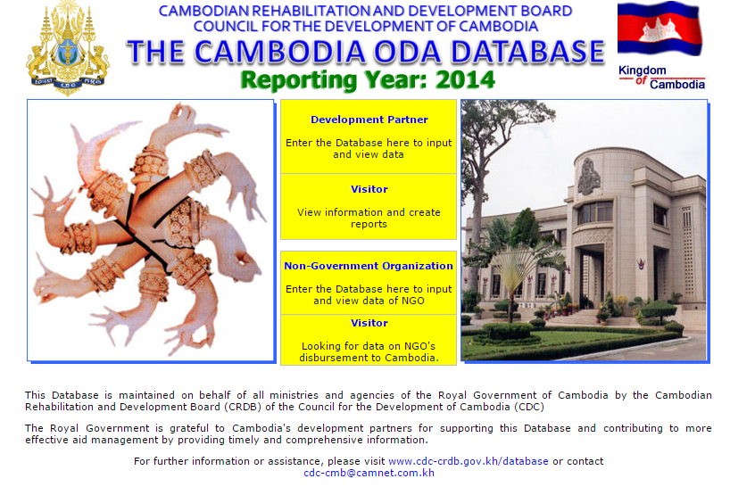
Notes:
The important role of AIMS and the processes, staff, capacity around them seems significant for the 11 countries.
That we find a good starting point – as to date, 46 partner country governments have developed AIMs, and 24 are publically available. AIMS are a tool to manage development cooperation programmes in terms of volume, sectors, pipeline, forecasting, technical assistance (TA) and in-kind support. AIMS rely on a manual process that requires development partners to provide information on their development cooperation activities.
Data entry is usually required at the time of agreeing a new project, and then more data is required to provide disbursement projections in order to support the planning and budgeting strategy of the country, and then to confirm disbursements to support reporting and monitoring and evaluation work. Most partner countries will send reminders and so on to providers to do so. Sometimes they are good about that, other times less good – but overall this tool is now known to work and they are all making strong progress.
In some of the 11 of our China cases, the countries have sent exactly these reminders to China. But almost always it has been a little more complex than that. For example for Cambodia, the government produces a summary based on data provided by EXIM bank and/or MOFCOM, which is then verified by the Chinese Economic and Commercial Counselor at the Chinese embassy.

Slide 11
Data is available – how validate/expand/use?
Notes:
Madagascar
Big question is how to access, validate and ensure continuous data feeds/inputs.
Cambodia examples – ECCs don’t have the overview!

Slide 12
How to access information on Chinese development assistance?
AIMS
Loan agreements
Chinese ECC Office
Direct contact with MOFCOM/MOF in Beijing
Many players
State Council
MOFCOM & ECCs
MOFA & Embassies
MOF
Exim Bank
CDB
Ministries of Agriculture, Science & Technology, Health, Education, etc.
+ 25-20 other institutions
State Owned Enterprises
Private Sector
Notes:
Overall, we found that partner countries gather Chinese development cooperation information to put into their AIMs from 3 sources:
The primary source is from Chinese loan agreements, including concessional loans and non-concessional loans. These loan agreements provide information on the volume, sector, terms of lending, timeframe and focal points.
A second source comes from Chinese Economic and Commercial Counsellors’ Office within the Chinese embassy. Not just embassy.
The third route is for partner countries to get in touch directly through email or phone with MOFCOM or MOF in China to obtain information.
But what does this mean? What about the other 33 countries that didn’t report China’s data, and the many more that don’t have AIMs? Will Partner countries and China ever get a comprehensive picture of its development cooperation?

Slide 13
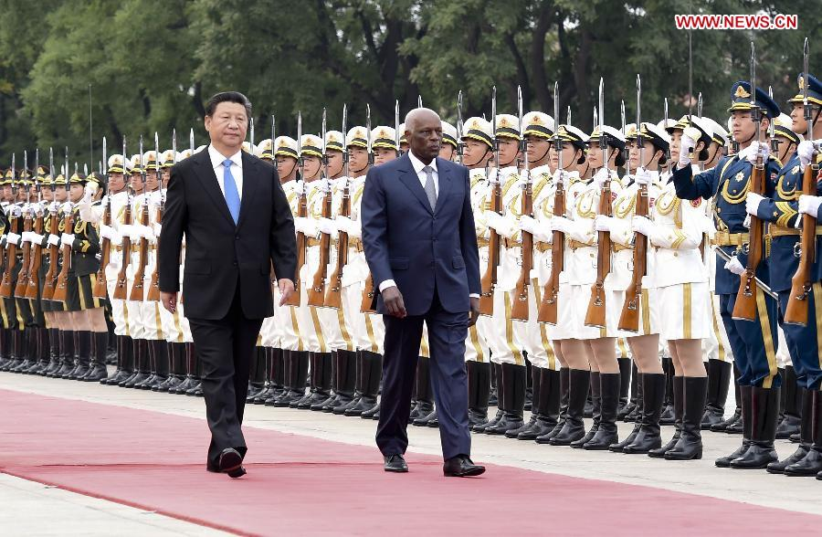
Is it just a matter of asking?
What are trends?
Country demand a starting point
Dedicated government staff attention and time
Capacity of AIMS to match SSC categories
Publication of data and reports
Build network and ties with ECCs
Notes:
the paper identifies some trends:
There is increased demand from partner countries for China’s development cooperation information, and that this should improve/expand;
China has become increasingly incentivized to provide information and have it positively reflected in partner countries’ annual reports;
For partner countries, some challenges exist with regard to accessing Chinese development cooperation data as well as integrating the data into national planning and budgeting processes.
First for partner countries, the key lesson is, JUST ASK!
The Good news is that if asked, and possibly as a result of the new aid measures which put a lot more emphasis on the counselors on the ground, the Chinese ecnonomic counselors will say yes to providing information about their development cooperation.
But it may well, and at least at first, require a bit of extra work by the partner country government. In all 11 countries we spoke to, they talked about extra transactions costs. But they all thought it was worth it, and they want the Chinese government officials to continue to keep working with them to better align with their national systems and procedures for collecting and reporting development cooperation data in the future.

Slide 14
China’s South South Cooperation
Overall Trends On Foreign Assistance
Thirteenth Five Year Plan in 2016
  “Increase the efforts of providing foreign aid, and actively participate in the sustainable development agenda in 2030.”
  “Strengthen South-South cooperation. Optimize foreign aid system/structure, innovate foreign aid modalities, increase economic and technical assistance that aims at improving welfare, social and public infrastructure and capacity-building for developing countries.”
China’s UN Announcements
  South-South Cooperation Aid Fund
  Increase investment in the LDCs
  Debt cancellation
  The “Six 100s” initiative
  China-UN Peace and Development Fund
  “Global Energy Network” Initiative
  Launch a Center for International Knowledge on Development
  South-South Climate Cooperation Fund
  Contribution to UN Women
Aid Reform in MOFCOM
  Establish program management mechanism and regulate project process
  Build a project database system, connect with provincial-level departments in charge of commerce
  Focus on Macro policy research, establish the legal system, project approval,monitoring and evaluation
  Formulate mid- to long-term policy guidelines on Chinese foreign aid in 2015
  Along the “One Belt One Road” countries and in China’s periphery
Notes:
The general trend: Aid reform, increasing attention to ‘image’, continuous departure from partner country demand.
13 FYP:
The engagement of China in the 2030 sustainable development agenda needs the promotion of cooperation between government and UNDP China.
China will:
Strengthen South-South Cooperation. Increase China’s foreign aid to other developing countries and strengthen economic and technical cooperation with other developing countries
Expand the scale of foreign aid, and improve the approaches of (providing) foreign assistance, to provide more free consulting and training to developing countries on human resources, development planning and economic policies, expand foreign cooperation and assistance in areas including science and technology education, health , disaster prevention and mitigation , environmental management , wildlife protection and poverty reduction and expedite humanitarian aid efforts.
China’s UN Announcements:
South-South Cooperation Aid Fund
Over the next 5 years
Initial aid is $2 bn USD to support developing countries to implement post-2015 agenda.
Increase investment in the LDCs
To reach $12 bn USD by 2030.
Debt cancellation
Will cancel the debt of the outstanding intergovernmental interest-free loans due by the end of 2015 owed by relevant LDCs, landlocked developing countries and small island developing countries.
The “Six 100s” initiative
Over the next 5 years
100 poverty reduction programmes
100 agricultural cooperation projects
100 trade promotion programmes
100 environment protection and climate change programmes
100 hospitals and clinics
100 schools and vocational training centers (To nurture 500,000 professional technicians for developing countries; To provide 120,000 training opportunities and 150,000 scholarships in China to students from developing countries); To build an Academy of South-South Cooperation and Development.
Aid Reform in MOFCOM:
On December 15, 2014, China’s new Measures for the Administration of Foreign Aid came into effect. The measures are China’s first comprehensive ministry-level regulations regarding the administration of foreign aid, drawing from over 60 years of experience in providing foreign aid. The release of the measures represents a significant step in the context of a larger foreign aid reform and has significant implications for China’s foreign aid, as they provide the regulatory framework for future reform and will facilitate further standardization of China’s foreign aid system.
FOCAC today

Slide 15
So what is next?
Do partner countries need and want this?
Can partner country led data collection benefit IATI?
Can AIMS (and IATI) cater for SSC flows and definitions, e.g. knowledge cooperation?
How to address capacity needs – partner countries and China?

Slide 16
One next step….
Mapping
AIMS that capture Chinese flows
Trends under GPEDC monitoring 2015/16
Joint Research
System: How AIMS register Chinese flows (geo, sectors, grant/loans, modalities, etc)?
Dialogue
Beijing-level dialogue (embassies, partner country representatives, MOFCOM/MOF/MOFA, Universities and Think Tanks)
Policy briefs targeting MOFCOM, MOFA and MOF.
Process: How do countries engage, how validate?
Use of data: How is the data used in budget/MTEF/expenditure tracking processes? Public reports?
Other providers: Match with experiences with other SSC providers
Establishment of pilots
Which Chinese institutions?
Notes:
Justification to move ahead to DDD 2.0:
To conduct in-depth research expanding on the first report’s findings and recommendations
To provide comparison between two GPEDC monitoring rounds and identify trends
To deduce from this monitoring round how countries are accessing information and finding good practices for others
To use recommendations as a foundation for practical discussion among experts and policy makers in Beijing
Partners/Stakeholders:
UNDP China and partner country offices
Funding entity-TBC
IATI focal points in partner countries
GPEDC monitoring focal points at JST Secretariat
Universities in China
Chinese MOFCOM
Chinese embassies in partner countries
TRANSLATION
PC embassies

Slide 17



www.cn.undp.org
Thank you

