Slide 1
IATI Indicator
Report to IATI Steering Committee – 3 December 2015

Slide 2
Process
Separate Processes for IATI, CRS, FSS
June 2015 Steering committee instructed IATI Tech Team to prepare revised methodology
Consultation based on IATI Dashboard Publishing Statistics opened end of October
Report back to December Steering Committee

Slide 3
Comparison with 2014 Methodology
Busan-based architecture remains unchanged
Improvement of Frequency calculation
Forward-looking
Review of elements to inspect
Timely, Forward-looking, Comprehensive + Coverage
Timeliness
Calculations based on count of current activities with budgets
Comprehensiveness
Double weighting of core fields
Coverage
Review of comparative data for all publishers other than bilateral DAC reporters

Slide 4
Quality of Content
IATI Secretariat 100% committed to developing a quality of content dimension
Developing a machine-based assessment is difficult
This is a 2016 priority for Tech Team and TAG

Slide 5
Pillars of IATI Indicator
All IATI Publishers are assessed
Assessment is run nightly
Assessment is based 100% on machine logic
Indicator will store history and track progress over time

Slide 6
Dashboard Tables
Publishing Statistics
Timeliness
Frequency
Time Lag
Forward Looking
Comprehensiveness
Coverage
Indicator
Core
Financials
Value Added

Slide 7
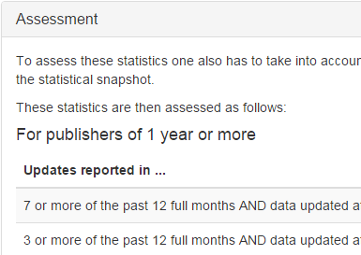
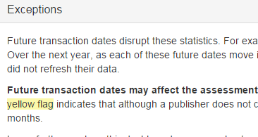
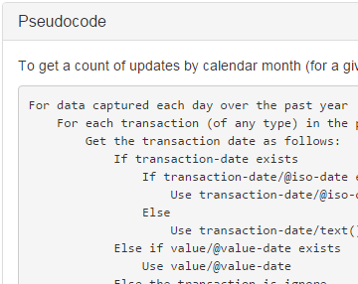
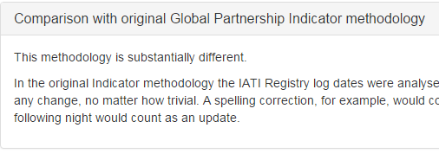
Each table contains

Slide 8
Consultation

Slide 9
Overview (http://dashboard.iatistandard.org/transparencyindicator.html)

Slide 10
Frequency

Slide 11
Time Lag

Slide 12
Forward Looking

Slide 13
Comprehensiveness Summary

Slide 14
Comprehensiveness Core

Slide 15
Comprehensiveness: Financials

Slide 16
Comprehensiveness: Value Added

Slide 17
Coverage
Notes:
NB Spend Ratio vs Coverage
Round up Ratio Quintile

Slide 18
Next Steps
Today: Agree in principle
February: Complete detailed work and consult on Coverage and outstanding methodology
March: Submit data to GPEDC
TAG: Review and Refine
TAG: Discuss Quality Dimension

