Slide 1
Notes:
Reid

Slide 2
But first….
IMPORTANT ANNOUNCEMENT
Notes:
James -- 1 minute.

Slide 3
October 5th, 2017: Launch of APODS
Agricultural Projects Open Data Standard

Slide 4
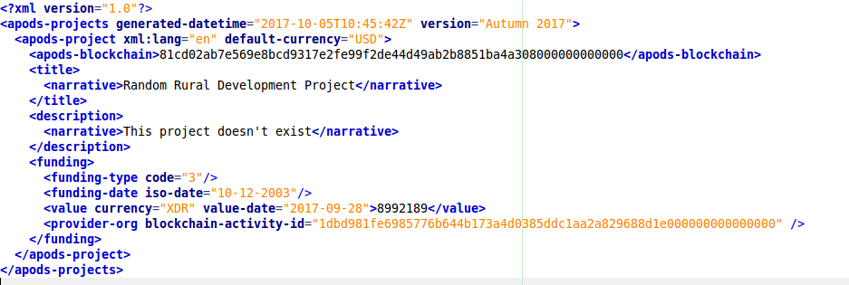
APODS: Looks like IATI

Slide 5
APODS: Looks like IATI
(but not interchangeable)

Slide 6
APODS: Delivery
Documentation: Skype
Support: Postal
Change control: seasonal*

Slide 7
APODS: Delivery
Documentation: Skype
Support: Postal
Change control: seasonal*
*(tidal and lunar timescales under discussion)

Slide 8
APODS: Data Quality & Use
...

Slide 9
Better Data, Better Decisions (And more cashew nuts!)
By the Initiative for Open Ag Funding
Notes:
Reid

Slide 10
Who are we?
Notes:
James -- 1 minute.

Slide 11
What have we done?
Data Pilot
February - July 2017
Technical Assistance to donors
March 2017 - Present
Draft Recommendations & ‘Utility Consultations’
August - October 2016
Project started
February 2016
Tool development
February 2016 - Present
Revised Recommendations & Technical Research
October - December 2016
Initial User Research
April - July 2016
Notes:
Reid

Slide 12
What have we found?
People need information on... who’s doing what, where, and to what effect?
(No surprises there…)

Slide 13
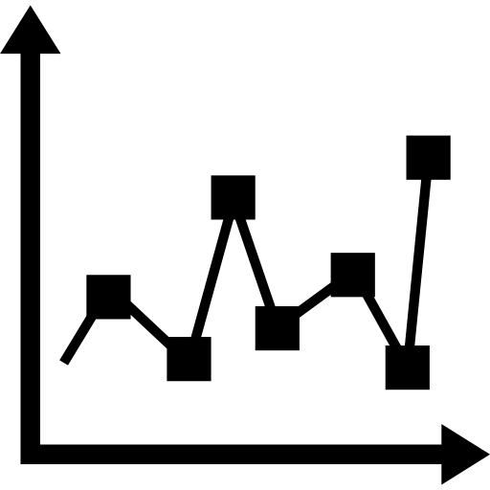
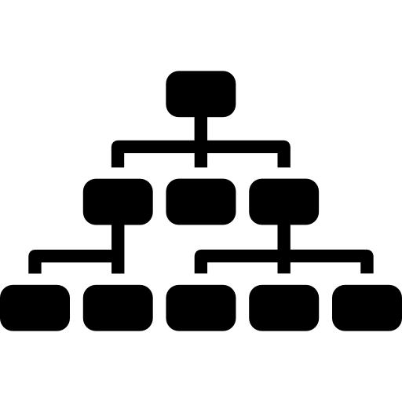
How do we answer those questions?
Sub-National Location
Results
Participating Organisations
Granular Classifications

Slide 14
Can IATI help with planning an agricultural project?
Notes:
James:
We spoke to a lot of people during our consultation and got a lot of good information, but few had used IATI themselves.
Why? Didn’t know about it, or put off by the complexity. We said let’s link up.
DFID - livelihood team - agricultural project
7 countries, 4 crop types down to 3 couuntries, 2 crop types.
Landscape analysis.
Who is spending what where.
Had timelime. Had the ask.

Slide 15
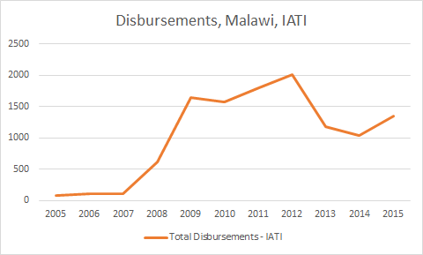
Step 1: Financial Data
Needed: landscape of inflow per country.
Visible data gaps, errors and missing donors.
No definition of what is on IATI.
Forward looking budgets were only available for a small number of donors.
Notes:
First step was basic inflows.
How much was going to each country?
I struggled.

Slide 16
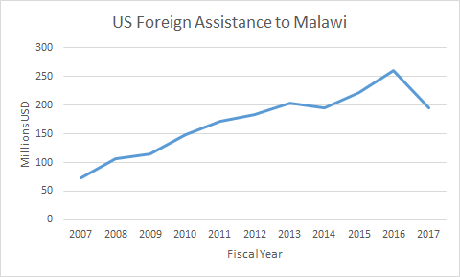
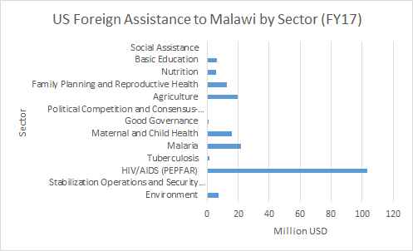
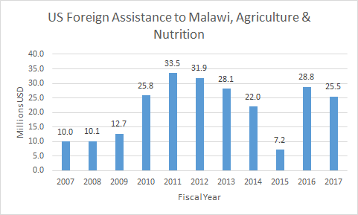
Notes:
Good example: US - organisation file
BUDGET, not disbursements. Not the same, but still useful.
Total
Total to each country
By sector
Trend within sectors

Slide 17
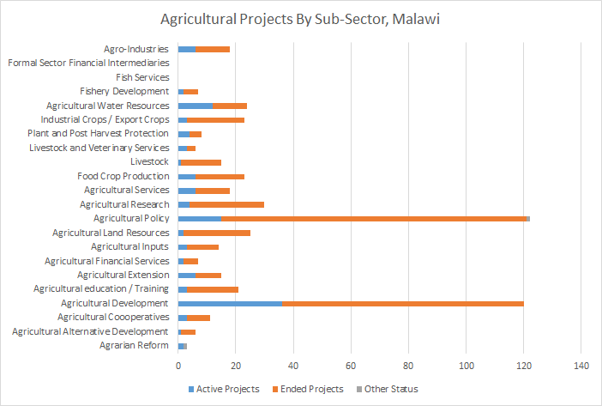
Step 2: Sector Level Analysis
Needed: What were other donors doing In agriculture?
We identified 22 relevant DAC codes.
Tooling: how can I differentiate between donor or implementer?
Outcomes same for every country: most centered on same three high level DAC codes.
Notes:
Sector level analysis

Slide 18
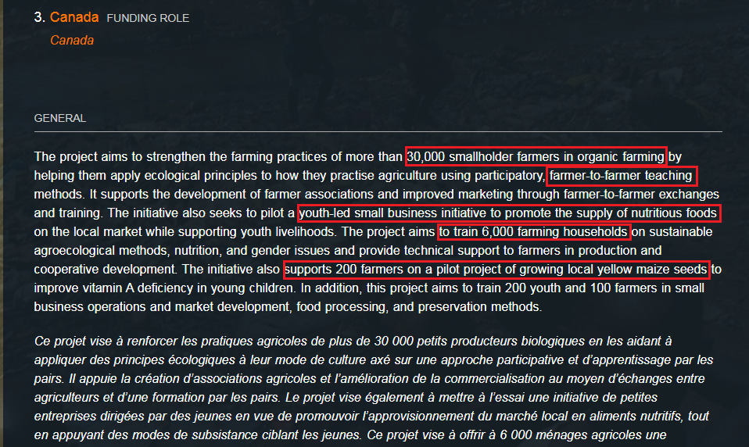
Notes:
A good description explains the APPROACH
How many people? HOW will the donor reach them? What methods will you use? Who will get the support and why?
REMEMBER TO MENTION DOCUMENTS too

Slide 19
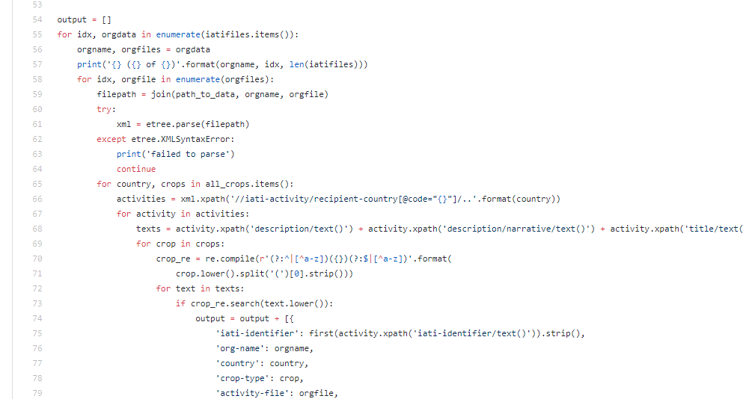
Step 3: Project Level Analysis, Search By Crop-Type
Needed: Filter projects by crop type per country.
Very few results per country.
When accessible: most valuable data.
Cannot do a landscape analysis if only some share the data.
Notes:
James 1 min.

Slide 20
What did we learn?
Not A ‘One-Stop-Shop’: When used with other data, produced a landscape analysis.
Looking through a keyhole: Gaps meant it likely didn’t truly reflect full situation.
IATI is useful, but [so far] only at the project level: Aggregated data is challenging but lots of good project level data.
Not easy: Using IATI is time consuming and requires a solid understanding of the Standard.
Notes:
Confirm that IATI activity level data is useful if its more useful, to make it more useful, make it more granular - the design is fine and workable and useable

Slide 21
So...what does all this mean for members?
“...the will to succeed,
the grace to compromise”
Notes:
Testing IATI with users, publishers, tool makers with focus on ag (not APODS)
We’ve learned this data is useful, but it can be improved
Publishers need assistance with technical stuff
The standard needs to change slightly (tag - we wouldn’t have found the discovery use casesthere without AGROVOC/ag data)

Slide 22
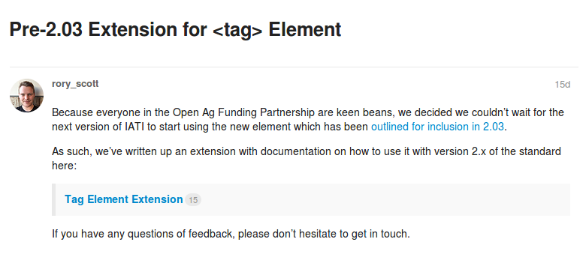
And the Standard?
Notes:
What do users need? granularity/classifications Use case of discovery, not statistics
Where does it go in the standard - sector codes? Policy markers? <tag>s!
Tools...

Slide 23
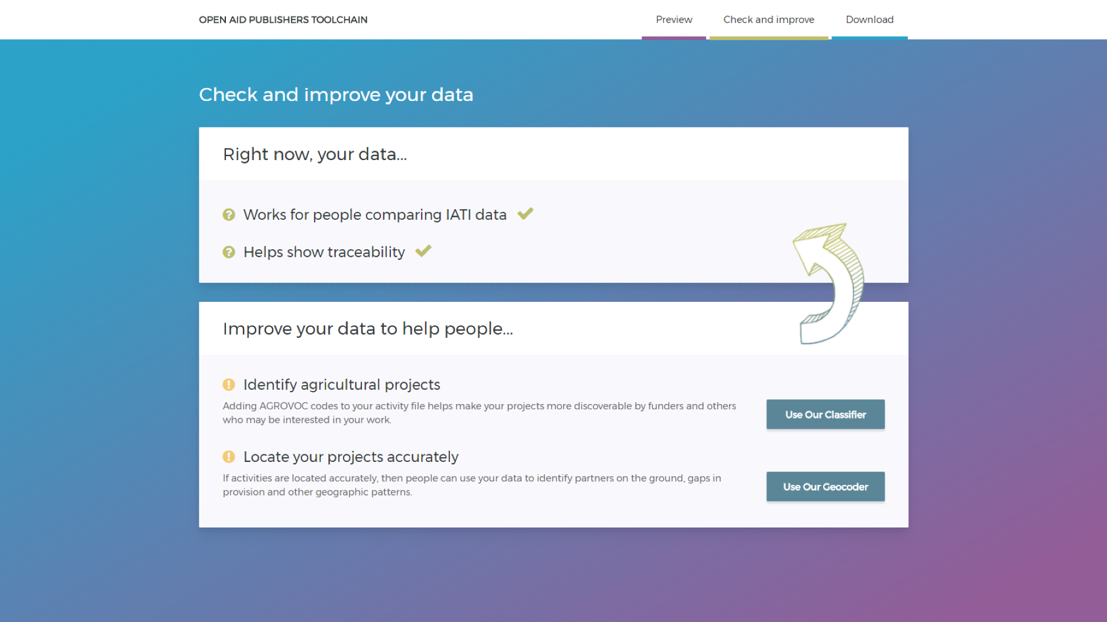

Slide 24
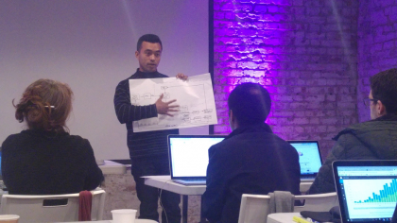
London Workshop I
Notes:
We didn’t dream up a tool, we got people together and we tested assumptions again and again….
5 continents....

Slide 25
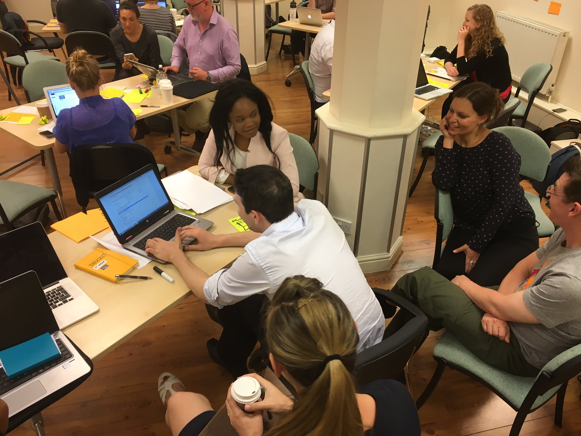
London Workshop II

Slide 26
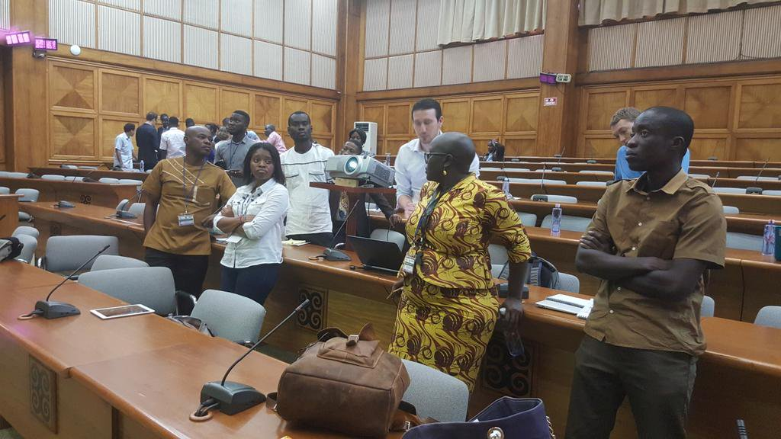
Africa Open Data Conference 2017

Slide 27
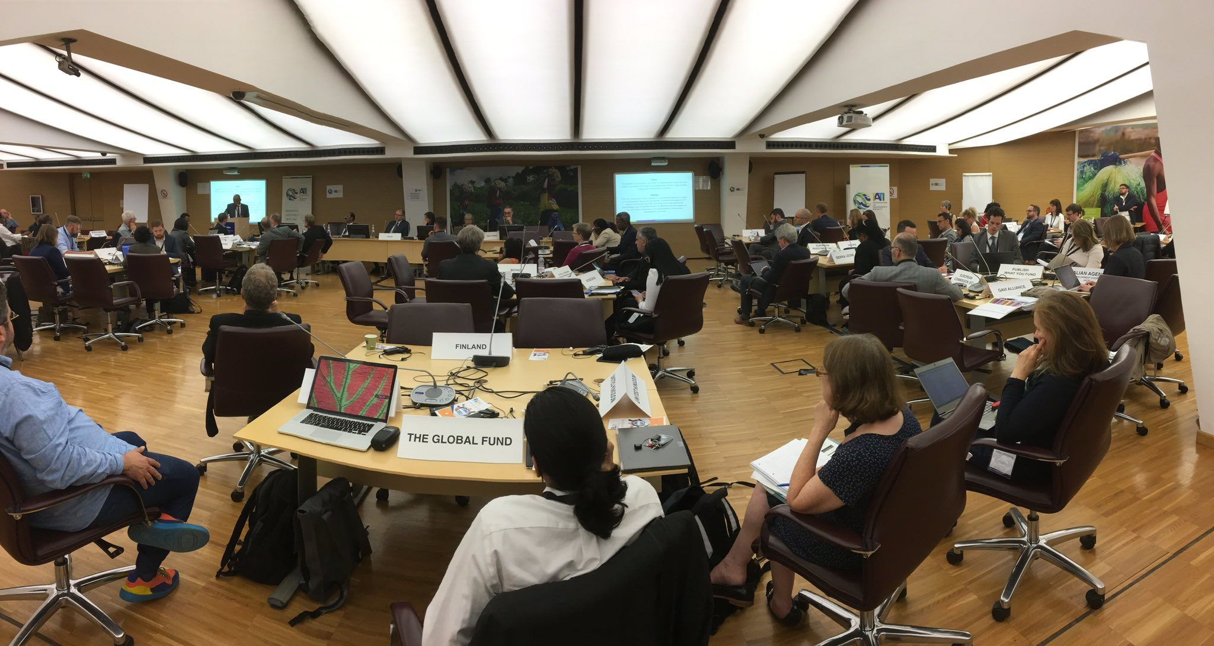
Open Ag Showcase at Members Assembly

Slide 28
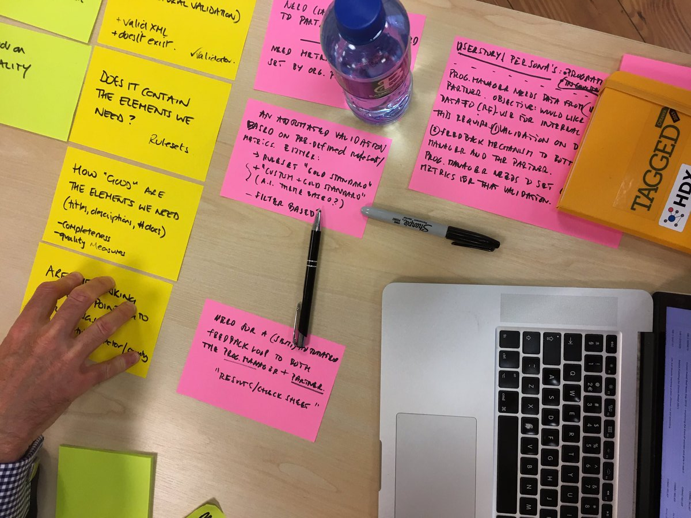
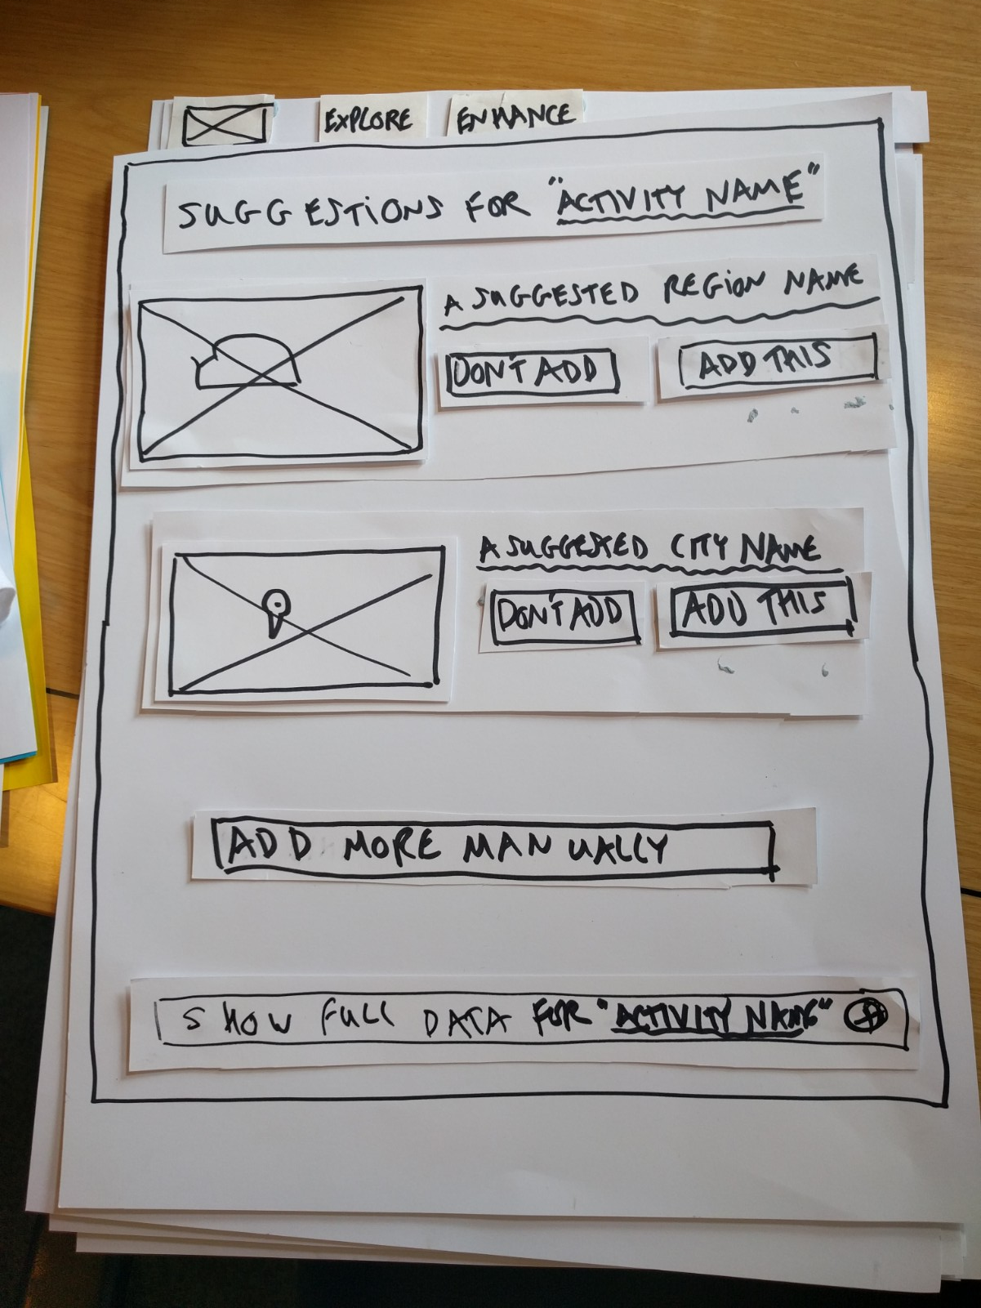
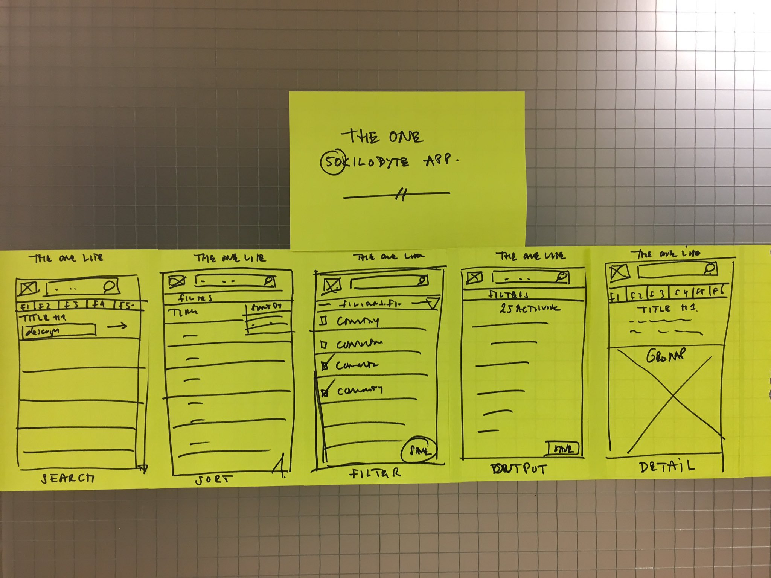

Slide 29
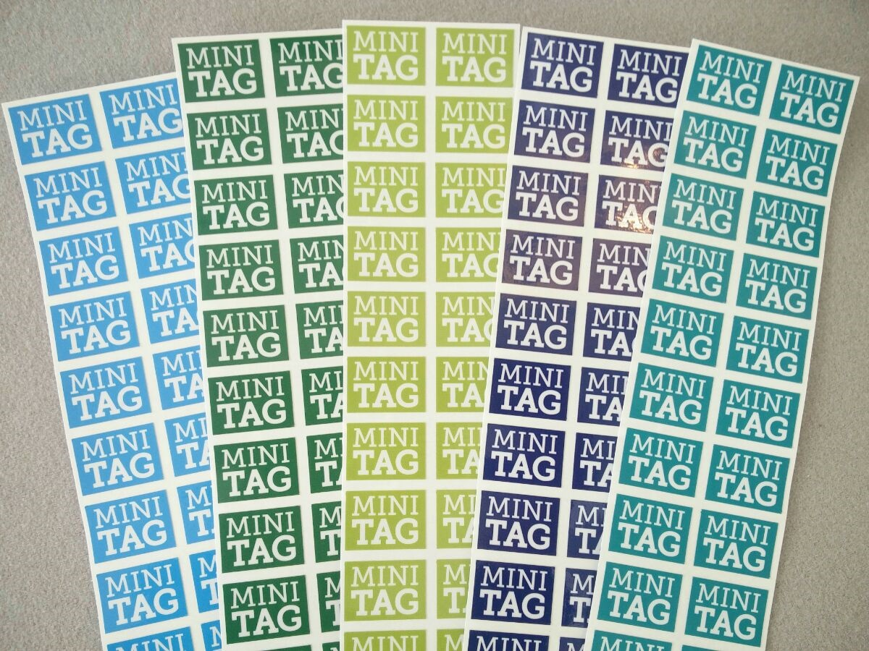
And we’re doing it again tomorrow! ...hopefully not in a basement, Sangita?

Slide 30
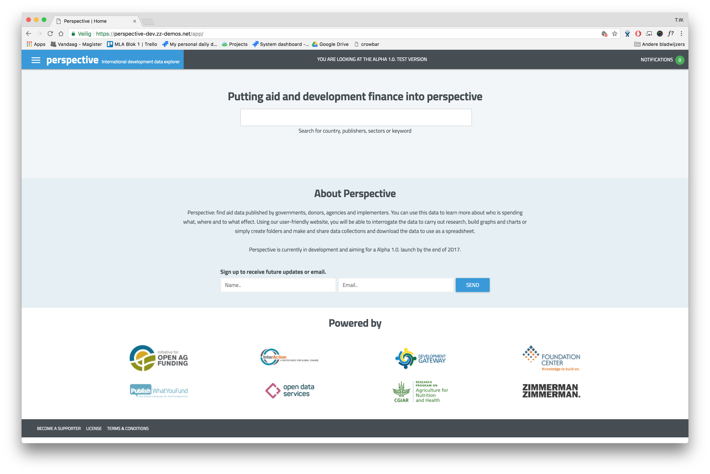
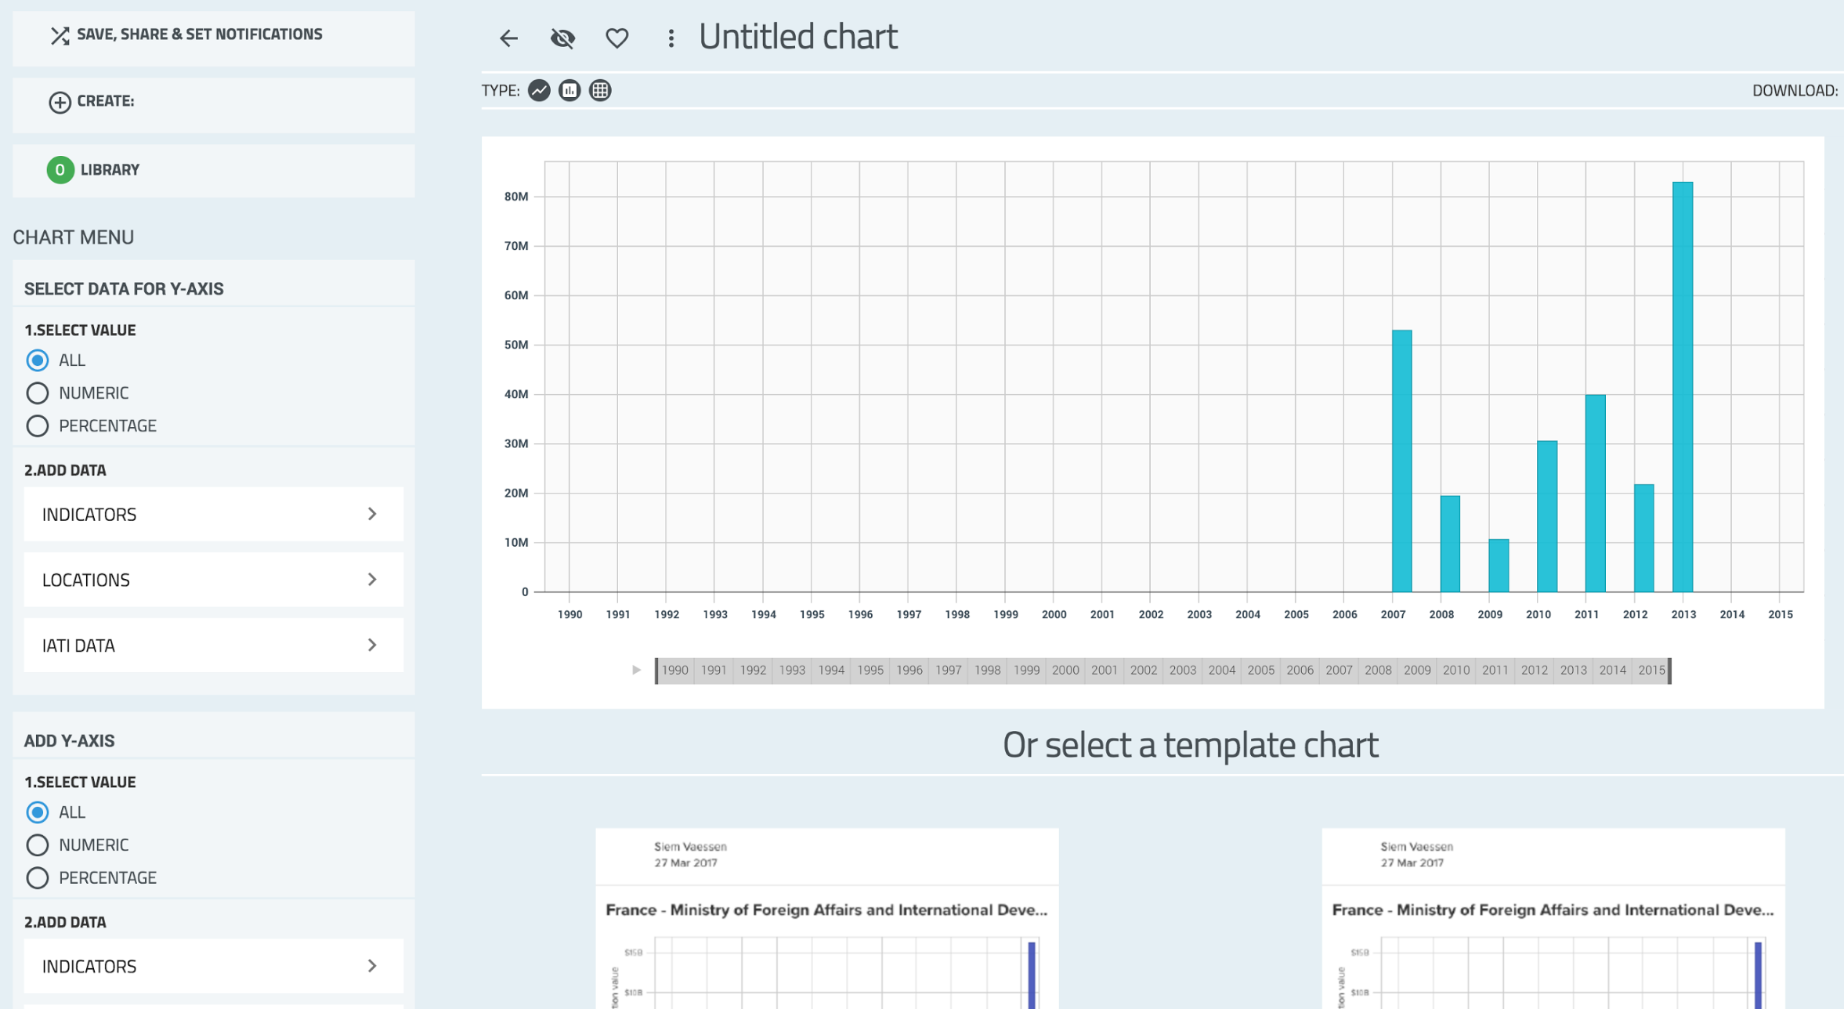
Notes:
Notifications for new data (that you care about)
Query any combination of fields in the standard
Visualize IATI data alongside World Bank Development Indicators, FAOSTAT, CGIAR Ag Science & Tech Indicators, and more

Slide 31
So what’s next for Open Ag?
Open Ag 2.0?
Open Ag Inc.?
Open Ag X?
Open Humanitarian?
Open Energy?
...

Slide 32
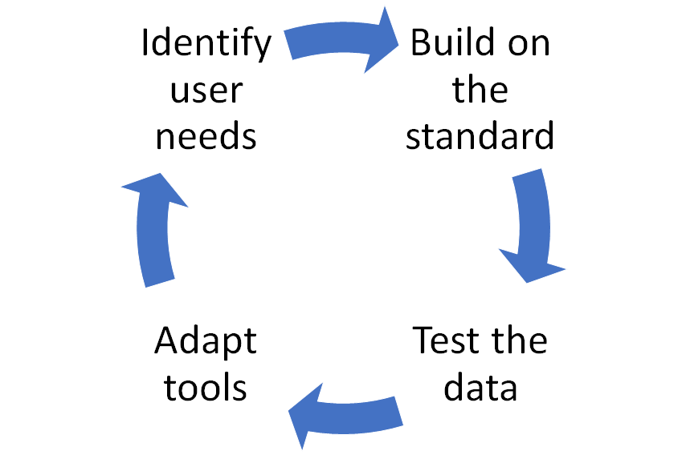
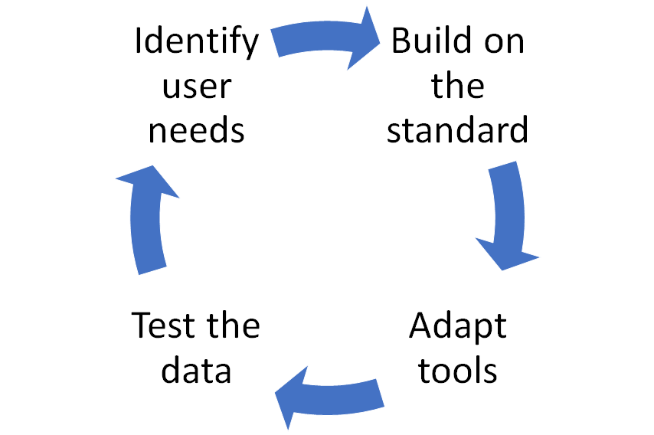
It doesn’t matter! It’s a model...

Slide 33
...and it’s not APODS;-)

Slide 34
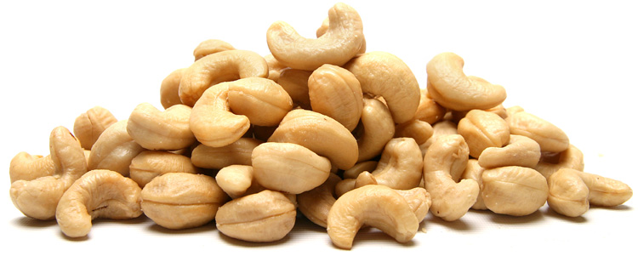
Thank you!
Notes:
Thank all and gates

