Slide 1
Members’ Assembly meeting,
3-5 October 2017, Rome

Slide 2
REACHED TARGET:
March 2017 AICS joined IATI’s accession procedure
June 2017, AICS already published:
First organizational chart
budget data 2016-2018 with a break down for partner countries
ON GOING:
Authomatic transmission both to IATI and to Openaid in order to grant data consistency
BY END OF OCTOBER publication of the first file of «pilot case» Ethopia

Slide 3
AID TRANSPARENCY INDEX
ex art.17 clause 9 L.125/2014
IATI International Aid Trasparency Initiative
OGP
Open Government Partnership
Action 21 of 3° action plan
2016-2018

Slide 5
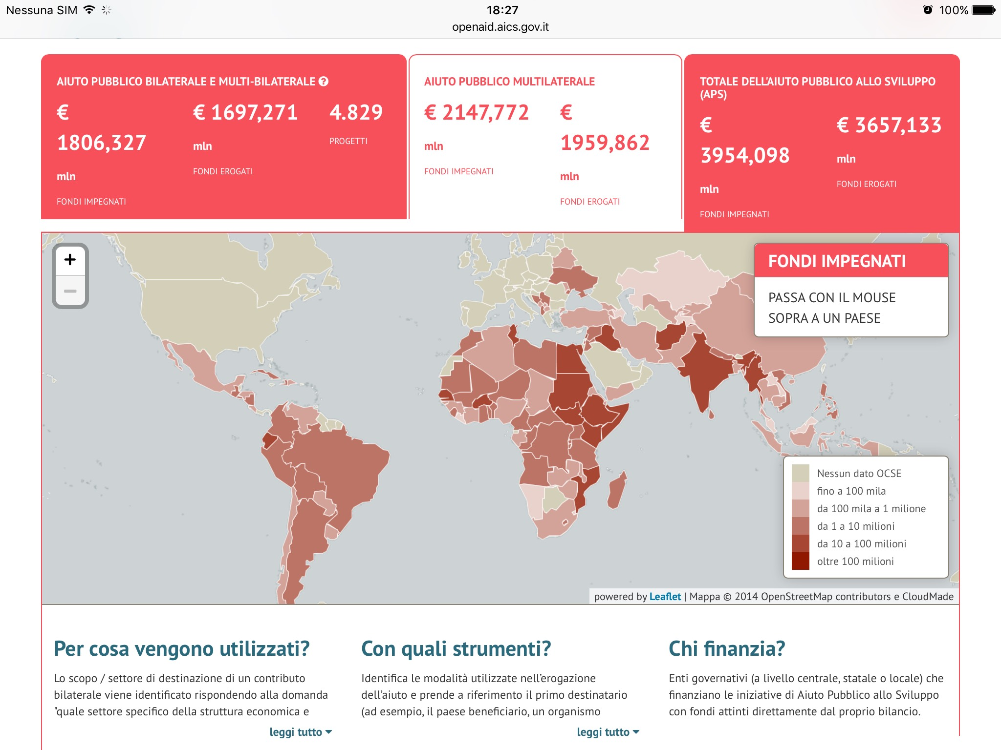

Slide 6
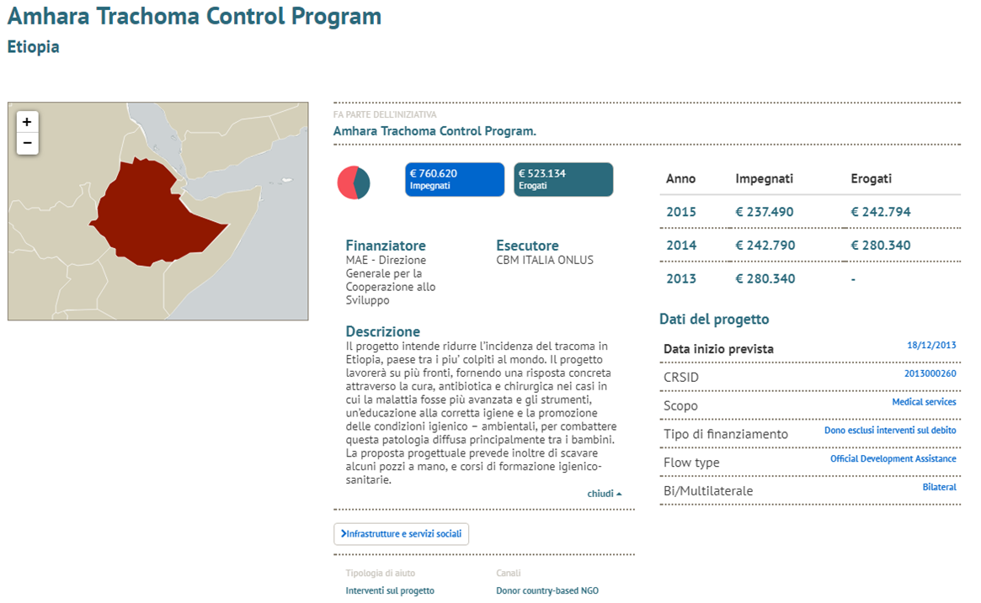

Slide 7
