Slide 1
Session 5: Communications
Members Assembly Meeting, 3-5 October 2017

Slide 2
IATI website and brand project
Notes:
IATI is currently working to improve our brand and website and in this presentation we’ll be updating members on our work so far. Alongside this work, we’ve provided a written update in Paper 5 on our day-to-day communications activities that support delivery of the workplan.
However in this presentation (mainly due to time constraints of this meeting) we are solely focusing on the website and brand project.

Slide 3
Why?

Slide 4
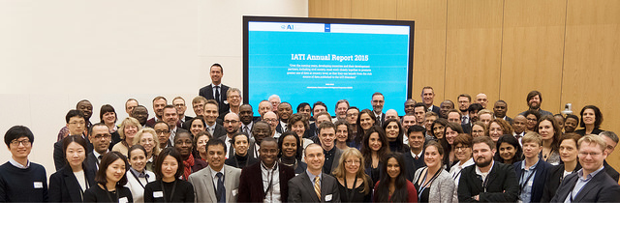
“Members approved Recommendation 3 on renaming and re-branding of IATI in the interests of supporting outreach to a more diverse range of development actors and underpinning its positioning within the 2030 Agenda.”

Slide 5
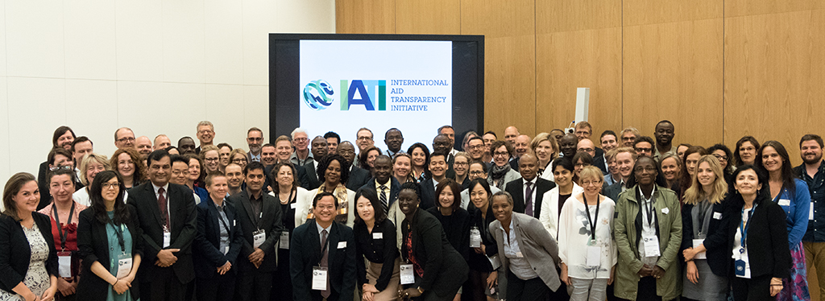
IATI Workplan Financial Years 4-5 (Sep 2016-Aug 2018) agreed

Slide 6
IATI brand and website
experience of existing data publishers/users
engagement with members and community
ensure we’re best able to appeal to new .
audiences

Slide 7
What’s the problem?

Slide 8
We engaged 100+ participants in one-two-one interviews, usability testing and workshops

Slide 9
There were many positives...
Real passion about transparency and open data The political buy-in Recognised as global standard Nearly 600 publishers in 6 years Data use greater than anticipated

Slide 10
“The political momentum has been fantastic. There’s a huge political buy-in” “Publishing our data to IATI has helped lift our credibility and partners’ confidence”
“I have seen that 600 projects are active in my country and this is information that I didn't know before” “We use IATI data to find out expected incoming flows, and I provide this to the Minister”

Slide 11
Barriers

Slide 12
Awareness

Slide 13
2. Remit

Slide 14
Approachability
“We got a bit of a [gasp] fright when we first looked at it.”
Notes:
friendly presentation of brand easy to understand language: translating technical into non-technical

Slide 15
4. Navigation
15+ IATI websites plus third party tools!

Slide 16
Guidance
“I don’t find the definitions of the schema useful as it just describes the code of it, I want to know what to know what it actually describes. I want the dictionary definition”

Slide 17
Credibility
“to encourage more use, we need a clear evidence base on how IATI data adds value to government systems and their decision making processes.” - Development Initiatives IATI Data Use Report, March 2017
Notes:
we discovered more of use cases
we will be celebrating our sucess - 600 publishers in 6 years - many positive quotes

Slide 18
Language
je ne sais pas

Slide 19
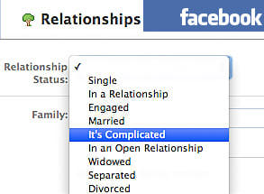
In a nutshell...

Slide 20
Brand reveal
https://drive.google.com/file/d/0B6kJxnk-ijlrUUo4dmRZQ0hsa1k/view?usp=sharing

Slide 21
Brand reveal
<iati-drumroll>
<narrative>IATI brand</narrative>
</iati-drumroll>

Slide 22
Notes:
As you can see the new logo has the acronym in lower case. Using lowercase makes IATI more approachable. It also easy to read. Some might also say it has a more modern feel to it. Please also note that we see a symbol over the i. The circles are reminiscent of data visualisations. Being circular it also keeps something from our old symbol.
In some sense one might say that we’re using the brand partly to counter the risk we’re running to been seen as a complex data initiative and rather be approachable and contemporary.
And personally I feel that this is still true to what IATI is.

Slide 23
Notes:
As you can see the new logo has the acronym in lower case. Using lowercase makes IATI more approachable. We’re using the brand to try to counteract the associations with complex data to ensure we are approachable

Slide 24
Notes:
We keeping the core colors from the old brand.

Slide 25
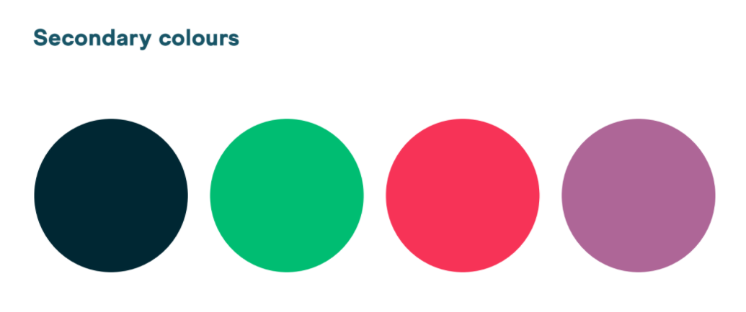
Notes:
But we’re to our brand by including secondary colours to be used when produce a wide range of publications e.g. our annual report or training videos where two colours just won’t do...

Slide 26
Notes:
But this how it will look in

Slide 27
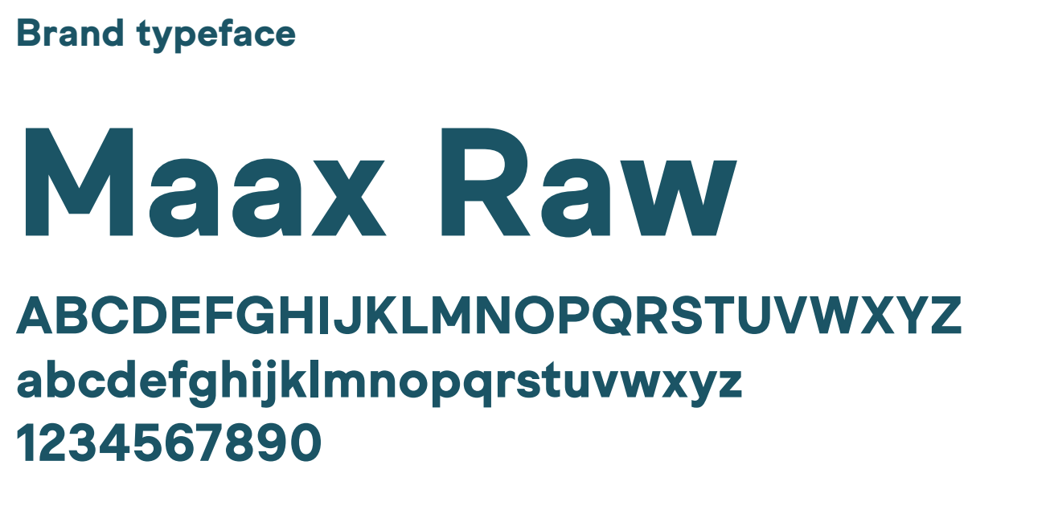
Notes:
Here is the brand typeface. It is called Maax Raw - but don’t let the name fool you. It was chosen to - again - be friendly and approachable.

Slide 28
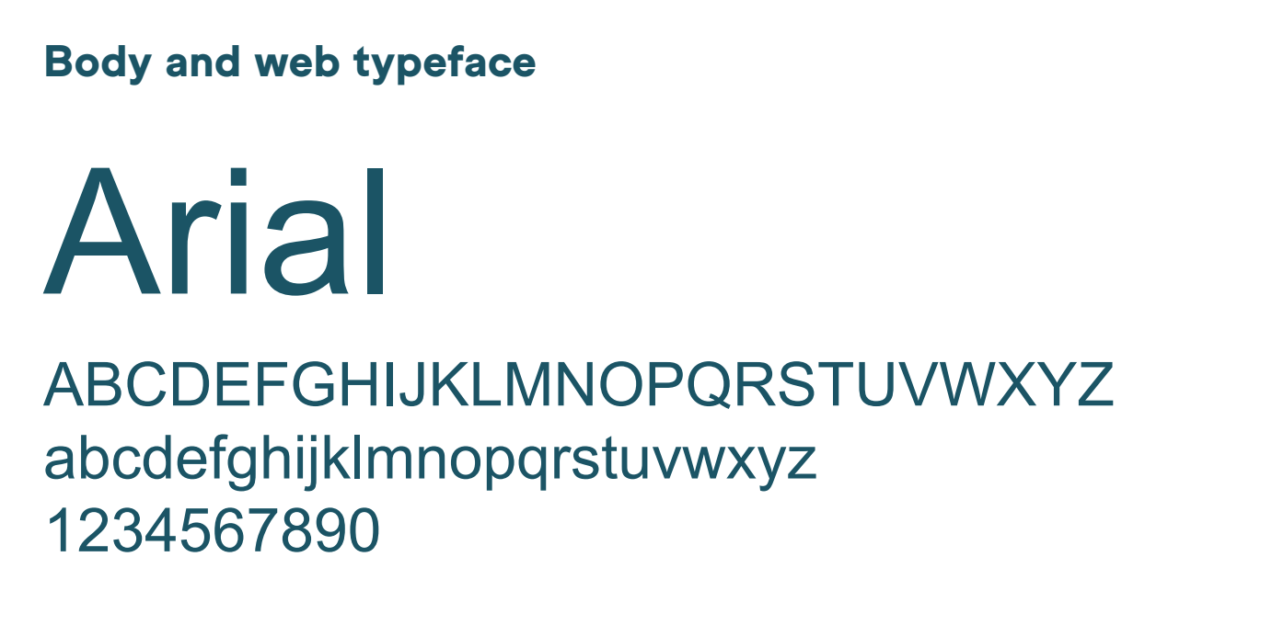
Notes:
For body text and web we will stick to the universally accepted and simple font Arial.

Slide 29
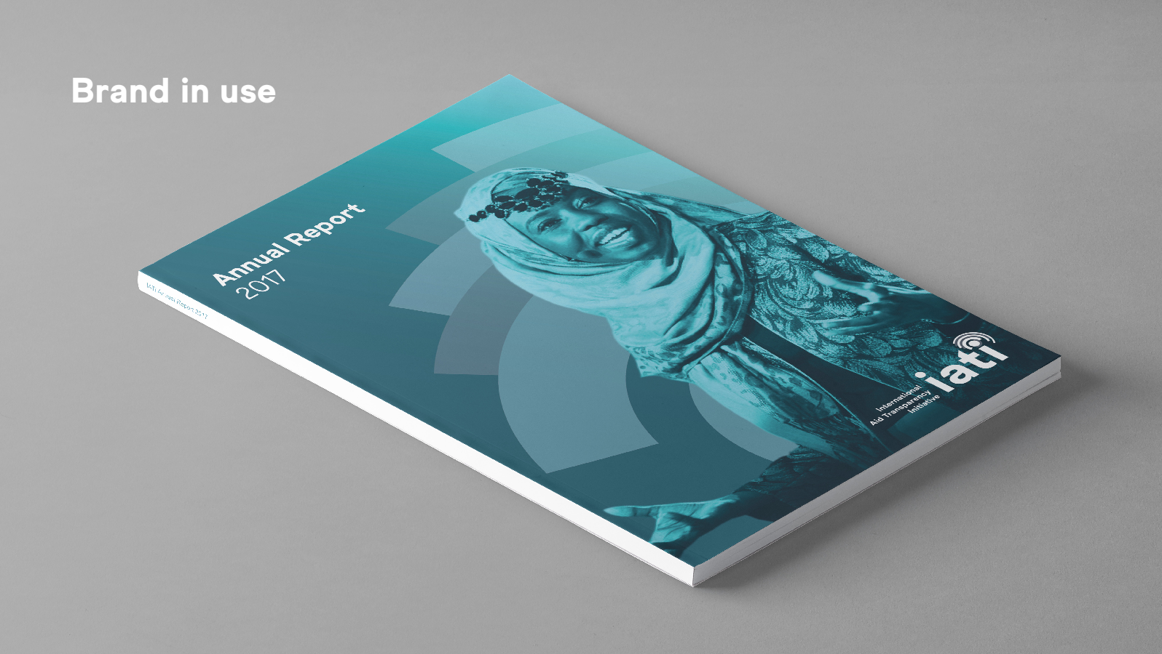
Notes:
And here is an example of how the brand might look like when applied to a publication.

Slide 30
Website
http://www.beta.iatistandard.org/

