Slide 1
IATI workplan implementation, Y4 (2016-17)
Members’ Assembly, Rome
3 October 2017
Annelise Parr, IATI Secretariat
Notes:
Following on from the financial presentation - Y4 was first year that IATI budget has been fully funded. THANK YOU again to all members who contributed to that.
In line with what we promised last year, the additional funds have enabled us to:
Hire an additional developer, which has helped us to strengthen IATI's tech infrastructure;
Hire an additional business analyst to support publishers to improve the quality of their data via a targeted strategy;
Help members to meet their WHS commitment to transparency;
Begin work on data use, with extensive research on user needs, improvements to d-portal and use case profiles developed by UNDP;
Start work on re-designing the IATI website - a project previously put on hold because of lack of funding - you'll get a preview later in the meeting.
At the same time as taking forward work on the website, we've taken the opportunity to refresh the brand - again, you'll get a preview later.
Meanwhile the Board commissioned the Powered by Data report on future institutional arrangements which will be discussed tomorrow, and the Secretariat organised consultation with members.
While we are a little behind schedule on data use work, we have been able to spend more time on thorough research into user needs and there are lots of good examples of data use emerging from members, showing that we need to keep focusing on our collective responsibility to deliver on use.
As well as all of the new work we've been able to start in Y4, we've also been busy with business as usual, delivering on all the everyday work that contributes to the achievement of our objectives. Details are in paper 2B and here is a flavour of the key highlights from the year.

Slide 2
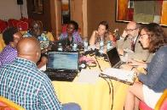
1 – Promoting data use
Research & scoping
Data Use strategy
Local workshops
More experts
Website work / DQ
Supports data use
Notes:
Scoping work has been completed and members will see a presentation on the proposed data use strategy later today – the work plan and budget for that has been circulated.
Local workshops and miniTAGs (like the one here in Rome on Friday) have helped expand the pool of technical experts.
The Secretariat is ready to support a proposed initiative by the donor caucus to initiate pilots on data use in five countries (though note leadership needs to come from them).
Work undertaken on the website and data quality also support data use.

Slide 3
2 – Improving data quality
Publishers up by 112 / 25% in Y4
Support requests up by 19% in Y4 = 1,402 requests
Working directly on data quality with 100 of our biggest publishers
Improving guidance & support materials based on users’ needs
Notes:
The number of publishers increased by 112 in Y4 and now stands at 586 - a 25% increase on Y3.
The tech team received 1402 requests for support in Y4 - up 19% on the previous year. The solution to year on year increases is to improve the website and guidance to increase self-publishing using online support.
Each of our ‘top 100’ publishers now has a lead contact within the tech team who works with them directly and proactively to resolve issues with their data.
Guidance materials are updated on an ongoing basis, and the Secretariat has undertaken detailed consultation on publishers' needs for tools and guidance as part of the website project.

Slide 4
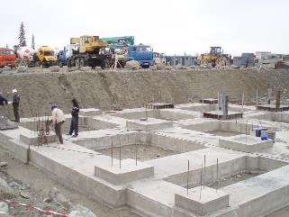
3 – Maintaining & strengthening IATI systems
PyIATI – giving IATI stronger foundations for the future
d-portal – better search of IATI data
Roadmap – plotting the direction of all IATI’s tools and infrastructure
Notes:
As noted above, additional staff capacity has enabled the tech team to complete work on the python library (PyIATI) – essential to give IATI’s technical infrastructure the strong foundations it needs for the future.
d-portal has been significantly improved with the addition of free text search and the ability to search on multiple criteria.
Work on the datastore will be prioritised in Y5.
A roadmap for the development and maintenance of core IATI technical systems and tools has been produced.
The tech team has undertaken work on existing IATI products including the Registry, Dashboard and Standard website.
Tech team priorities for rest of 2017 include work on the validator, the 2.03 upgrade and architecture design and development to improve the experience for website users.

Slide 5
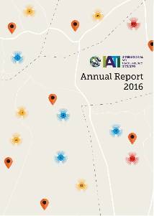
4 – Communications & Outreach
Events
Publications
New brand & website…
Notes:
IATI participated in several key international events including the GPEDC HLM in Nairobi in November, COP22 in Marrakech in November and the African Open Data Conference in Accra in July.
The Annual Report was published in March and savings on this project were invested in an information video which has been viewed over 1,700 times.
Work to refresh and renew the IATI brand and website are ongoing - more to come on this.

Slide 6
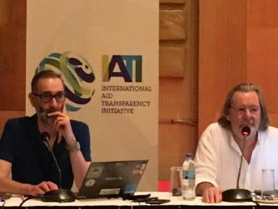
5 – Institutional Arrangements
Secretariat
Met weekly
Supported Board meetings
Organised Members’ Assembly
Drafted TORs and supported the Board's work on institutional review
Organised TAG
Notes:
The Secretariat continues to meet virtually on a weekly basis, as well as one face-to-face meeting, service Board meetings and organise the annual Members’ Assembly.
The Secretariat also organised a highly successful TAG in Tanzania in March, with generous support form DFID. This was our first TAG in a partner country and our most well-attended community meeting so far, with 137 participants. The TAG Chair election process ran smoothly, with John Adams re-elected for another term. The new concept of the ‘miniTAG’ began with an event in London in July focusing on traceability.

