Slide 1
IATI – An Introduction
Notes:
1

Slide 2
When was IATI launched?
Accra HLF 2008
“publicly disclose regular, detailed and timely information on volume, allocation and results...”
“provide regular and timely information on forward expenditure and implementation plans...”
Accra Agenda for Action Para. 24a and 26b
Busan HLF 2011
“Implement a common, open standard for electronic publication of timely, comprehensive and forward looking information on resources provided through development cooperation...”
Busan Declaration Para. 23 c

Slide 3
What is IATI?
Multi-Stakeholder
Standard
Single point of access

Slide 4
Why did we need IATI?
There’s lots of information available but it’s...
Different formats
Hard to find
Not current
Not comparable
Inconsistent
In multiple locations
Not forward looking
Not comprehensive

Slide 5
How does IATI overcome these issues?
IATI enables organisations to publish data that is...
In a standardised format
Updated Regularly
From a range of actors
All in one place
Forward looking
Comparable

Slide 6
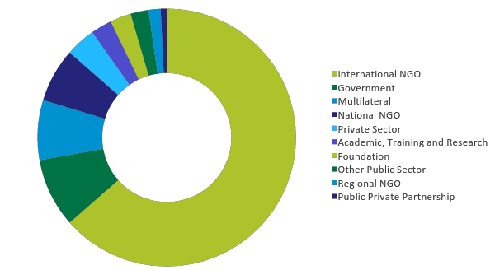
What kind of organisations are publishing to IATI?
585
Notes:
IATI is a voluntary multi-stakeholder initiative that seeks to increase the transparency of development cooperation and consequently improve its effectiveness in tackling poverty.
At the centre of IATI is a data standard. This is a format and framework for publishing data on development cooperation activities, intended to be used by all organisations engaged in development, from government donors to private sector organisations, and national and international NGOs. It was designed in close consultation with key users of development cooperation data in developing countries, to ensure its relevance and utility for a variety of different data users.
IATI also provides a single point of access for the data organisations publishing to the IATI Standard. This is called the Registry. The Registry holds links to all the data that is being published in the IATI Standard format, meaning that users can access it from one single point.
6

Slide 7
What information do organisations publish?
Organisation Standard
Activity Standard
Forward looking budgets
Full transaction history
Strategic documents
Sub-national Geographic coding
Sectors and Classifications
Country budgets
Forward looking budgets
Conditions, Outputs, Outcomes

Slide 8
Who wants IATI data?
Partner Country Governments
Tax payers
Civil Society
Media

Slide 9
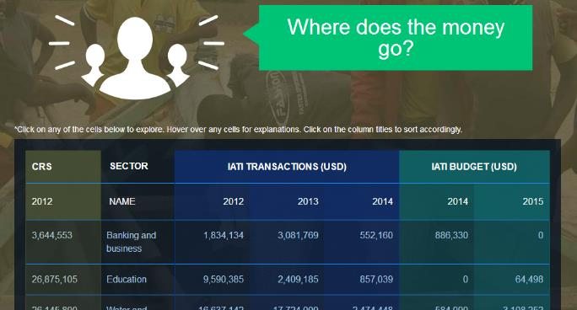
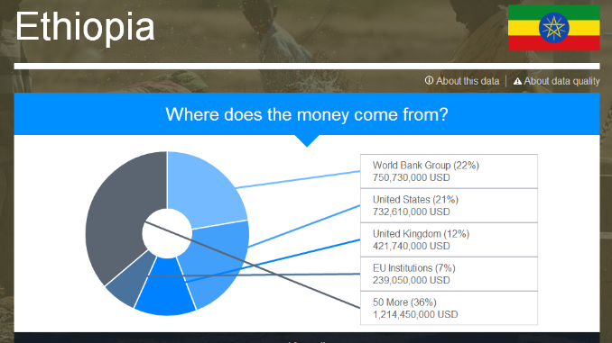
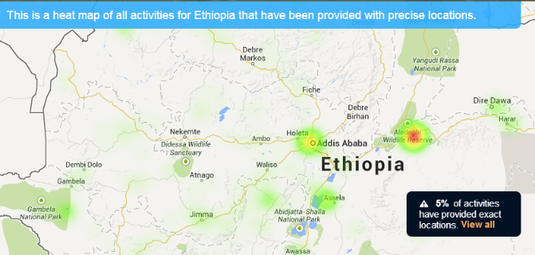
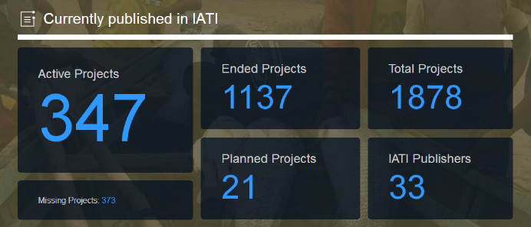
How can we explore IATI data?
Notes:
There are a number of online tools that can be used to explore and use IATI data. For beginners it is worth starting at d-portal.org, where you can easily search for IATI data by recipient country, by publisher, or by simply doing a free text search.

Slide 10
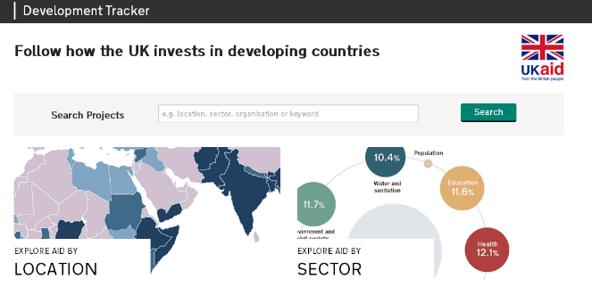
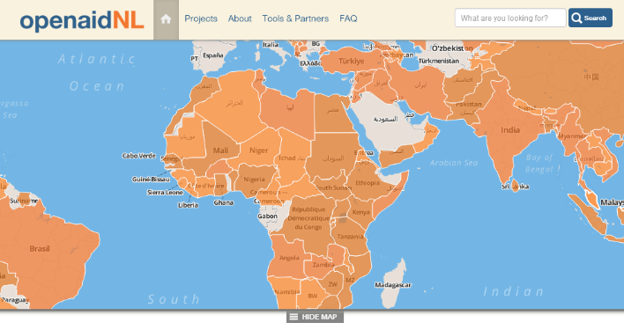
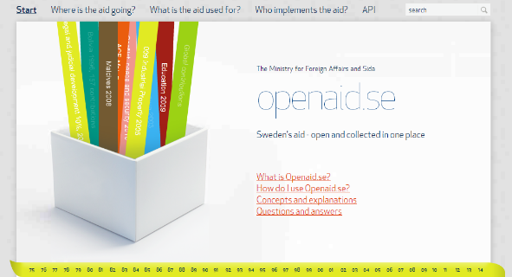
How is IATI data being used?
devtracker.dfid.gov.uk
www.openaid.nl
www.openaid.se
Notes:
A growing number of IATI publishers have created their own bespoke tools to share their IATI data. This includes the UK’s Department for International Development’s Dev Tracker and Sweden’s openaid.se

Slide 11
How is IATI data being used?
The government of Bangladesh have developed a home-grown Aid Information Management System that uses IATI data
Liberia used IATI data to inform the government’s response to the Ebola crisis

Slide 12
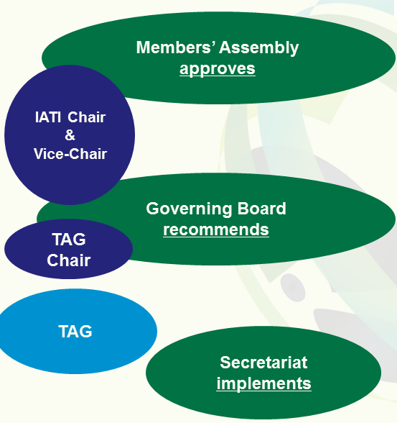
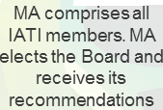
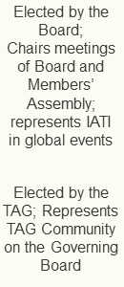
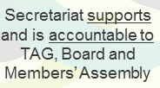
How is IATI governed?

Slide 13
What are the next steps for IATI?
More data
Better quality data
Data being used

Slide 14
More information... www.aidtransparency.net
info@iatistandard.org: General enquiries about IATI, membership or governance
media@iatistandard.org: Media enquiries
support@iatistandard.org: Information and support on how to publish data to the IATI standard or any other technical enquiries.
code@iatistandard.org: Information and support for developers.

Slide 15
Any Questions?

