Slide 1

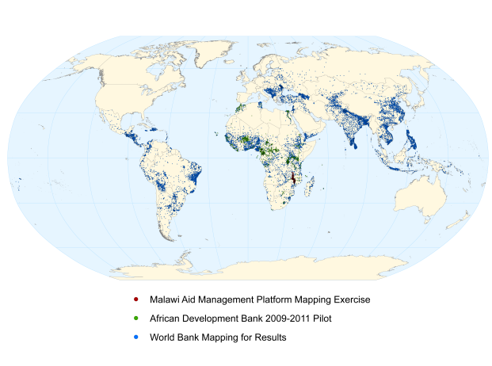

Sharing Aid Information – The IATI Way
Stephen Davenport & Dan Mihaila & Alexandru Gartner

Slide 2

Overview
Scenario overview and challenges
Publishing and sharing your data
  IATI Explorer
Accessing published data
  IATI Explorer API
  IATI Library / Mobile Application
Transforming Donor & Government data into IATI
  IATI Exchange
Future steps
Stephen Davenport – Dan Mihaila – Alexandru Gartner
2

Slide 3
Scenario and Challenges (1)
Donors have their internal reporting systems for aid projects
Governments employ different systems for managing foreign aid data (like the Aid Management Platform)
Donor & Government need tools for transforming, accessing and sharing the data
  they should be nice graphical tools for transforming and accessing the data
  there's also a need for an efficient interface (API) for accessing the data
Integrating external IATI data into the organization's internal IT ecosystem
Stephen Davenport – Dan Mihaila – Alexandru Gartner
3

Slide 4
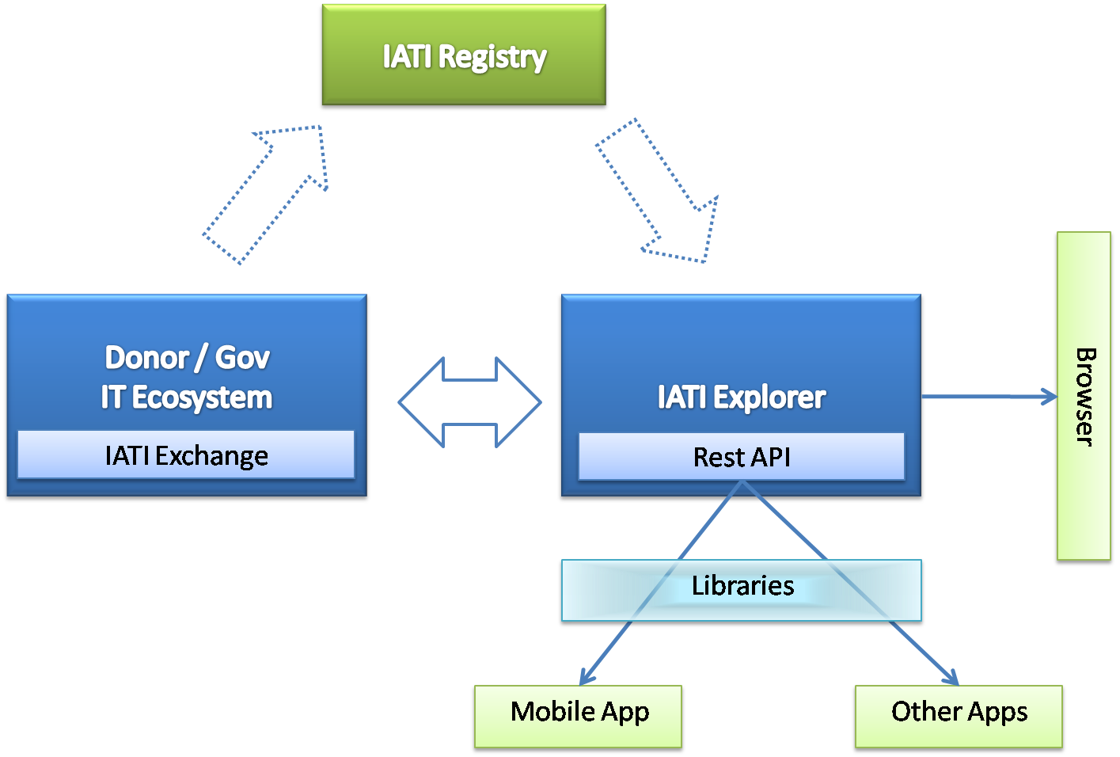
Scenario and Challenges (2)
Stephen Davenport – Dan Mihaila – Alexandru Gartner
4

Slide 5
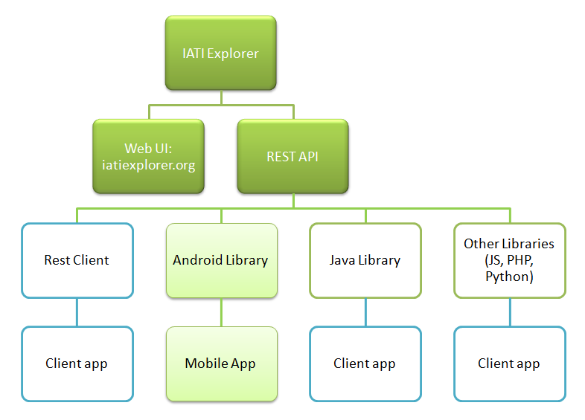
IATI Explorer Diagram
Stephen Davenport – Dan Mihaila – Alexandru Gartner
5

Slide 6
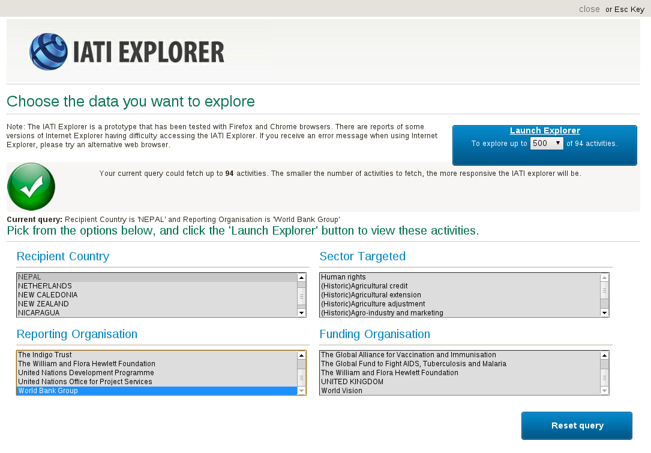
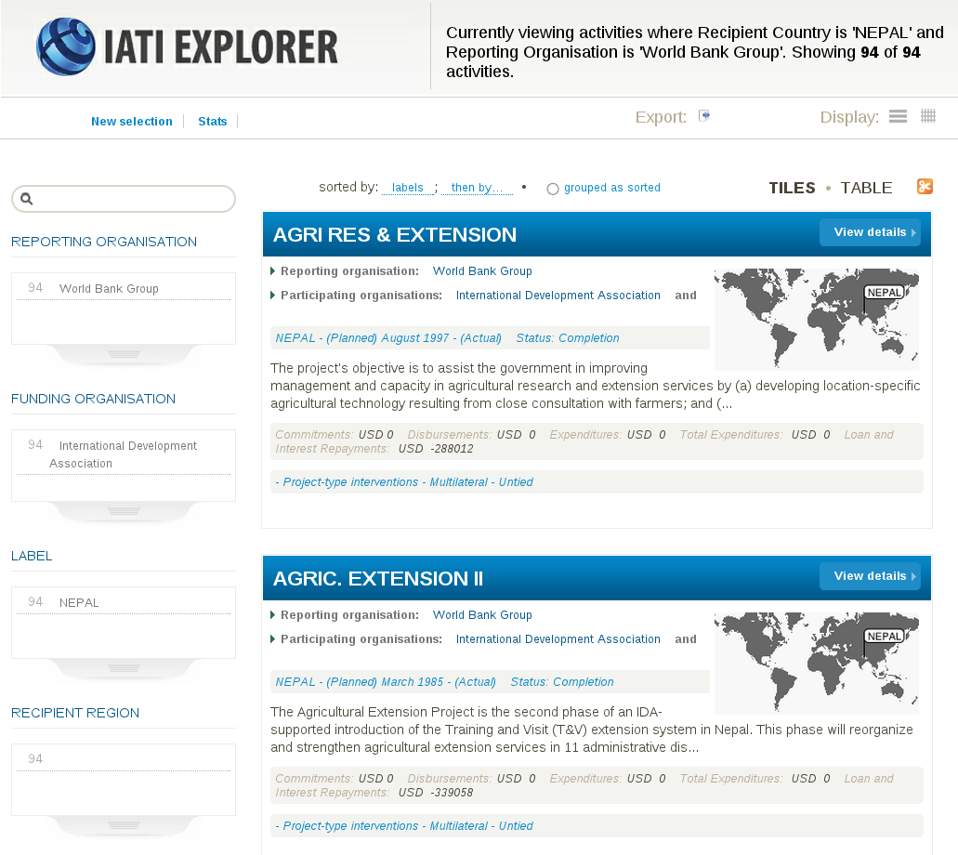
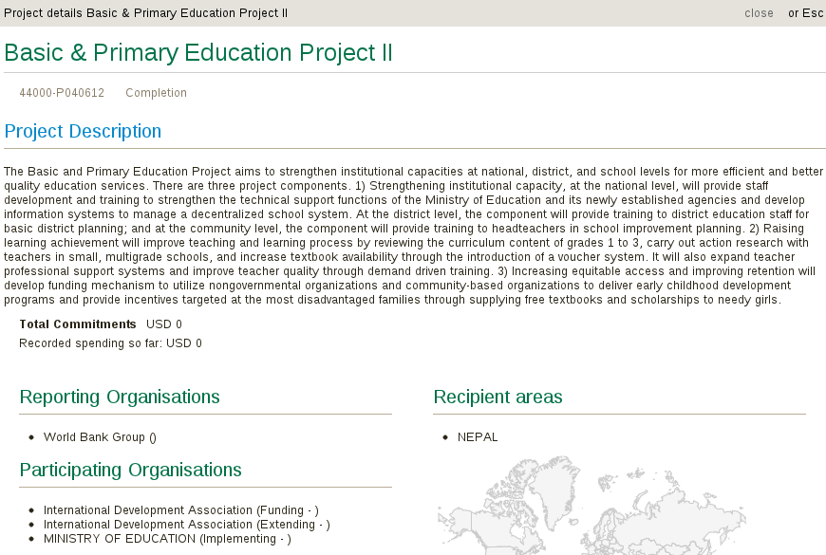
IATI Explorer Web UI http://iatiexplorer.org
Stephen Davenport – Dan Mihaila – Alexandru Gartner
6

Slide 7
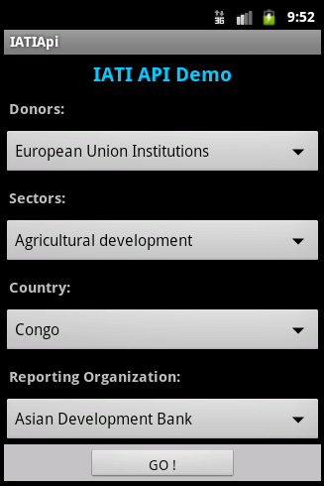
Android Application – Prototype (1)
accessing data from IATI Explorer
using Android library developed by Development Gateway
automatically populates filters with information from IATI Explorer
browse activities based on selected criteria
view activity details
Stephen Davenport – Dan Mihaila – Alexandru Gartner
7

Slide 8
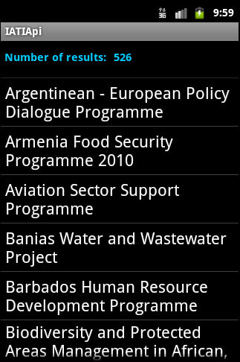
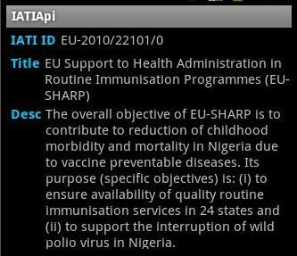
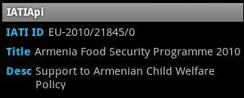
Android Application – Prototype (2)
Stephen Davenport – Dan Mihaila – Alexandru Gartner
8

Slide 9
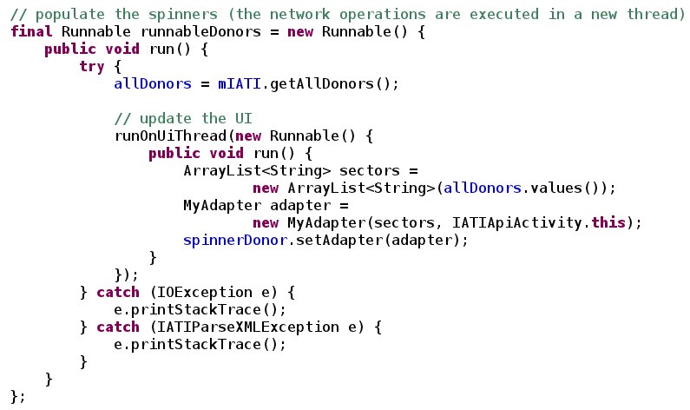
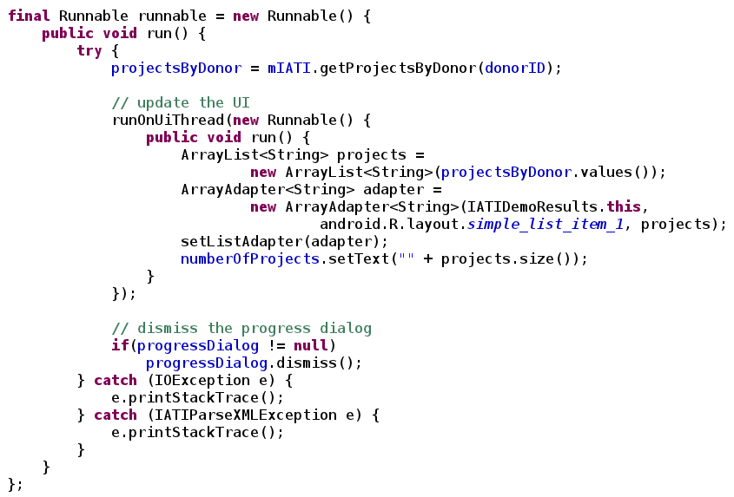
IATI Explore API & Libraries
Sample code for using the Android library
Stephen Davenport – Dan Mihaila – Alexandru Gartner
9

Slide 10
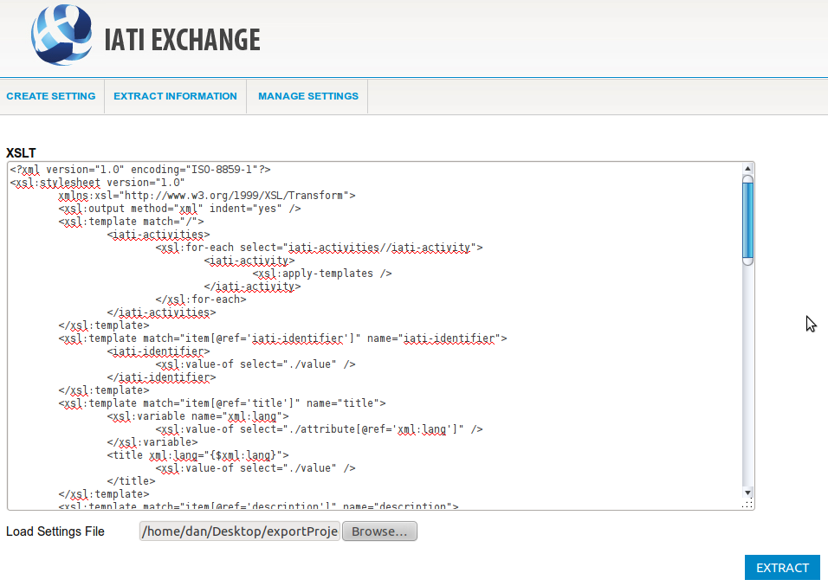
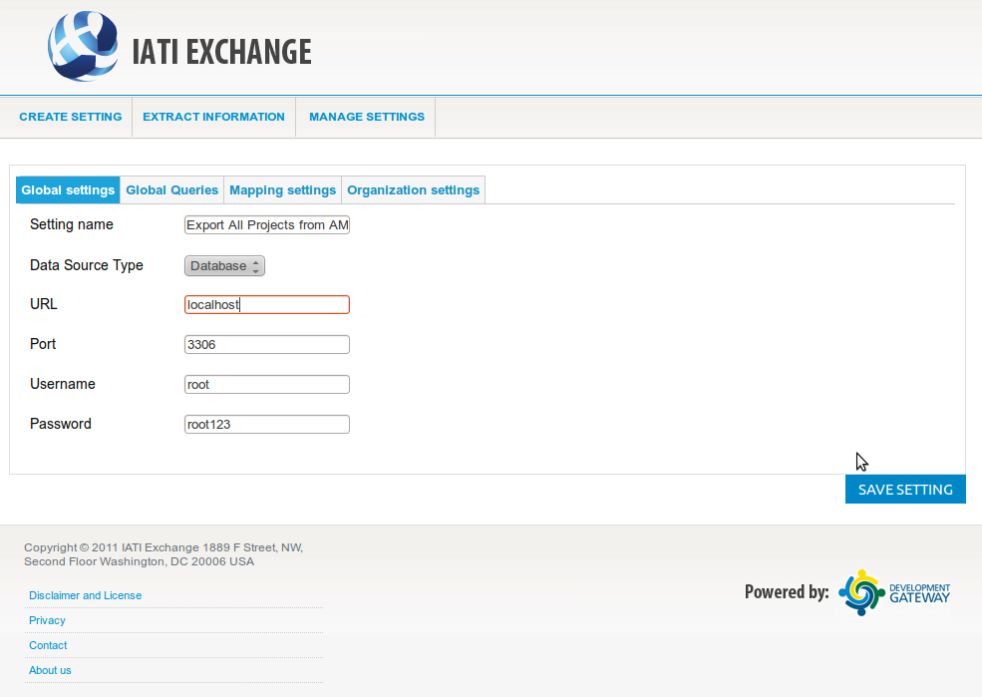
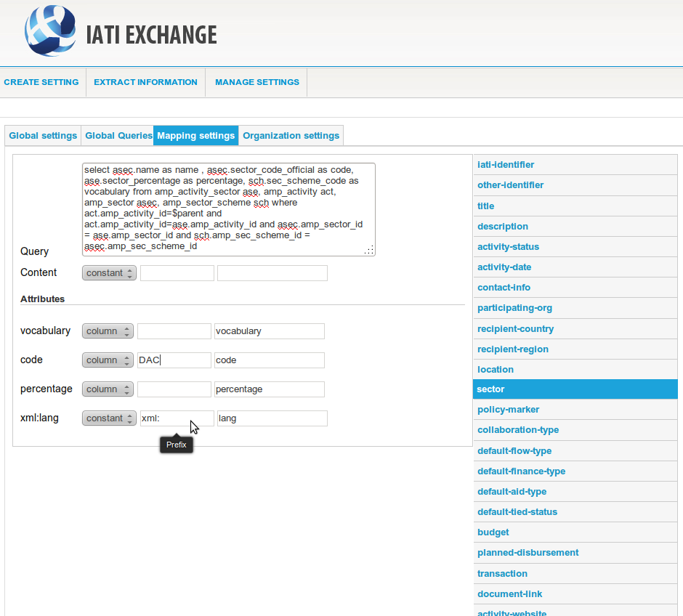
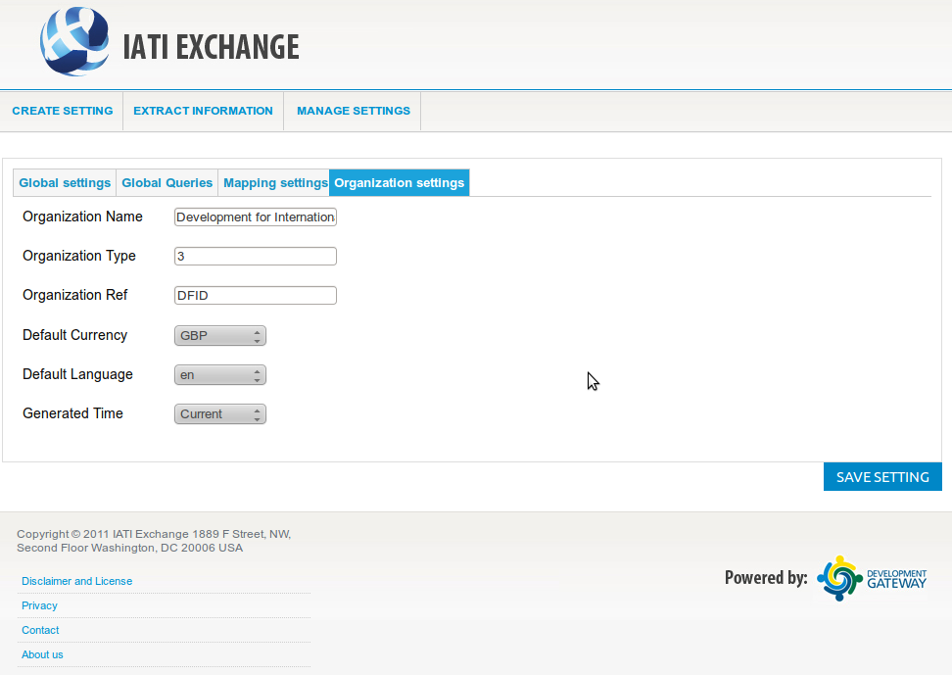
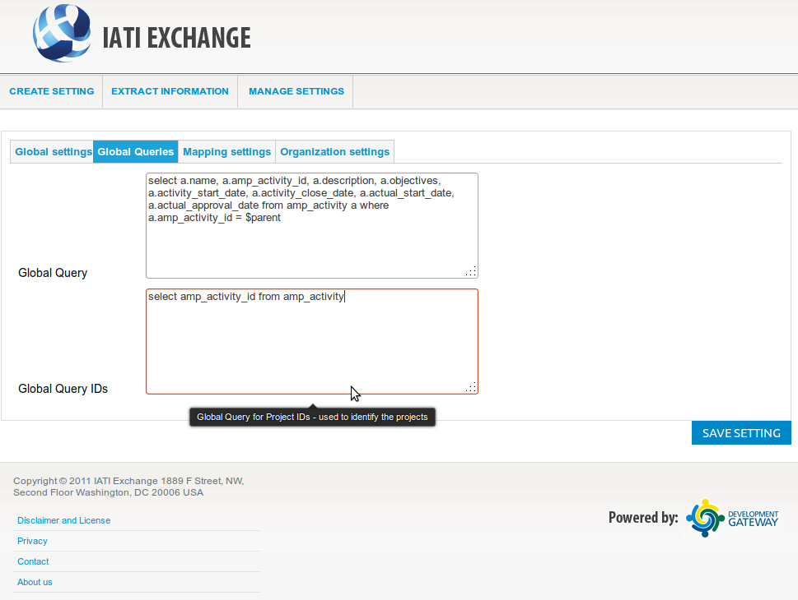
IATI Exchange - Prototype
Deploy and connect the IATI Exchange with the Donor / Government systems
Flexible, configurable settings
Visual linking the existing data structure to the IATI data structure
Allow "fine-tuning" of the result - XSLT
Stephen Davenport – Dan Mihaila – Alexandru Gartner
10

Slide 11
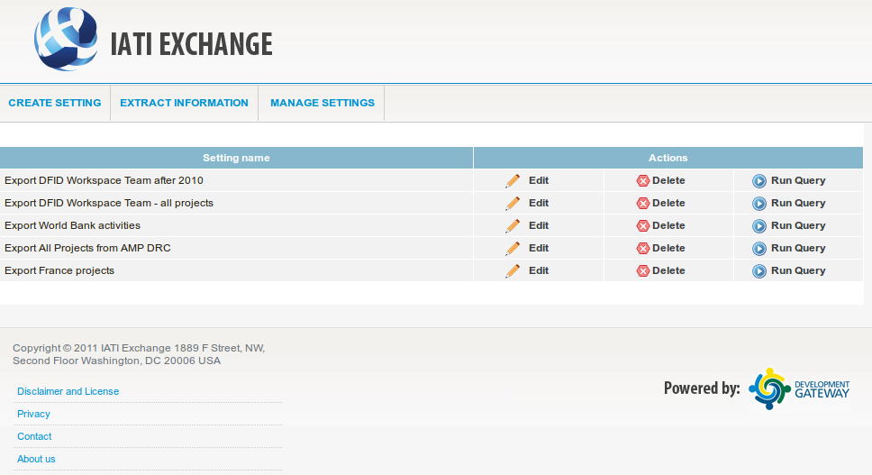
IATI Exchange – Prototype (2)
Scheduler for publishing
Easy-to-run the transformation process
Stephen Davenport – Dan Mihaila – Alexandru Gartner
11

Slide 12
Publishing and Sharing
Notify the IATI Registry regarding the newly created IATI feed
The feed will be automatically imported into the IATI Explorer
The data is available for use by the general public :
  querying
  visualizing
  statistics
  mobile applications
  integration
Stephen Davenport – Dan Mihaila – Alexandru Gartner
12

Slide 13
Future Steps
IATI Exchange
publishing automatically the IATI feed
support CSV, XML formats
IATI Explorer
giving automatic feedback to problems with both the structure and the content of IATI feeds
additional libraries for more programming/scripting languages
Stephen Davenport – Dan Mihaila – Alexandru Gartner
13

Slide 14
Thank You
Stephen Davenport
  sdavenport@developmentgateway.org
Dan Mihaila
  dmihaila@developmentgateway.org
Alexandru Gartner
  agartner@developmentgateway.org
Stephen Davenport – Dan Mihaila – Alexandru Gartner
14

Slide 15
IATI Explorer API & Libraries
To integrate the data from IATI Explorer into your own ecosystem of applications there are several options:
Writing a REST client for accessing the REST API directly
Using a wrapper library over the REST API that facilitates the access and makes the communication to the server transparent
Stephen Davenport – Dan Mihaila – Alexandru Gartner
15

Slide 16
IATI Explorer API & Libraries
Allows the programmatic access to the information in the IATI Explorer.
get all donors from the IATI data
get all sectors from the IATI data
get all reporting organizations
get all funding organizations
get list of activity names ( and identifier ) based on a certain criteria
get entire activities by identifier
get any entities based on a certain criteria
get lists containing names of any IATI entity
Stephen Davenport – Dan Mihaila – Alexandru Gartner
16

