Slide 1
Results Theme Tagging
A method for making results data more searchable and usable

Slide 2
The Challenge
How can we use and visualize results data in IATI?
While results data across organizations often can’t be aggregated together, it can still be useful to identify and review results of organizations tracking similar indicators.
Notes:
I’ll be sharing an example of one approach we’ve taken to make data across organizations more searchable and usable. While we haven’t used data from IATI data, this could be applied to IATI data just as well.

Slide 3
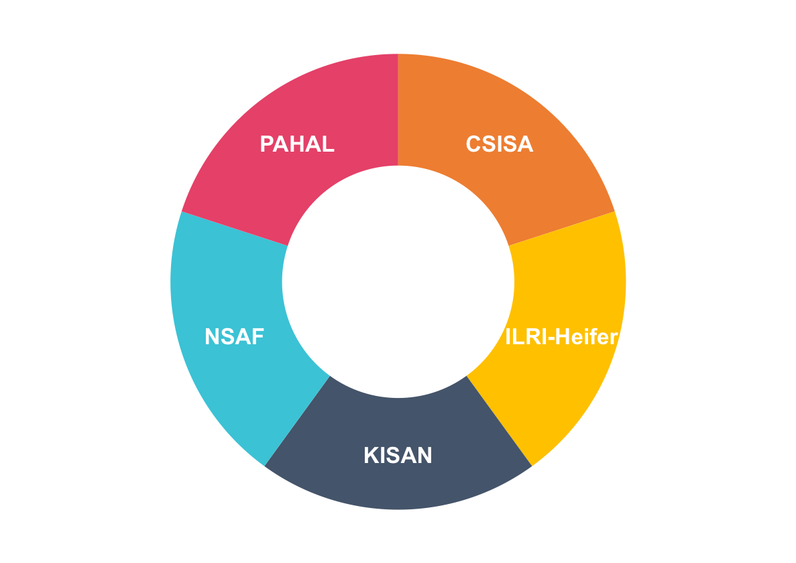
Pilot for mSTAR
Pilot using Feed the Future baseline data in Nepal and Cambodia.
Goals:
Identify areas for cross-portfolio research.
Identify areas for possible standardization.
5
databases
1100+
Nepal Indicators
Notes:
As part of our work on FHI 360’s mobile Solutions Technical Assistance and Research (mStar’s) program on Accelerating Data Driven Agriculture Development in Cambodia and Nepal, we worked with USAID Feed the Future implementing organizations to improve data sharing. Our goals included identifying possible areas for cross-portfolio research, and understand where there might be additional needs for standardization.

Slide 4
Methodology Used
Consolidate indicators into a single file.
Map each indicator into specific themes, and sub-themes.
Sub-themes were determined organically depending on prevalent indicator topics.
Sub-themes were then grouped into larger thematic areas. Theme must be distinct enough to not fit as a sub-theme to any other theme.
Notes:
For the pilot we collected baseline survey data from Feed the Future implementing partners in Nepal and Cambodia. We took a bottom up approach, where sub-themes were created organically as data was reviewed. These sub-themes were then grouped into larger themes. This was a very subjective process as a pilot. Ff done on a large scale should include sector experts.

Slide 5
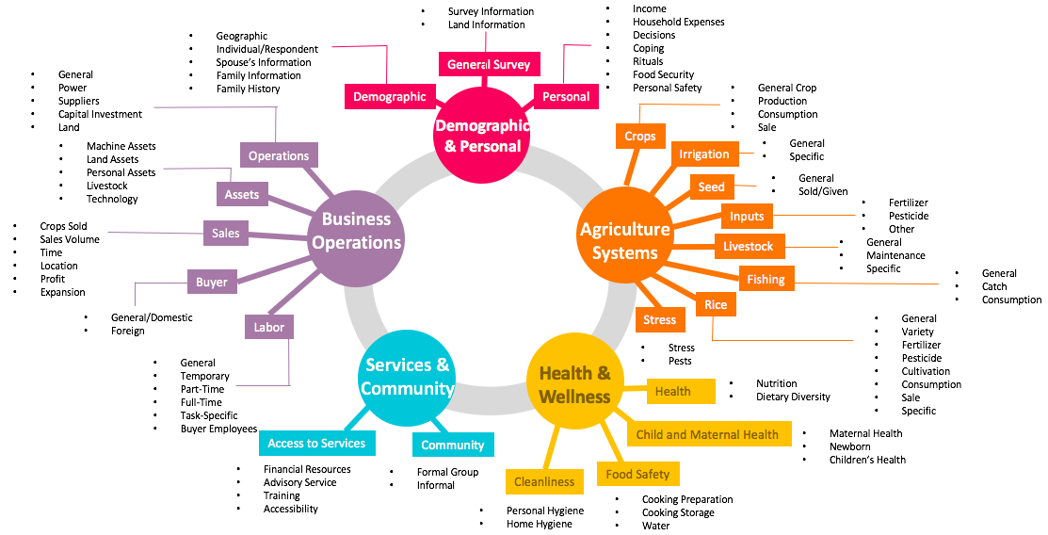
Theme and Sub-Theme Mapping
Notes:
You can see here the themes and sub-themes and overall categories that were generated for the Cambodia data we reviewed. We had five overarching categories, under which the themes and sub-themes fell. As an example, you can see under Services and Community we have Access to Services, and then Accessibility.

Slide 6
Search by Theme & Sub-Theme
Notes:
We created an Excel database as a quick tool to access the data and categories. You can see under that example of Accessibility, there are questions about distance to different services, such as self help group office, distance between vegetable field and where you sell vegetables. Because one of our goals was to identify opportunities for standardization, the far right column shows the number of projects the indicator is used. The colored columns are the projects these questions came from, 1 means this question was included, .5 means something very closely worded was included. The total similarities adds up the to show how many projects used the same, or similar question.

Slide 7
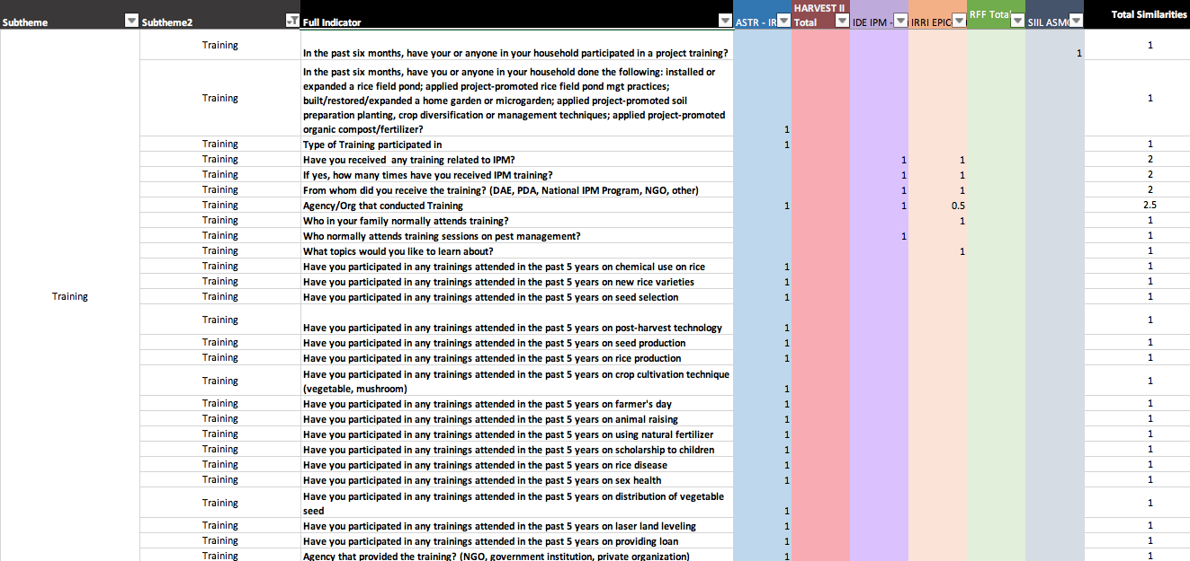
What Agriculture Trainings Have People Participated In?
Notes:
What this allows us to do is if we have a question such as “What agriculture trainings have been administered?” We can start to filter down to training and see what kind of training are being asked about, and what project is asking about it. So these are obviously survey questions, while in IATI it will be specific outputs, outcomes, impact that will be reported, however this approach can be applied to this data as well.

Slide 8
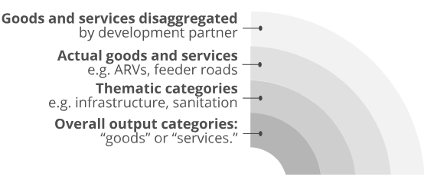
Similar Approach for RDI
Results data scraped for Agriculture and Health in Tanzania, Sri Lanka, and Ghana.
Categorized into four levels.
Notes:
We followed a similar approach for our Results Data Initiative. We first scraped results data from organization websites focused on Agriculture and Health in Tanzania, Sri Lanka, and Ghana. In this case we categorized into four levels.

Slide 9
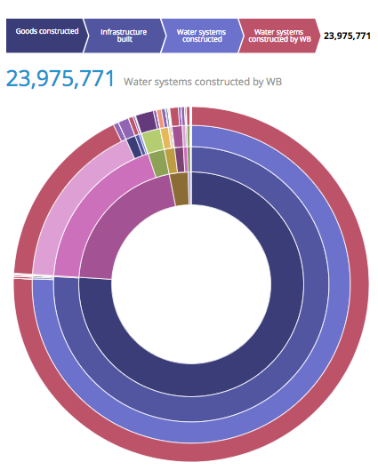
How many water systems has WB constructed in Ghana?
Able to explore various organizations efforts and results in an interactive visualization.
Found at - rdi.developmentgateway.org
Notes:
We were able to create an interactive visualization to explore some of the data. Give Demo of the RDI Visualization. While this tool is more focused on numbers, it doesn’t necessarily need to. These tags could be used other ways, such as in our Excel table to find and extract data.

Slide 10
Uses of Thematic Tagging
Easier to identify indicators of interest across portfolios & organizations.
Identify projects where results and lessons learned could provide further insight through the evaluation report or contacting the organization.
Identify data for cross-portfolio research.
Identify the data collected by other organizations to identify and avoid overlap, and improve coordination.

Slide 11
Potential Future Applications
Apply methodology to IATI results data.
Algorithms and tools such as Machine Learning could speed up process for mapping data to themes on a large scale.
Create tools that allow users to interact with, search for, and visualize results data.
Notes:
While our examples didn’t highlight the baseline, target, and actual figures, this could easily be visualized as well.

Slide 12
Stay in touch!
Taryn Davis Holland: tdavis@developmentgateway.org

