Slide 1
Can we make IATI data more usable with visualisations?

Slide 2
Overview
Case Study: PWYF US Budget Case Study - Challenges in using IATI data for research
Case Study: A Publisher’s Perspective on Publishing IATI Activities - Challenges in using accounting data as a source for IATI
Discussion: Can we use visualization techniques to make data more usable for end users while maintaining data accuracy for publishers? If so, what are some ideas for visualization techniques that might work? How can we test these ideas?

Slide 3
Case Study: PWYF US Budget Case Study - Challenges in using IATI data for research

Slide 4
There are currently 1,103,518 activities on IATI. However, is more always better?

Slide 5
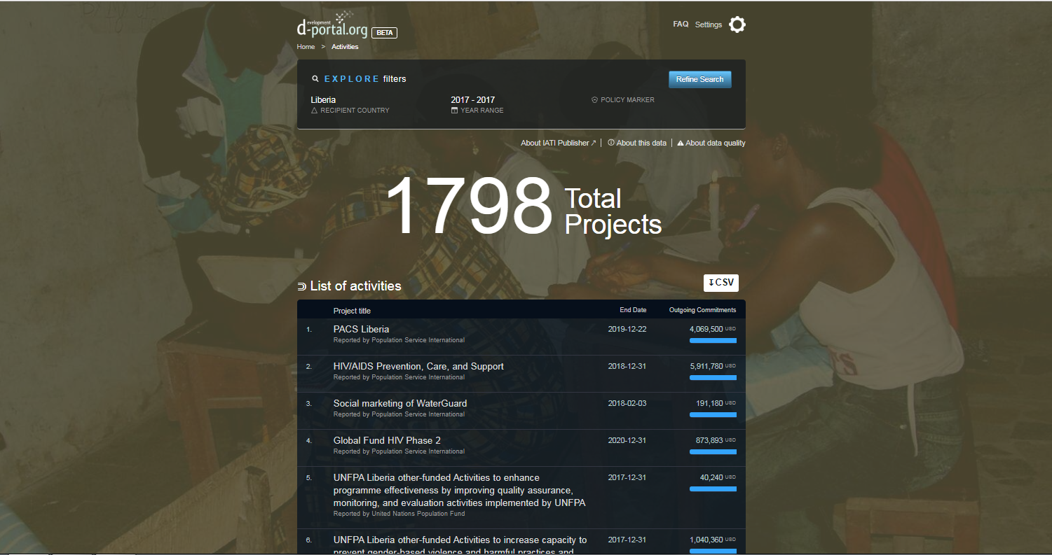
Using available tools, what if I want to “landscape” Liberia (2017) to understand who is operating there?

Slide 6
Assuming you need, on average, 30 seconds to determine whether an activity is relevant, it will take you 15 hours to look through this data.
What if I want to “landscape” Liberia (2017) to understand who is operating there?

Slide 7
Assuming you need, on average, 30 seconds to determine whether an activity is relevant, it will take you 15 hours to look through this data.
You would spend nearly 2 hours looking through just administrative activities.
What if I want to “landscape” Liberia (2017) to understand who is operating there?

Slide 8
Assuming you need, on average, 30 seconds to determine whether an activity is relevant, it will take you 15 hours to look through this data.
You would spend nearly 2 hours looking through just administrative activities.
If you wanted to landscape just one sector over time (2015 - 2018) it would still take almost 4.5 hours.
What if I want to “landscape” Liberia (2017) to understand who is operating there?

Slide 9
Perhaps this is just because IATI has so much useful data?

Slide 10
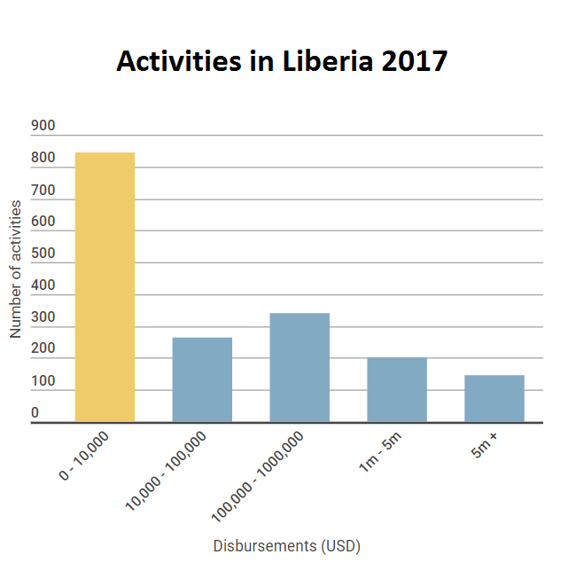
Almost half of all activities (2017) in Liberia have a spend less than $10k.

Slide 11
There are 36 publishers sharing these activities.
Almost half of all activities (2017) in Liberia have a spend less than $10k.

Slide 12
There are valid reasons for this. I’m not saying delete this data...
...But is it helpful to show the user everything at once in a flat structure?
Who | Activity ID | ($) | Explanation
DFID | GB-1-113608 | 0 | “Parent” activity. Perfectly valid.
Action Aid UK | GB-CHC-27446721-XUK0D13007 | 4,813 | No contextual data.
United States | US-GOV-10-LR-305793E6 | 1,007 | No contextual data.
USAID | US-GOV-1-0004A5988A | 863 | No contextual data.
InterAction | US-EIN-13-3287064NAM-MSH-LR-13-5726 | 0 | No contextual data.
DEVCO | XI-IATI-EC_DEVCO-2015%2F362-419 | 3,533 | Consultant fees. “Child” activity.
UN Pooled Funds | XI-IATI-UNPF-00088059 | 0 | No contextual data.
WHO | XM-DAC-928-LR-2016-17-06.004.AF01.LBR02 | 606 | Insufficient contextual data.

Slide 13
What if we let users filter out / toggle activities less than $10k?
...This will make results more usable but will it make them less useful? What other methods could we use as well / instead?
Recipient Country 2017 | Total # of activities | # activities under $10k | % reduction
Afghanistan | 2900 | 1148 | 40%
Haiti | 2436 | 1080 | 44%
Ethiopia | 4700 | 1697 | 36%
Liberia | 1798 | 845 | 47%
Cambodia | 1929 | 671 | 35%

Slide 14
Some reflections…
Lots of useful information is available. Even if this data is not as granular as we’d like; titles, descriptions and documents can provide a good ‘starting point’ for understanding who is doing what.
However, it’s being drowned out. It just isn’t helpful to receive hundreds or thousands of returns, with no easy way of narrowing your search further.
Data users = people: Would you spend five hours looking through activities to determine which ones are useful?
Data quality isn’t the only barrier: As data quality improves, our methods of access must be explored with a more critical lens.

Slide 15
2. Case Study: A Publisher’s Perspective on Publishing IATI Activities - Challenges in using accounting data as a source for IATI

Slide 16
Accounting Data as a Foundation for IATI
MCC is required to use its accounting data for the basis of its IATI reporting. We append programmatic data to this foundation.
Consistent financial reporting is critical so that no matter where a user accesses information about our activities, the financial data is consistent
Our process ensures consistent financial reporting but accounting data can be “messy.”
Visualizations could be a pragmatic solution to allow users to surface “true” activities more quickly while allowing the publisher to publish comprehensive financial data

Slide 17
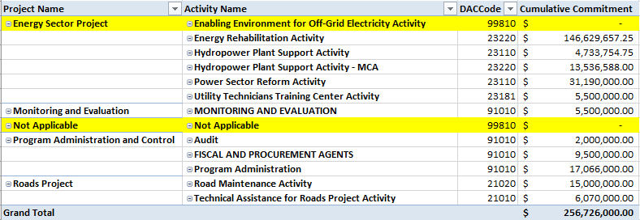
Liberia Compact Example

Slide 18
What context do we provide for these activities?
Coded as Sector Not Specified
Activity has a status of “cancelled” and a cancelled date
Activity descriptions:
This activity was used in the past for accounting purposes but it is not currently an active activity for the program. It has no funds either committed or disbursed against it and has a sector code of 99810 (sector not specified).
Pending subsequent report: Non-allocated funds requested by the MCA which have yet to be reallocated to a project/activity by the MCA on their financial reports.
This additional context wasn’t enough to provide PWYF the ability to easily filter out these activities in their research.

Slide 19
Discussion Topics
For End Users: We have an assumption that the number of activities in IATI make it challenging to use IATI data. Have you encountered this issue?
For Publishers: Do other publishers have similar issues publishing data? If so, how do they address them in their data?
Are filters a viable option? Brainstorm potential data filters to pull these out, such as sector, $ value, etc. How can we test these ideas? What are the potential problems we could face?
Who would be interested in forming a “working group” to explore these and deliver concrete recommendations on these ideas?

