Slide 1
Performance Web
The Global Fund’s New Online Grant Portfolio

Slide 2
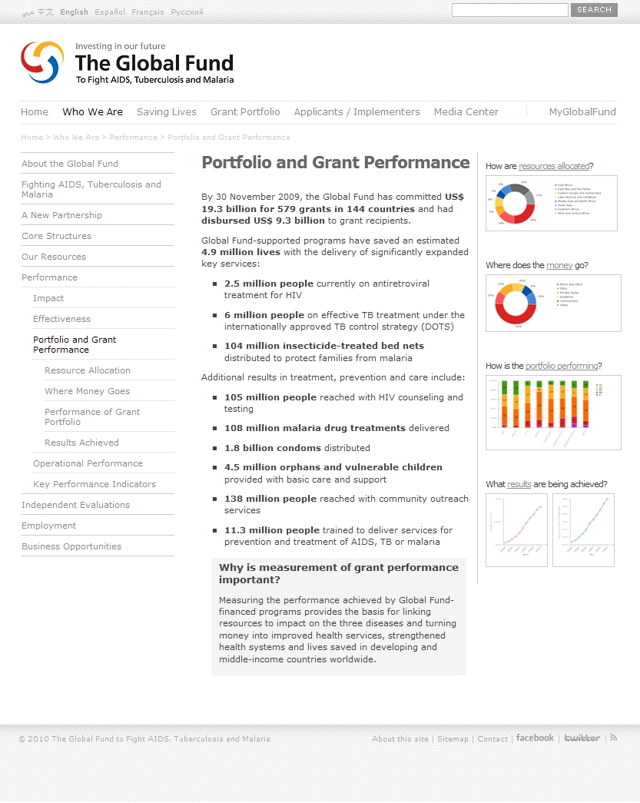
Performance Web
Phase I – Information
http://www.theglobalfund.org/en/performance/
Sets the context of performance-based funding and provides detailed information on the model
Provide detailed information on Global Fund and Grant Portfolio Performance
Access to critical descriptive text and performance data by partners and implementers worldwide
Make Monitoring and Evaluation tools, guidelines and assessments more accessible
Launched September 2009

Slide 3
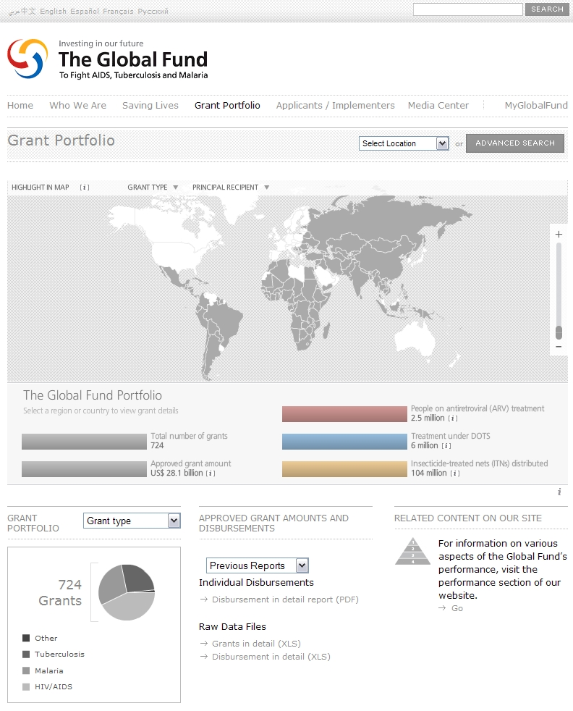
Performance Web
Phase II – Grant Portfolio
http://portfolio.theglobalfund.org
Key Objectives:
Radically increase transparency and accountability of Global Fund financing and achievements
Communicate global results and breakdowns by regions, countries and grants
Provide direct access to comprehensive and up-to-date information of the latest programmatic, financial and performance data
Direct stakeholders to key performance information on grants

Slide 4
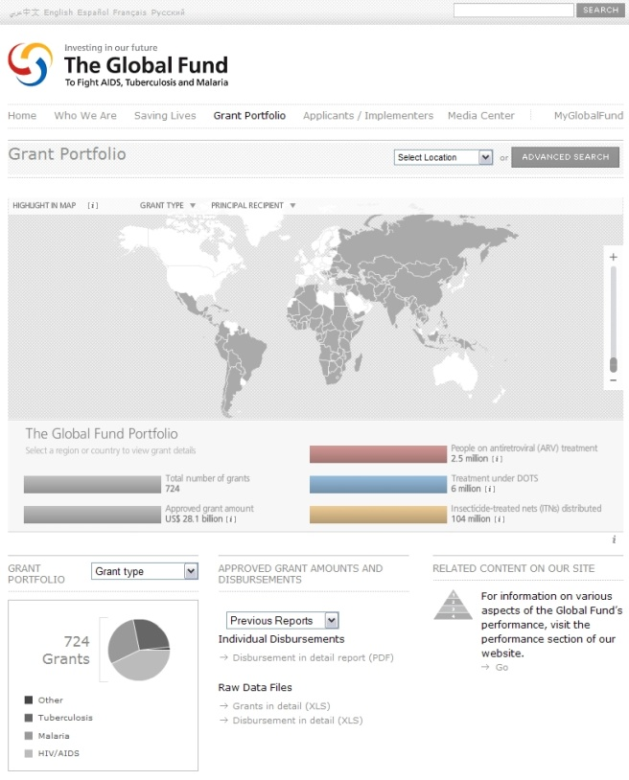
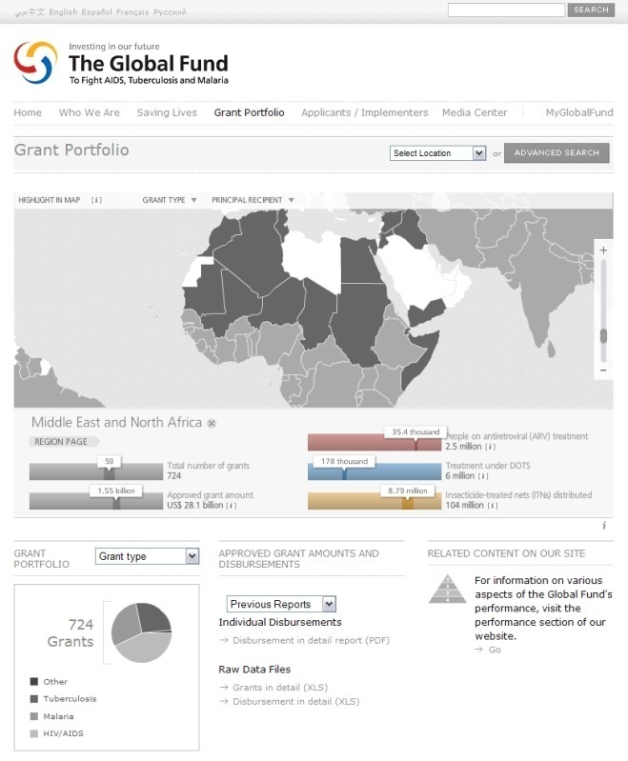
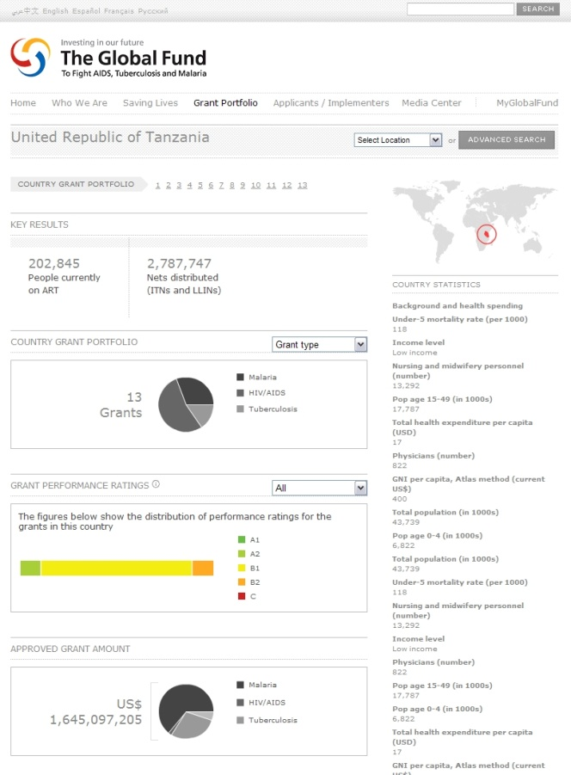
New
Grant Portfolio
Re-engineered content, structure and functionalities of the Grant Portfolio
Upgraded Country and Grant pages
New Regional pages
Extensive (visual) data on all individual Grants and their Performance
Advanced Search and Reporting functionalities

Slide 5
Afghanistan
Overview of grants
Grant type, title and grant number
Name of principal recipient of funding
Signed grant agreement amount
Status of implementation
Performance rating (based on Global Fund methodology)

Slide 6
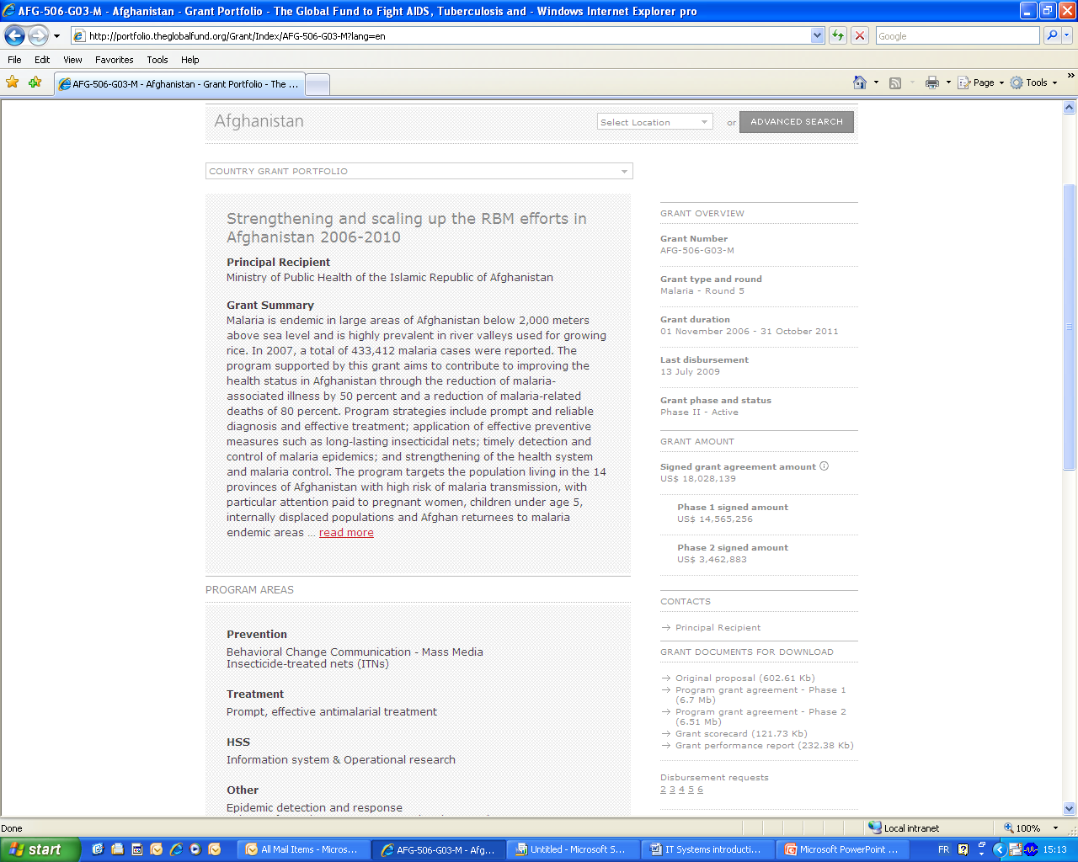
Afghanistan
Grant details
Grant summary and programme areas
Financial details, grant dates, status, last disbursement
Contact details with names, address, phone number, email
Grant documents
Grant performance and financial overview
Link to performance indicators and results

Slide 7
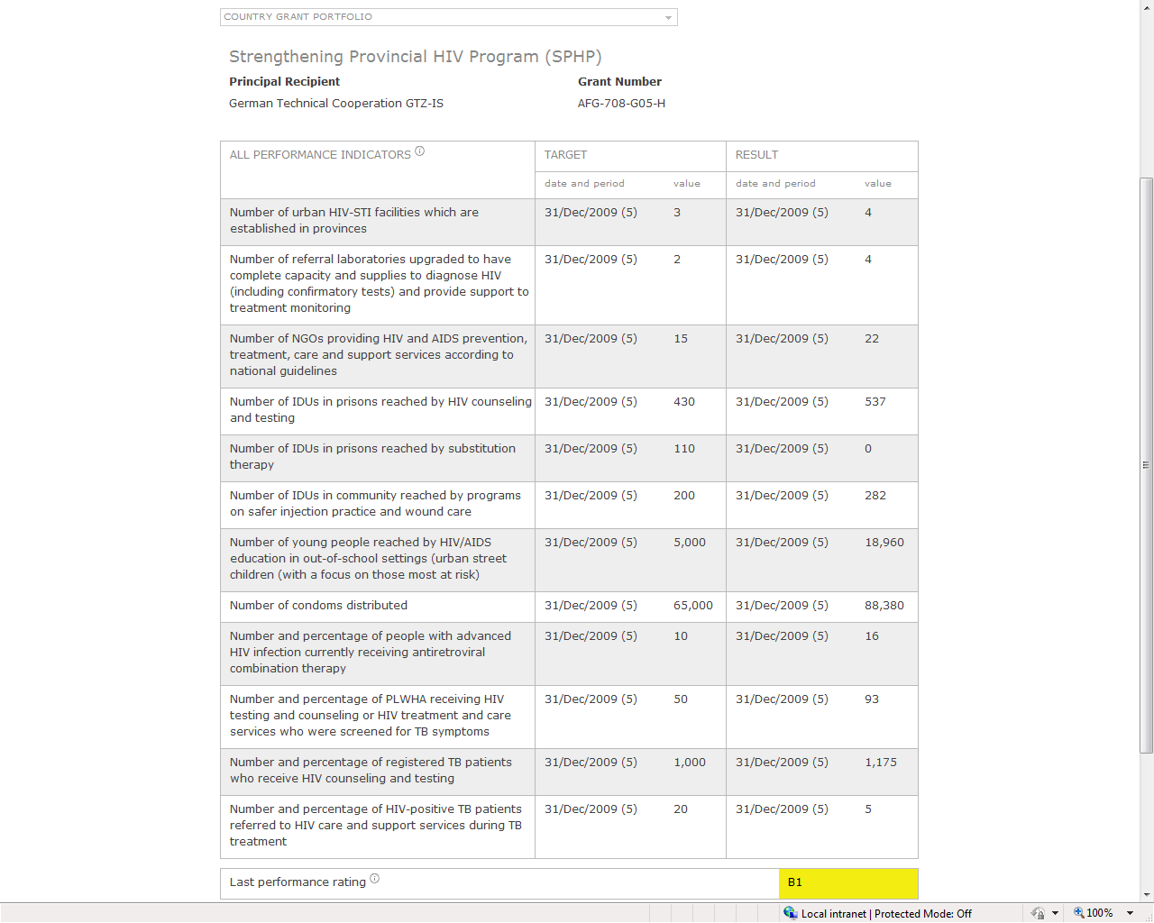
Afghanistan
Results
Performance indicators
Targets with dates and values
Results with dates and values
Aggregate performance rating

Slide 8
Regional aid effectiveness
Paris Declaration principle | Global Fund Aid Effectiveness Scorecard | 2008 result (n=8) | 2008 portfolio results (n=102) | 2010 target | Progress in relation to 2010 target
Ownership & alignment | Aid recorded in national budgets* | 48% | 32% | 85% | lagging behind
 | Grants aligned with country cycles | 85% | 76% | 90% | target nearly met
 | Aid using public financial management systems* | 78% | 46% | 59% | target met
 | Aid using national procurement systems* | 92% | 89% | 55% | target met
 | Countries with parallel implementation units* | 0% | 0% | < 5% | target met
Aid is predictable & untied | Ratio of actual versus expected disbursements | 107% | 102% | 95% | target met
 | Aid recorded as scheduled* | 46% | 28% | 60% | on-track
 | Untied aid | 100% | 100% | 100% | target met
Harmonization with partners | Aid provided in support for program-based approaches | 84% | 70% | 66% | target met
 | Joint missions with other donors | 11% | 14% | 40% | off-track
 | Joint analytic reports with other donors | 45% | 30% | 50% | on-track
Managing for results and accountability | Grants with transparent & monitorable performance frameworks | 100% | 100% | 100% | target met
 | Grants aligned to national monitoring & evaluation systems | 80% | 75% | 90% | on-track
Aid effectiveness
Collected annually
Aggregated to regional level
Used for:
results reporting,
corporate performance evaluation
grant performance assessment

Slide 9
Coming up in 2010
Enhanced customization features
Multiple printer-friendly export formats for programmatic and financial data (PDF, Excel)
Individual data components for use on partners’ sites (e.g. IATI)
Updates & information from partners

