Slide 1
DAD-Rwanda, IATI INTEGRATION
Copenhagen , Denmark
IATI Steering Committee
October, 2014
Marie-Ange INGABIRE
External Finance Unit (EFU)
Ministry of Finance and Economic Planning
RWANDA

Slide 2
Main Topics
IATI data to reduce AIMS challenges at the country level
Data Import Service
IATI Projects Mapping and Merging with DAD Projects
DAD-Rwanda, IATI Integration challenges

Slide 3
IATI data to reduce data challenges at the country level
Infrequent updating of data by DPs -> IATI data will reduce the burden on the side of DPs to report in the DAD and motivate them to report regularly by validating data already available from IATI.
Request is for quarterly reporting but in reality data is provided annually as a preparation for the DPAF and ODA reports
Having forward-looking data is critical for budgeting and macro-economic projections-> if IATI publishers provide the planned commitments and disbursements for years n+1, n+2, and n+3 on a rolling basis, this will represent a huge improvement in the data availability.

Slide 4
IATI data to reduce data challenges at the country level
Not all DPs report through DAD (i.e. emerging donors and non-resident donors) -> Encouraging emerging donors to publish on the IATI standard will make their data available for usage at country level.
The NGO module was implemented in the DAD and the GoR is looking at getting data from NGOs) -> some International NGOs that are operating in Rwanda are already IATI publishers.

Slide 5
IATI Data Import Service
The Ministry of Finance and Economic Planning of the Government of Rwanda and Synergy International Systems have signed a Contract to implement data import service for automatic data transfer from IATI Repository to DAD Rwanda. The work is ongoing and will be completed in December this year.
Key Features:
Through the Data Import service, these systems interoperate to provide a better view of the data.
The Data Import service ensures integrity and consistency of the project related data.
It provides means for triggering the data transmission process once the data is entered in the IATI Repository, thus allowing the data to be imported into the DAD Rwanda database for data comparison and analysis.

Slide 6
Mapping and Merging IATI Projects with DAD Projects
The Data Import service is empowered by an effective transferring mechanism that verified the merging of selected projects from IATI Repository with DAD Rwanda Projects in a way that data integrity and consistency are preserved.
The data merging process is executed in the following steps:
Step 1: Identifying and Linking Projects to be transferred
Step 2: Verifying Projects
Step 3: Mapping Project Fields
Step 4: Validating Projects

Slide 7
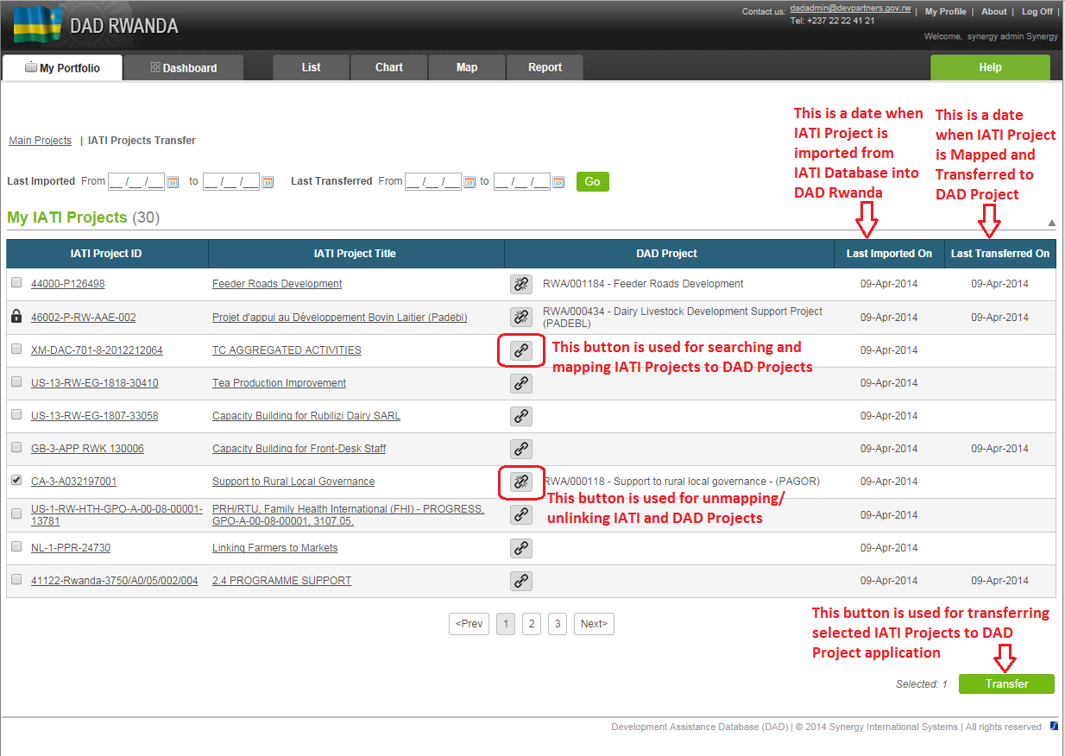
My Portfolio – IATI Projects Transfer Screen

Slide 8
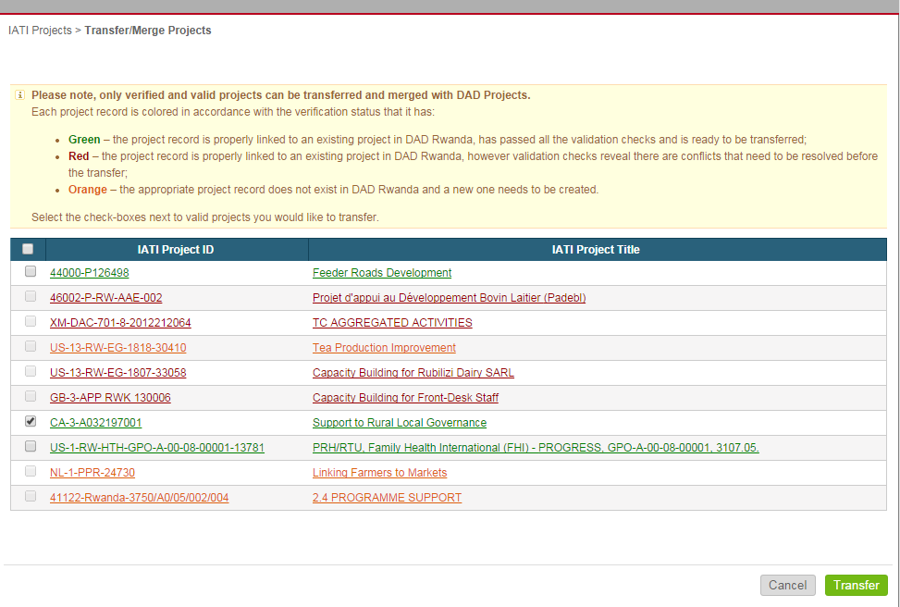
Verifying IATI Projects Subject to Transfer

Slide 9
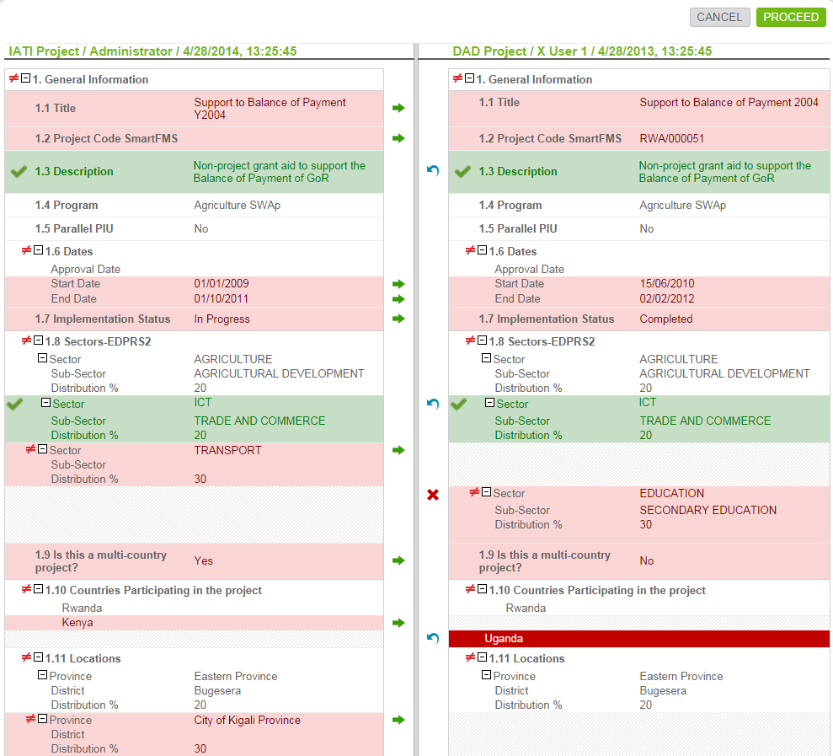
Comparing and Merging IATI and DAD Projects
Buttons:
Move data from IATI Project to DAD one
Remove data from
DAD Project
Revert / undo applied action (move or remove)
Colors:
Data that differ in two Projects
Data moved from IATI Project to DAD one
Data removed from
DAD Project

Slide 10
IATI Standard Conversion to DAD Project Constraints
Quality and frequency of data provided by DPs to IATI must be improved
It is important to have updated commitment and disbursement data for the current year on a quarterly basis so it can be fitted in the GoR’s fiscal year (30 June – 1 July)
Forward-looking information for the next fiscal year and two outer years at the project level and on a rolling basis is indispensable for budgeting and macro-projections
Increasing the number of DPs providing good quality data to IATI in the run up to the 2015 deadline is critical and requires political commitment at the highest levels

Slide 11
Thank you for your kind attention!
Please visit our Development Assistance Database
http://dad.synisys.com/dadrwanda
And our Development Partners Website
www.devpartners.gov.rw

