Slide 1
The Use of IATI Data in Country Systems
Presentation by Bill Anderson (IATI Technical Lead) Copenhagen – 14 October 2014

Slide 2
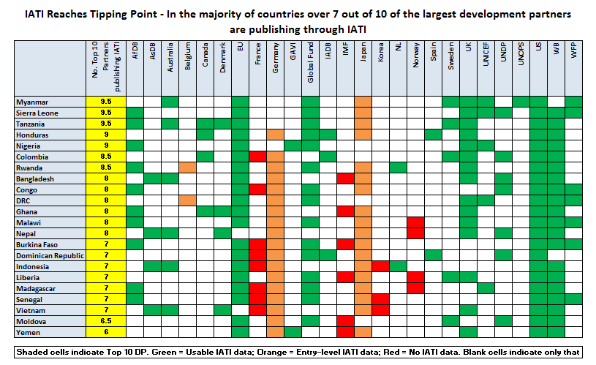

Slide 3
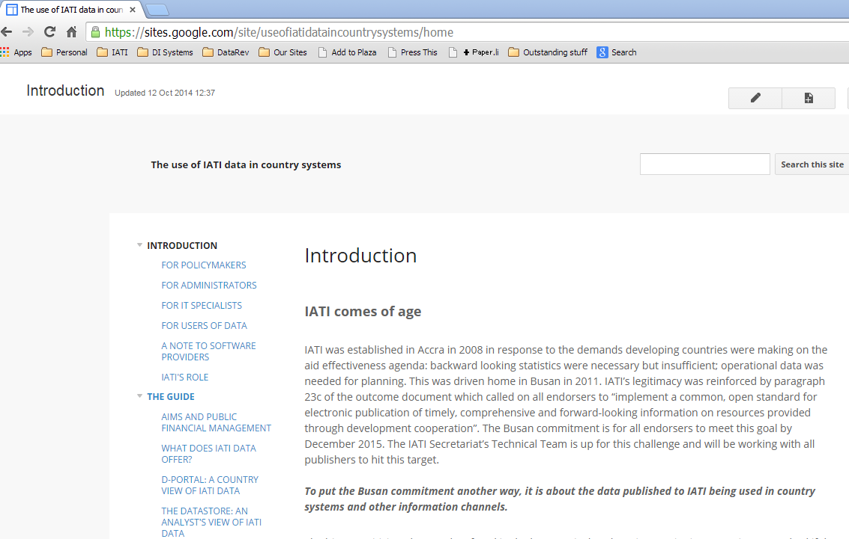
Draft Guidance

Slide 4
Who is the guide for?
Administrators
Policy
makers
Software Providers

Slide 5
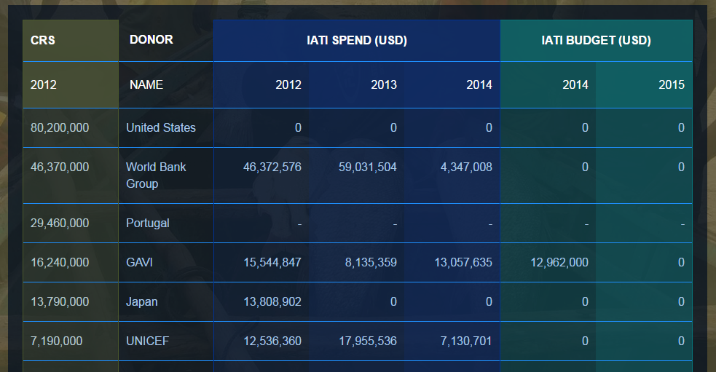
Assessing IATI Data: d-portal

Slide 6
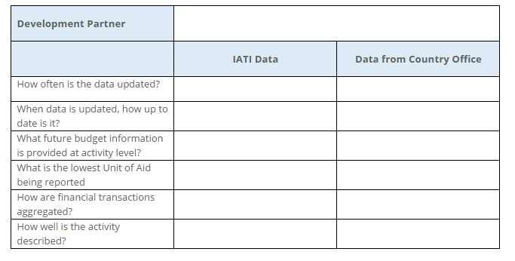
Assessing IATI Data

Slide 7
Configuring Imports
Static Data
Dynamic Data
New Records
Updated Records

Slide 8
Getting started
Alignment of Activities
Merging History and Current

Slide 9
AIMS and Public Financial Management
Integration
Ownership

Slide 10
IATI’s Role
IATI
Customer
Software Provider

