Slide 1
Development Gateway
Solutions that empower

Slide 2
Overview
Program Description and Learning Agenda
Activities Performed
Progress Made
Lessons Learned
Recommendations and Next Steps
IATI-AIMS Import Tool

Slide 3
Program Description
Identify “core” fields of IATI standard that facilitate country use
Assess data quality of major publishers in each country against “core” fields
Consult with partner country aid coordination/management units on selection of publishers for import
Creation of open source IATI-AIMS import tool
Understand prior knowledge and attitudes on IATI of country governments
Import sub-set of publishers identified through steps 1-3
Identify next steps and provide recommendations to IATI community

Slide 4
Phase I (January-June)
Initial identification of “core” fields for country use of IATI
Data quality assessment of largest publishers for each country
Requirements gathering and development of open source IATI-AIMS Import tool
Planning with country governments for timing and substance of Phase II trips
Publication of Working Paper 1

Slide 5
Phase II (July-December)
Country trips to upgrade AMP to latest version, including integration of IATI-AIMS Import Tool
Discussion of data quality assessment and selection of publishers for import
Identification of import and validation process
Training on use of new IATI-AIMS tool
Pre- and post-surveys, interviews on prior knowledge and attitude toward IATI
Creation of Steering Committee discussion paper, revision of Working Paper 1

Slide 6
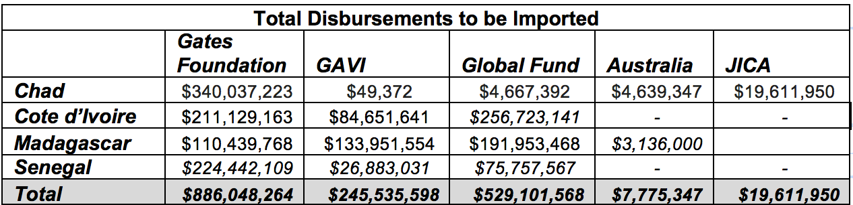
Funding Imports to AMP

Slide 7
Challenges Encountered
Development and integration of IATI-AIMS Import Tool took longer than expected
  Creation of a more robust tool than initially anticipated
Challenges in training for accessing/assessing IATI data quality (XML, CSV, existing IATI tools)
Concerns over data provenance, processes, rules for publication/exclusion reduced comfort level for import

Slide 8
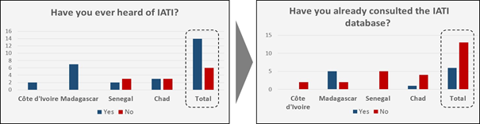
Prior IATI Knowledge and Use

Slide 9
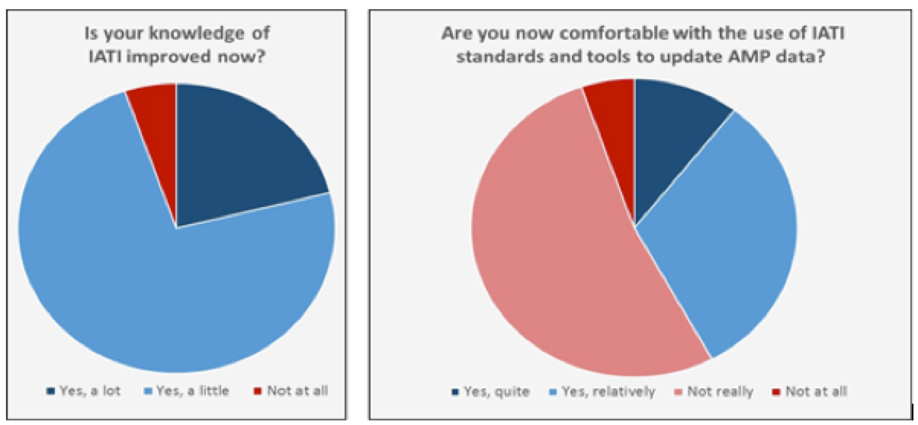
Post-Assessment of IATI Comfort Levels

Slide 10
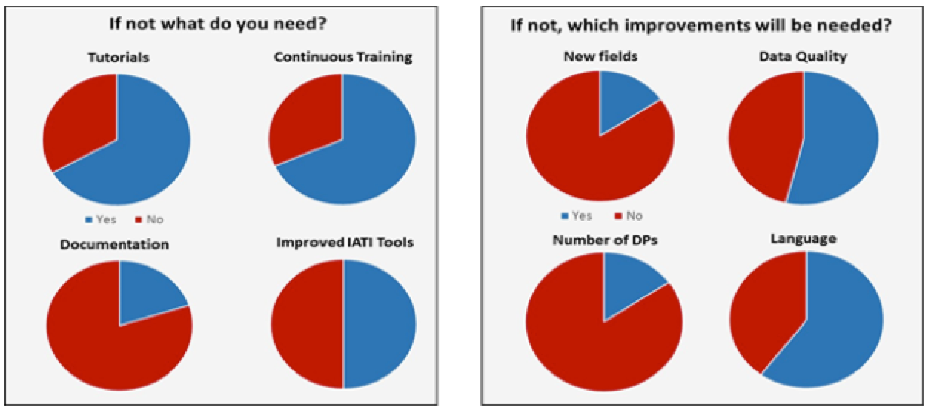
Stated Needs (skills, tools, data quality)

Slide 11
Recommendations to IATI Community
Publication of data in official language of partner country/use of version 2.01 for numerical code lists
Quarterly publication, at minimum, to match country processes, fiscal years, and data needs
Strengthened tools for exploring, filtering, and exporting IATI data (improved stability, additional filters, xls export)
Publisher narratives explaining data collection process, inclusion/exclusion rules, frequency, QA methods used, and aggregation that make HQ data different from country office

Slide 12
Recommendations to IATI Community
Increased engagement between HQ and country offices to raise awareness of IATI processes and data
Creation of documentation/how-to guides for key issues country governments face
  e.g. Determining on/off/through budget status of activity using delivery channel and aid type fields
Augment IATI standard upgrade process to deepen engagement with partner countries outside of TAG, message board, and steering committee fora

Slide 13
Next Steps for DG
Work with country governments on data management plans to ensure sustainable incorporation of IATI data
Disseminate (in English and French) user guide for IATI-AIMS Import Tool
Update Working Paper 1 and publish Working Paper 2
Increase number of countries with access to and training on IATI-AIMS Import Tool, IATI data, and data quality assessment techniques

Slide 14
IATI-AIMS Import Tool Steps
Select Processor (1.03, 1.04, 1.05, 2.01 supported)
Upload File
Filter Data
Select activities for import
Map fields to AMP destination fields
Map values to AMP destination values
Review and import
Save mapping template for future use

Slide 15
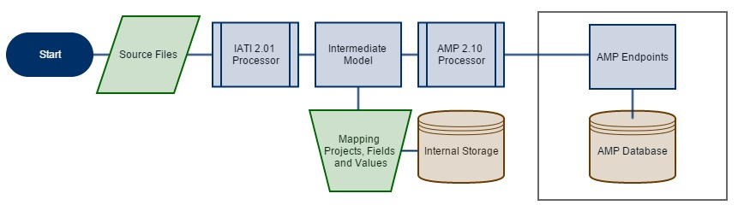
Import Tool Data Transformation Process

Slide 16
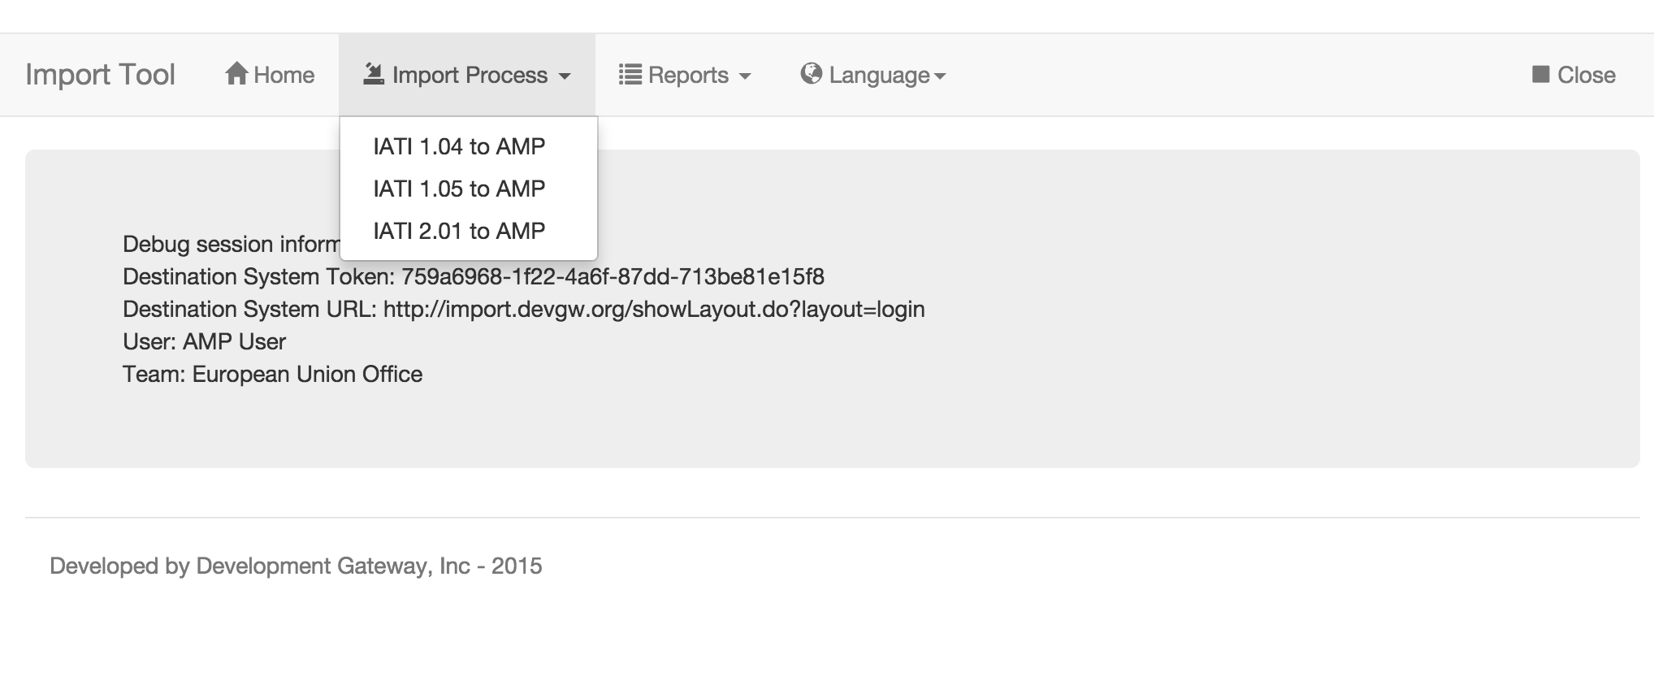
1: Select IATI Version

Slide 17
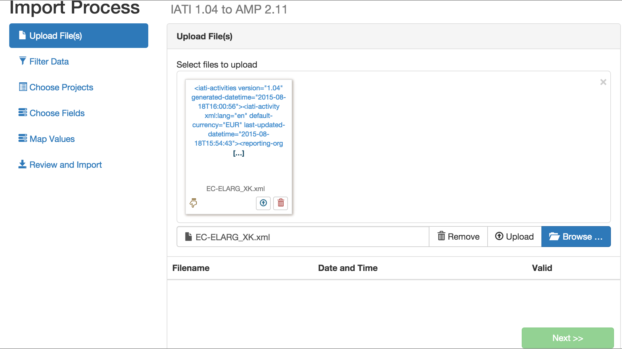
2: Select File for Import

Slide 18
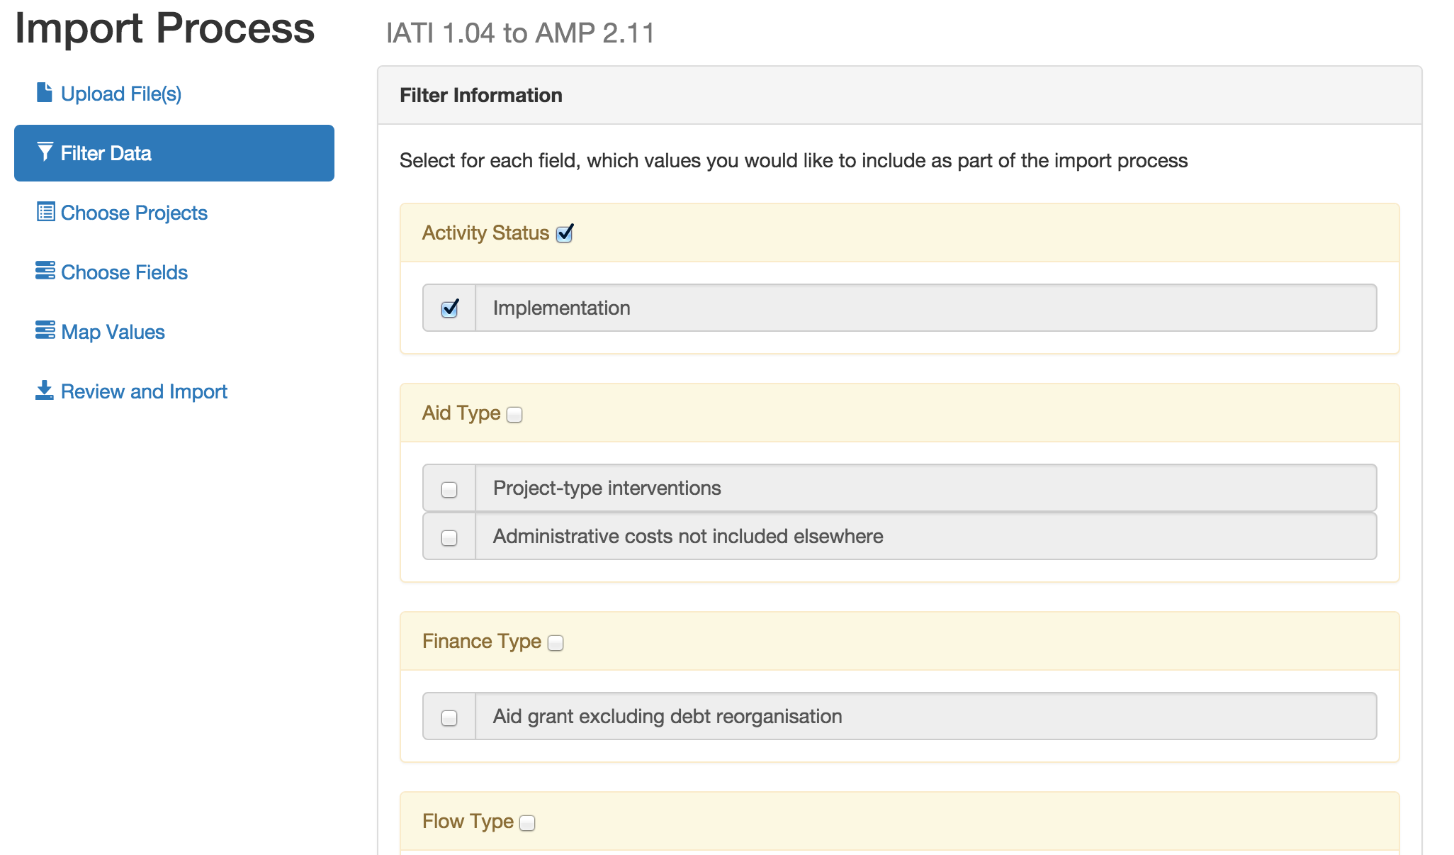
3: Filter to Desired Activities

Slide 19
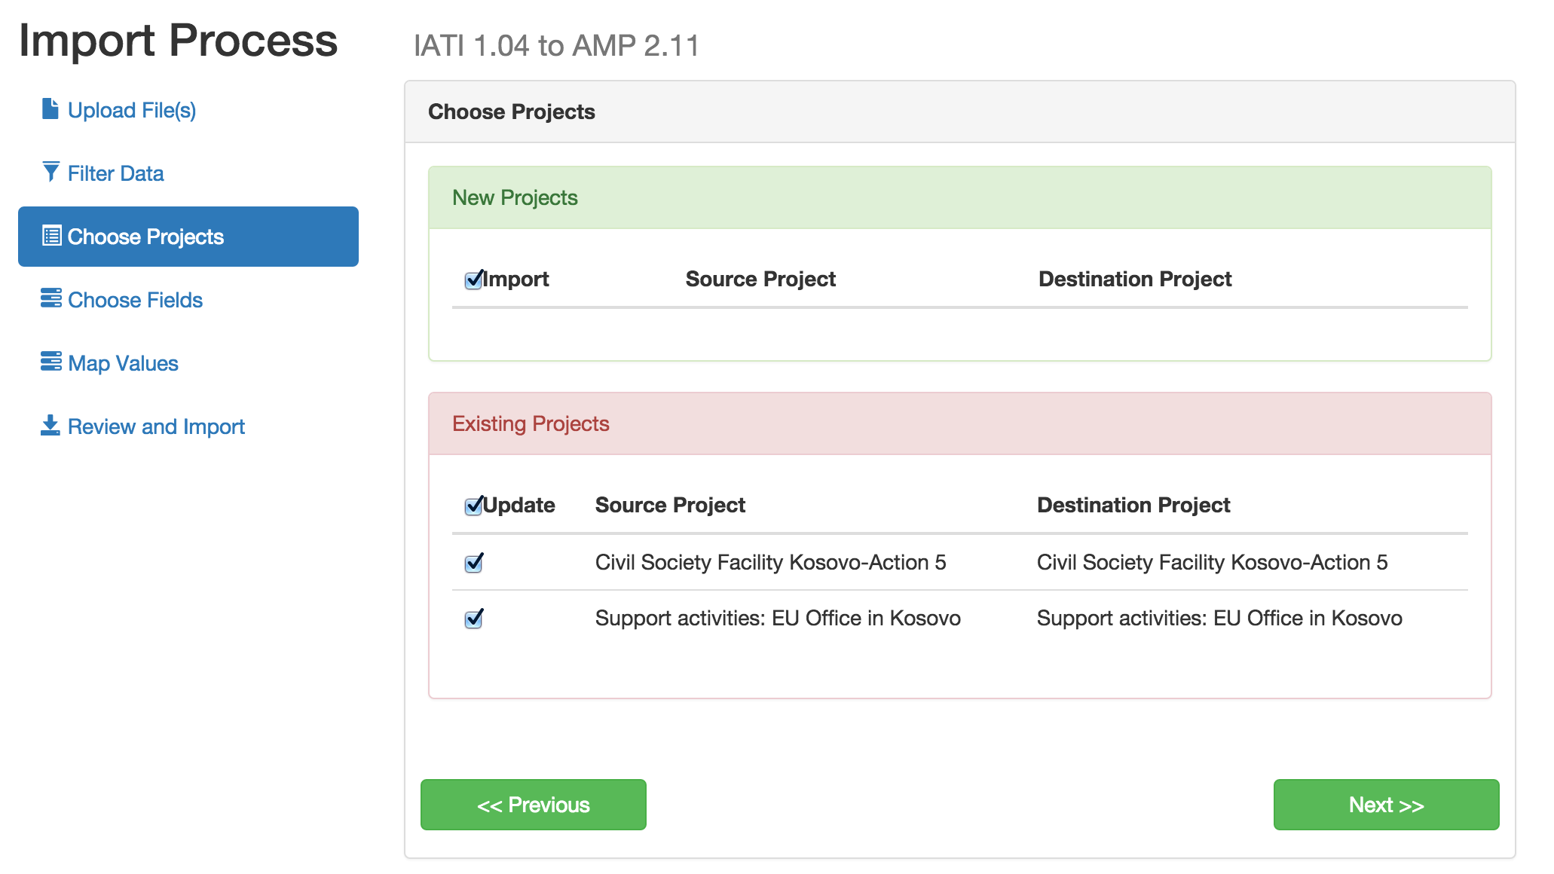
4: Existing Project IDs Auto-Match, Otherwise Search for Matches/ Import New

Slide 20
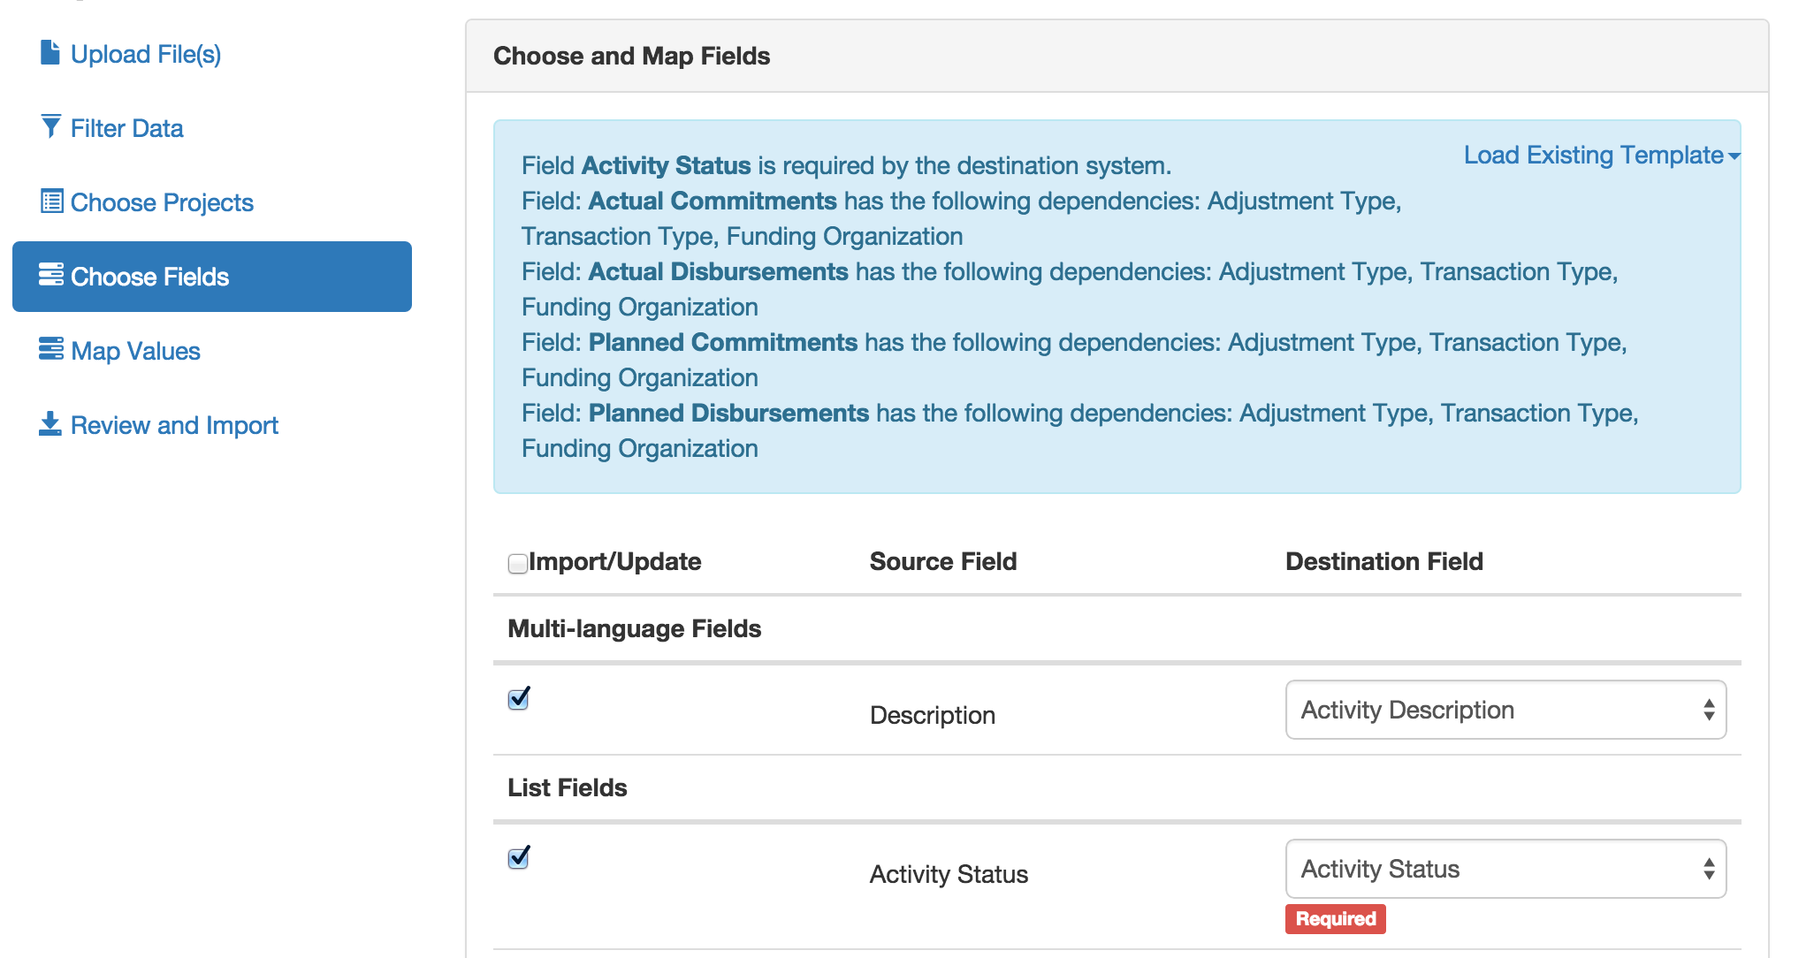
5: Map Fields from IATI-AMP (or load existing template)

Slide 21
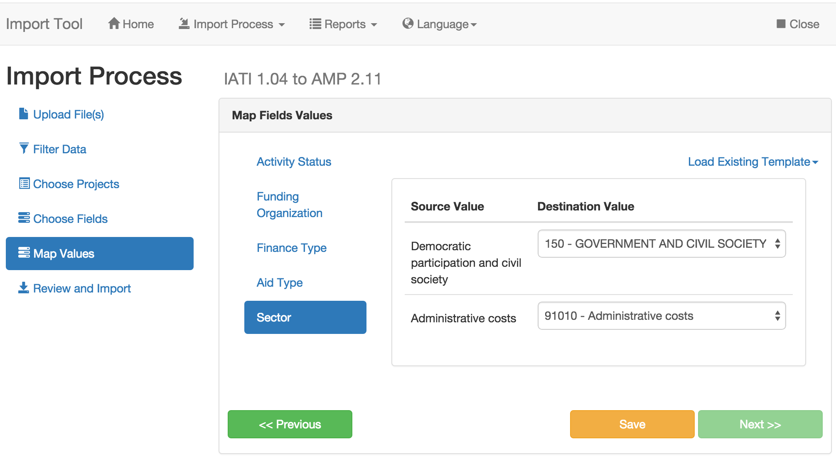
6: Map Values from IATI-AMP (or load existing template)

Slide 22
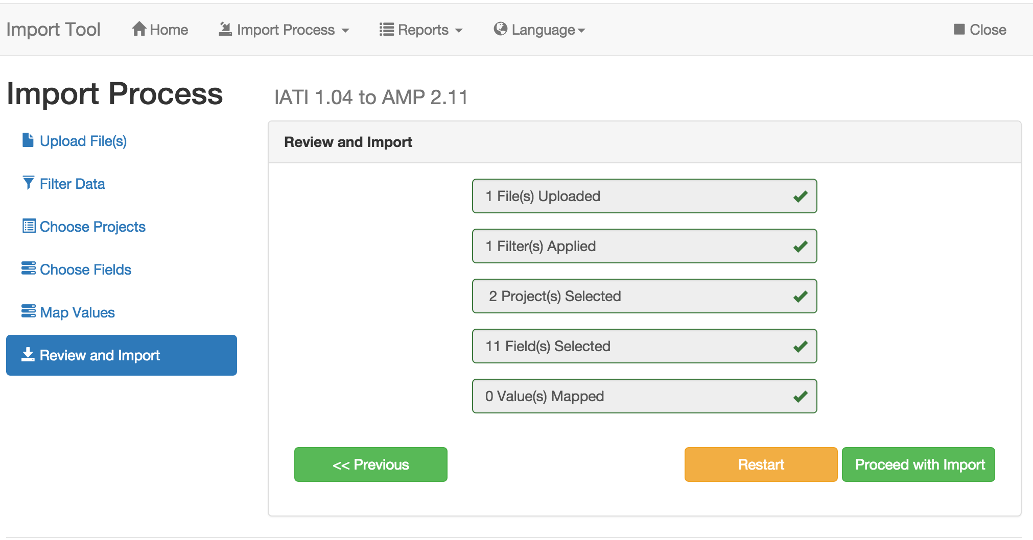
7: Review and Approve Import

Slide 23
Questions & Open Discussion

