Slide 1
IATI Licensing Working Group
Open Data Recommendations: Licensing

Slide 2
IATI Information Model
Data Collection -- carried out by member organizations according to their own procedures
Technical work – preparing information for publication in formats recommended by the IATI technical standard
Publication on own site – Organization and presentation of aid information with access tools on a public website, using licensing terms and best practices recommended in the IATI Licensing Standard.
Aggregation into the IATI registry – the IATI site will collect metadata and links to the information published on individual IATI member
Notes:
The IATI licensing standard is concerned with the last 2 points

Slide 3
Why is a license needed
Intellectual property law varies from one jurisdiction to another
To serve all users from an international data set, a common license framework is needed
Without a license, users can never be sure of their rights to the information
At present, aid organizations use different licensing terms, which may not allow data to be mixed and reused
Saves time, expense, and reduces uncertainty

Slide 4
What are Open Data?
Open data are any form of knowledge provided under the following conditions*
Access is free or at minimum cost
Data may be redistributed for free or for sale
Data may be reused and derivative works redistributed
Without technological restrictions – open format
No discrimination – against persons or fields of endeavor
But the license may specify
Attribution required for use or reuse
Limitation of liabilities and disclaimer of warranties
“No endorsement” language
*This is an abbreviated summary of the “Open Knowledge Definition” (http://www.opendefinition.org/okd/)

Slide 5
Types of Open Licenses
Public domain
Allow for the widest possible use and reuse of the information.
Creates information that is cross-compatible (from a licensing perspective) with any other content.
Follows the approach of governments such as the US, which does not generally assert IP rights over government-produced works.
Attribution required
Require some sort of credit or statement of source or contributors
But no other restrictions on reuse
Similar to approach adopted by World Bank for its Open Data Initiative

Slide 6
Examples of conforming licenses
Public domain licenses
Open Data Commons Public Domain Dedication and License (PDDL) http://www.opendatacommons.org/licenses/pddl/
Creative Commons CC0 tool
http://creativecommons.org/choose/zero/
Public Domain certification http://creativecommons.org/publicdomain/
Attribution licenses
Open Data Commons Attribution License (ODC-BY) http://www.opendatacommons.org/licenses/by/
Creative Commons Attribution License (CC-BY) http://creativecommons.org/licenses/by/3.0/

Slide 7
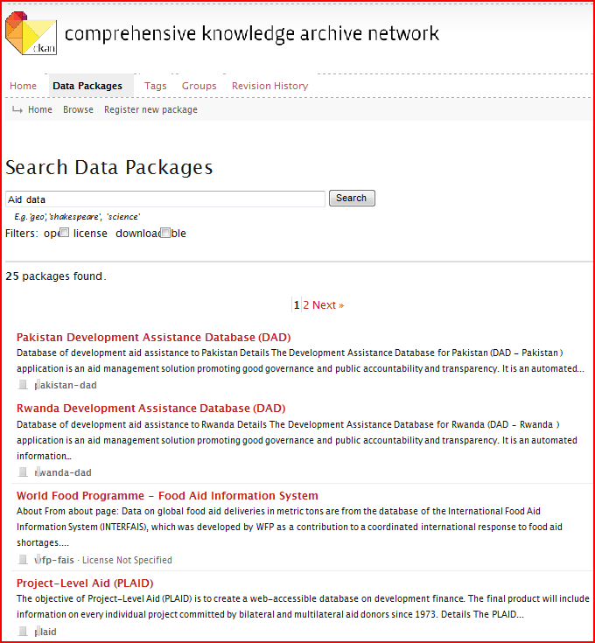
Example of a data registry (CKAN)

Slide 8
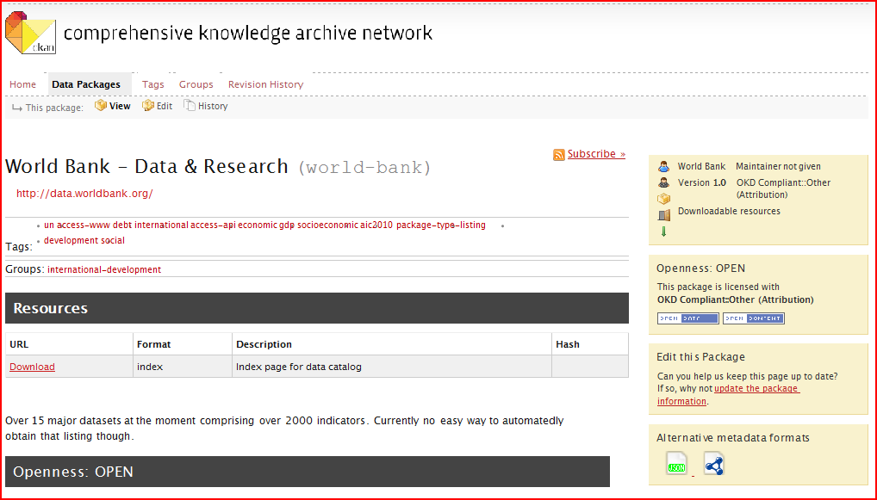
Data registry entry

Slide 9
Recommendations
Create an IATI Licensing Standard
The IATI Licensing Standard should be limited to open licenses as defined under the Open Knowledge Definition
The IATI Licensing Standard should further limit compliant open licenses to public domain dedications and attribution only
Create a model implementation of the new IATI Licensing Standard making use of existing open licenses
Provide an IP policy for the IATI registry
Create a set of resources to educate and help users about licensing

