Slide 1

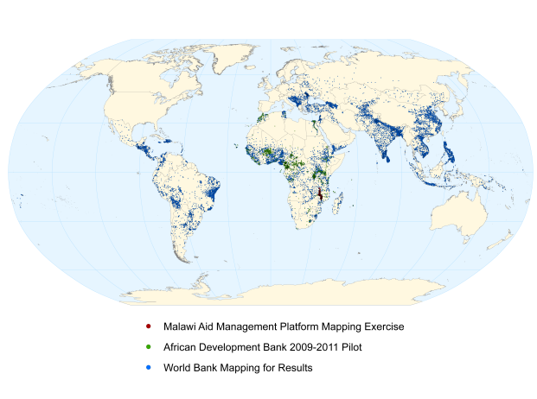

Solutions that Empower
Stephen Davenport & Joshua Powell

Slide 2
Overview
About Development Gateway
Geocoding Toolkit and Methodology
In-Country Geocoding Applications
  Malawi: Multi-donor mapping
  Liberia: Tools for country capacity and sustainability
Turning Aid Information into Impact: Disaster Aid Tracking
Next Steps
Notes:
This presentation is to provide AMP PMs with the tools that they need to effectively present geocoding and initiate the proposal process. It discusses the background of DG’s geocoding program, the IATI-endorsed methodology, ongoing AMP geocoding projects, possible project implementation methods, pricing considerations, existing (and future) visualizations, and next steps for DG in geocoding.

Slide 3
About Development Gateway
International non-profit organization with offices in Washington, DC and Brussels
Created in 2001 by the World Bank
Work made possible by grants and project funding from Australia, Belgium, EU, Germany, Japan, World Bank, UNDP, and others
Our mission is to enable change and reduce poverty in developing countries through the use of information technology. We provide web-based tools to strengthen governance and make aid and development efforts more effective.
Development Gateway works in the areas of
  Governance
  Knowledge and Networking
  Transparency and Accountability

Slide 4

Notes:
This map reflects all of the projects that DG has geocoded to date (that are publicly available). In September, this map will include all WB projects in Latin America, Eastern Europe, North Africa and the Middle East, and the remaining Asian and African countries.

Slide 5
Methodology, IATI, and OAP
Adapted and improved to incorporate lessons learned through work on WB Mapping for Results and AfDB coding
Creates a geographic hierarchy for each location
  Allows for aggregation, filtering by administrative division
  Allows users to filter to only site-level locations
Accepted as the IATI standard for sub-national geocoding
  Allows systems to communicate, sharing common standards
Methodology for the Open Aid Partnership (OAP)
Notes:
The methodology was adapted from the Uppsala Universitet Conflict Data Program (UCDP) methodology for geocoding conflict events. AidData has worked with UCDP and WBI to fine-tune the methodology for aid projects, develop methods for searching documents, and improve the geographic information accompanying each point location (i.e. standardized administrative hierarchy)
DG submitted the UCDP/AidData geocoding methodology to the IATI Secretariat, who have accepted it as the IATI standard for geocoding.

Slide 6
Geocoding Toolkit
Toolkit developed with WBI to improve geocoding process
Reduces demands for “manual” geographic data input
Validation tools assure highest data quality
Exportable to multiple formats
Notes:
The OpenAid Toolkit is being developed with funding from WBI to allow our coders to more effeciently and accurately geocode projects. It will also be available for use by other organizations, requiring the creation of new workspaces and data templates (to accommodate different project database fields)
An offline mode is being developed for countries with poor bandwidth to enhance the speed of the geocoding process (by uploading a gazetteer with place names and coordinates and a shapefile with administrative boundaries)
Swiftriver products (Sweeper, Geodict) are being investigated to speed up the document-searching process

Slide 7
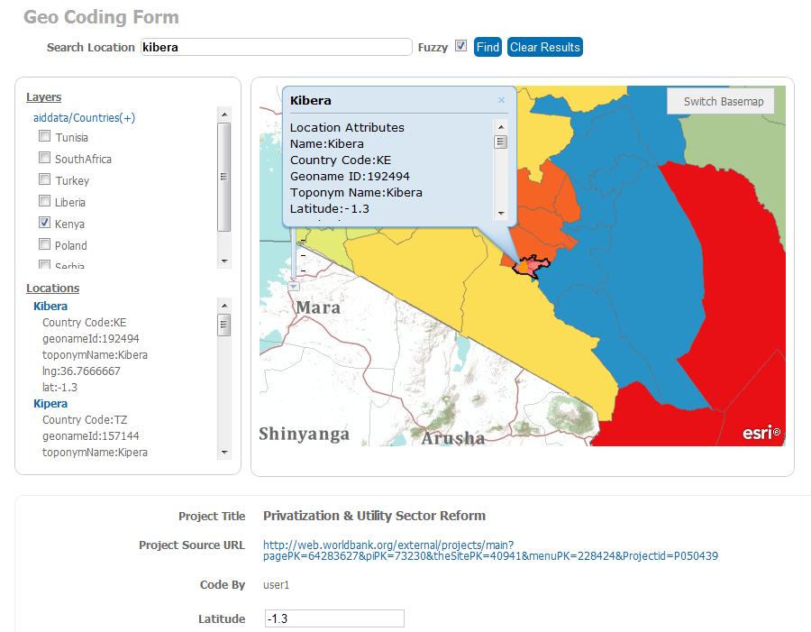
Notes:
This screenshot of the toolkit shows the selection of boundary files for different countries (top left), the search results for Kibera (left), the map – including the administrative boundaries (center), and the project information (bottom)

Slide 8
Country Impact: Malawi
Geocoding all projects in Malawi Aid Management Platform
  750+ projects from 30+ donors with nearly US$7 billion in total funding
  Geocoded $5.3 billion in commitments and $3.7 billion in disbursements from nearly 550 projects
Integrating geocoded data into AMP for sustainable workflow and improved division of labor
Work presented by Malawi MoF at High Level Forum in Busan
Replicable and sustainable process for other AMP countries

Slide 9
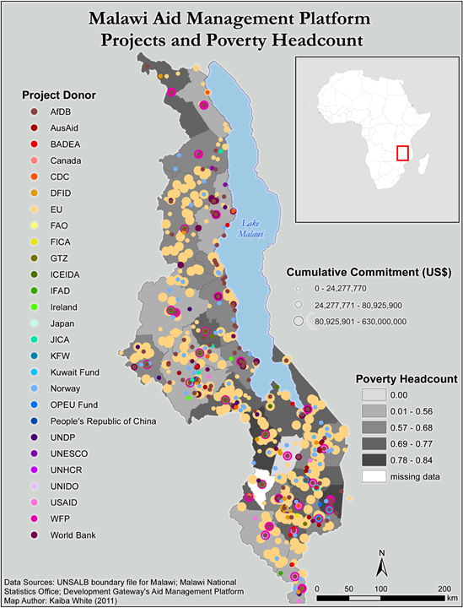

Slide 10
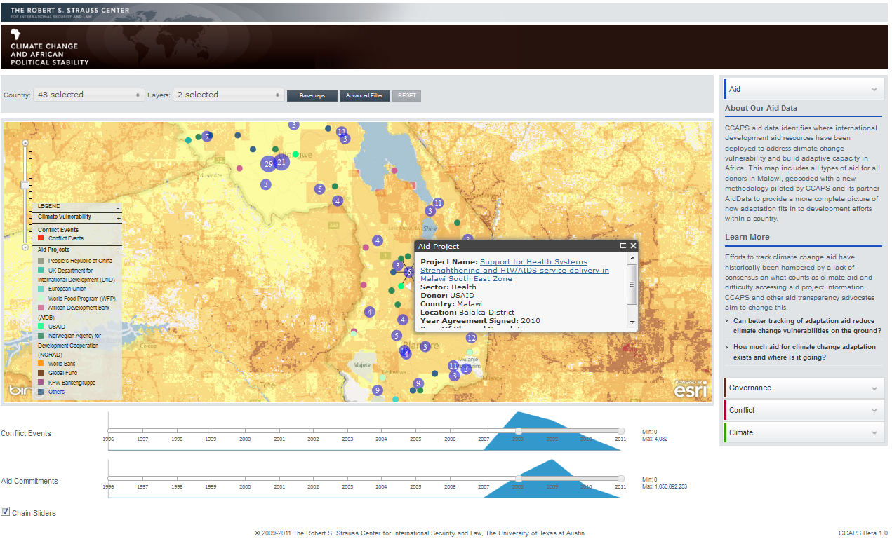
Malawi: CCAPS Dashboard

Slide 11
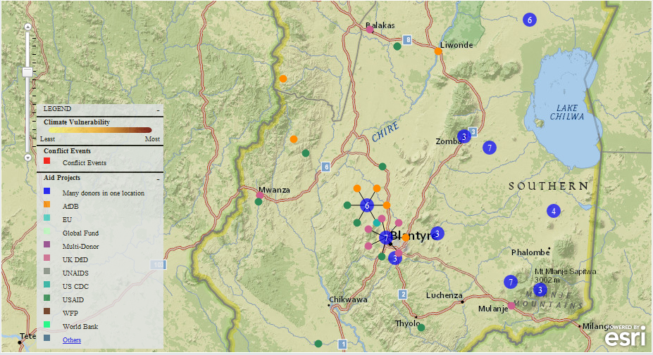
Malawi: Donor Coordination

Slide 12
Country Impact: Liberia AMP
Liberia Aid Management Platform GIS module
  Integrated with the AMP workflow
  Instant GIS mapping
  Identify and search for local activities
  Improve division of labor
  Report generation and planning
  Streamlined visuals
  USAID funded
Module is part of regular AMP implementations going forward
Notes:
There are two ongoing AMP geocoding initiatives, which will serve as the basis for defining the workflow, pricing, and implementation methodology for future projects.
In Liberia, a GIS portal is under development that will allow users to add locations in AMP and immediately have the results reflected on the map. Additional features for filtering and searching exist as well (discussed in more detail in the visualizations section)
In Malawi, a pilot project is working to geocode all 700+ projects from 29 donors in the Malawi AMP. A brief paper will be drafted in September outlining the challenges, costs, and advantages of performing the geocoding in Washington, DC

Slide 13
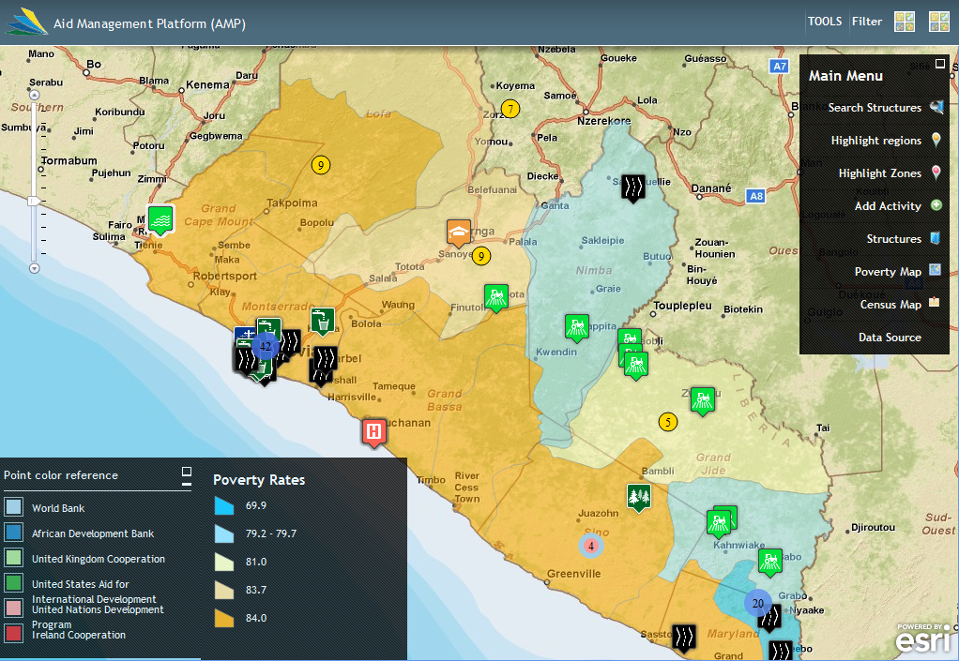
Notes:
This is a screenshot of the AMP Liberia GIS module, showing both regional funding (colored circles) and physical structures (icons) overlaid on a poverty base map

Slide 14
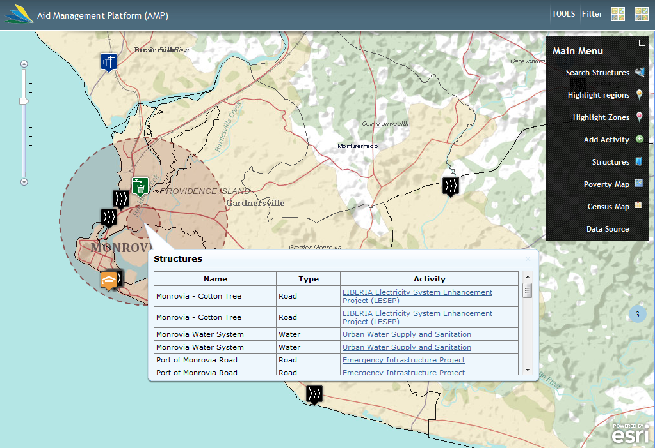
Notes:
This base map shows structures and regional funding from multiple donors overlaid on a population density base map.

Slide 15
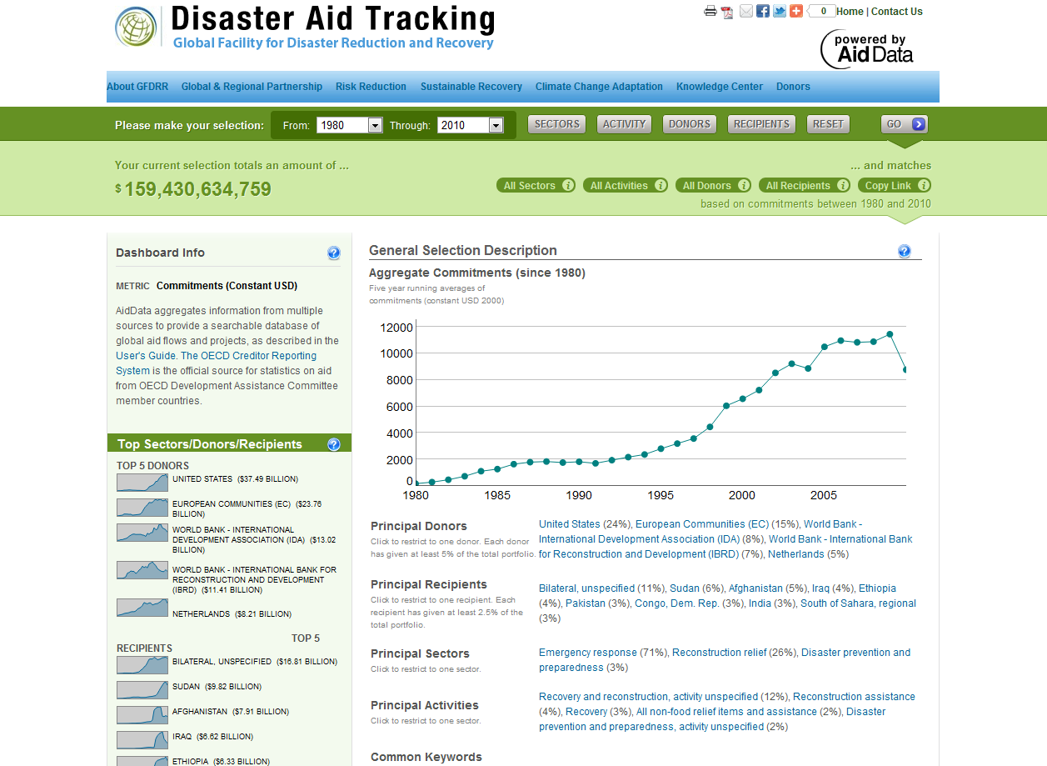
http://gfdrr.aiddata.org

Slide 16
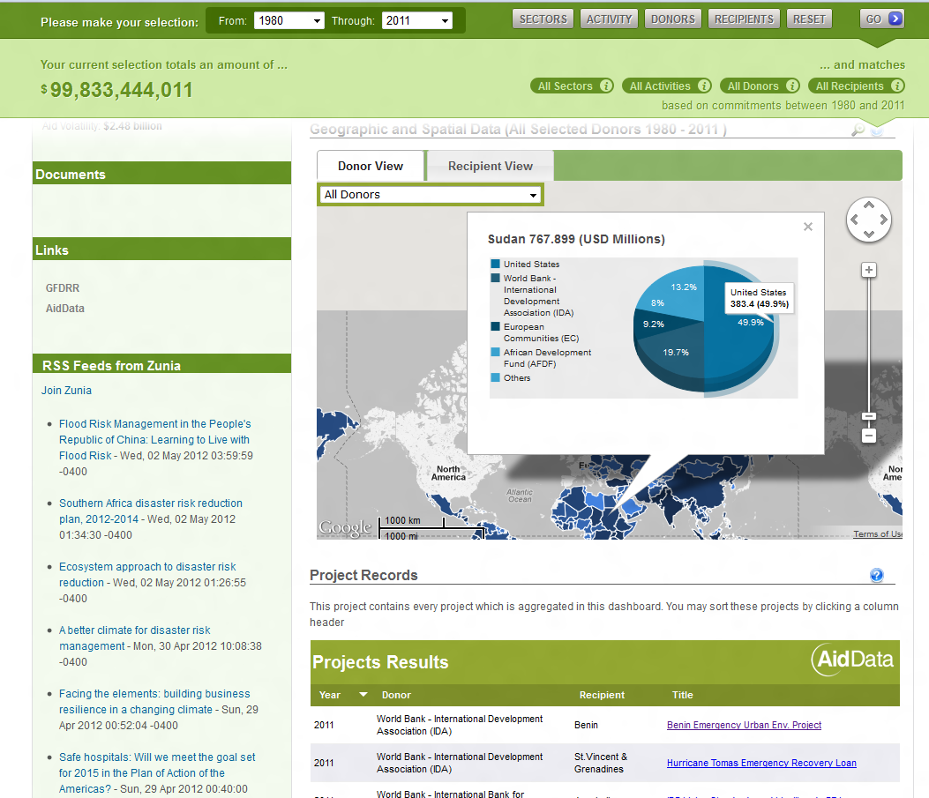

Slide 17
Next Steps
Roll out geocoding to more AMP country governments
  Open Aid Partnership
Create more advanced analytical tools to support aid targeting and visualization of results
  Dashboards, Score Cards, Offline, Mobile, etc.
Build local capacity to empower partner countries
  Sustainability of mapping efforts
  Using mapped data for planning, coordination, and results

Slide 18
Thank You
Stephen Davenport
  sdavenport@developmentgateway.org
  @davenportsteve
Joshua Powell
  jpowell@developmentgateway.org
  @joshuacpowell

