Slide 1
COLOMBIA AIMS

Slide 2
Título Capítulo

Slide 3
Background
Disbursment – 1998
ODA System – 2000
Cooperation Map – 2005
Non traditional donors – 2007
SSC – 2010
New Agency – New Challenges - 2011

Slide 4
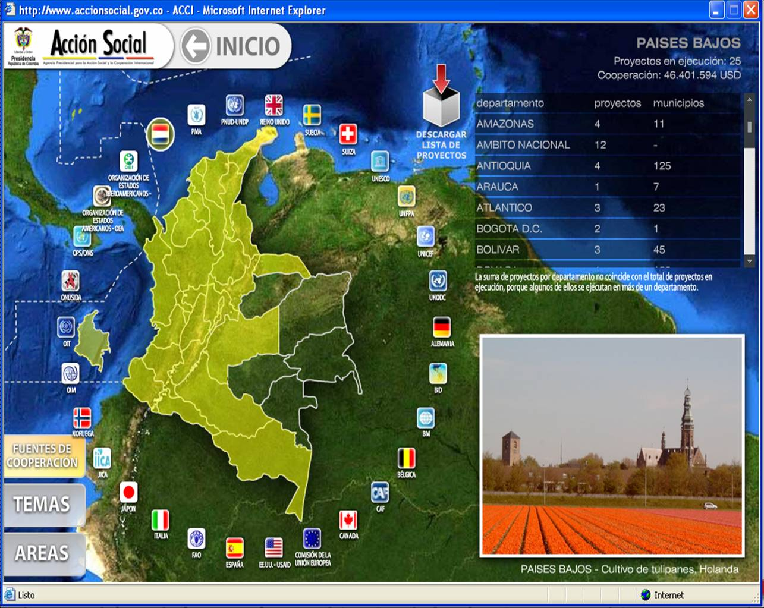
Demand Map
Information by:
Donor
Theme
National Estrategy Areas

Slide 5
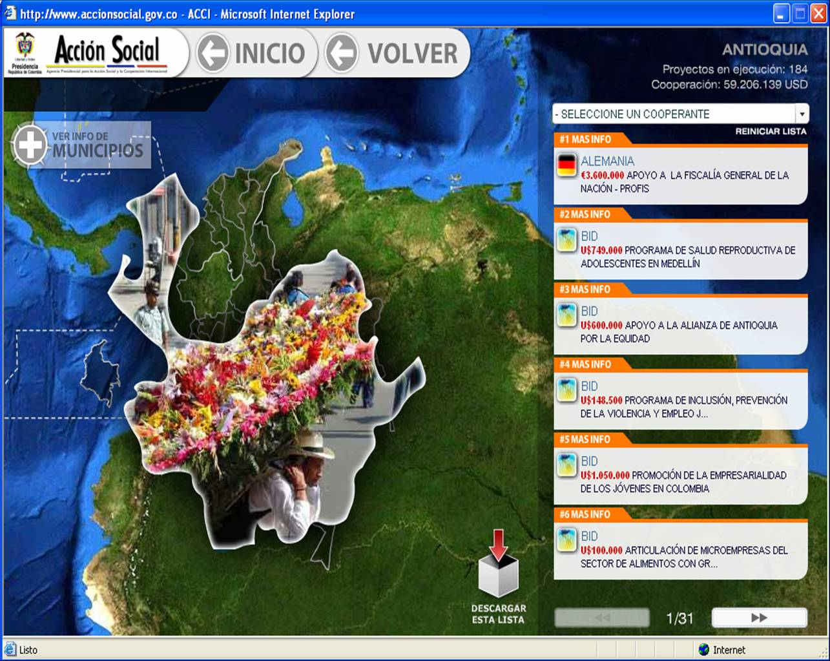
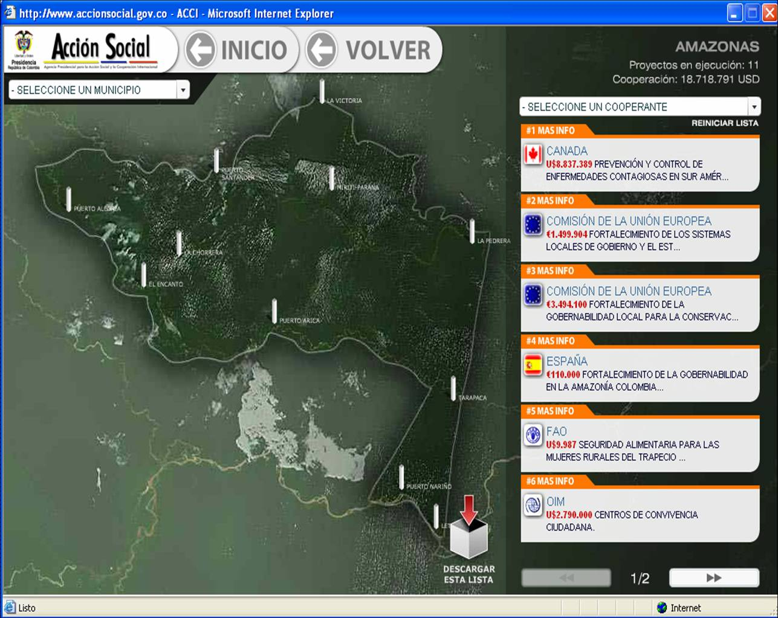
Subnational Demand Map

Slide 6
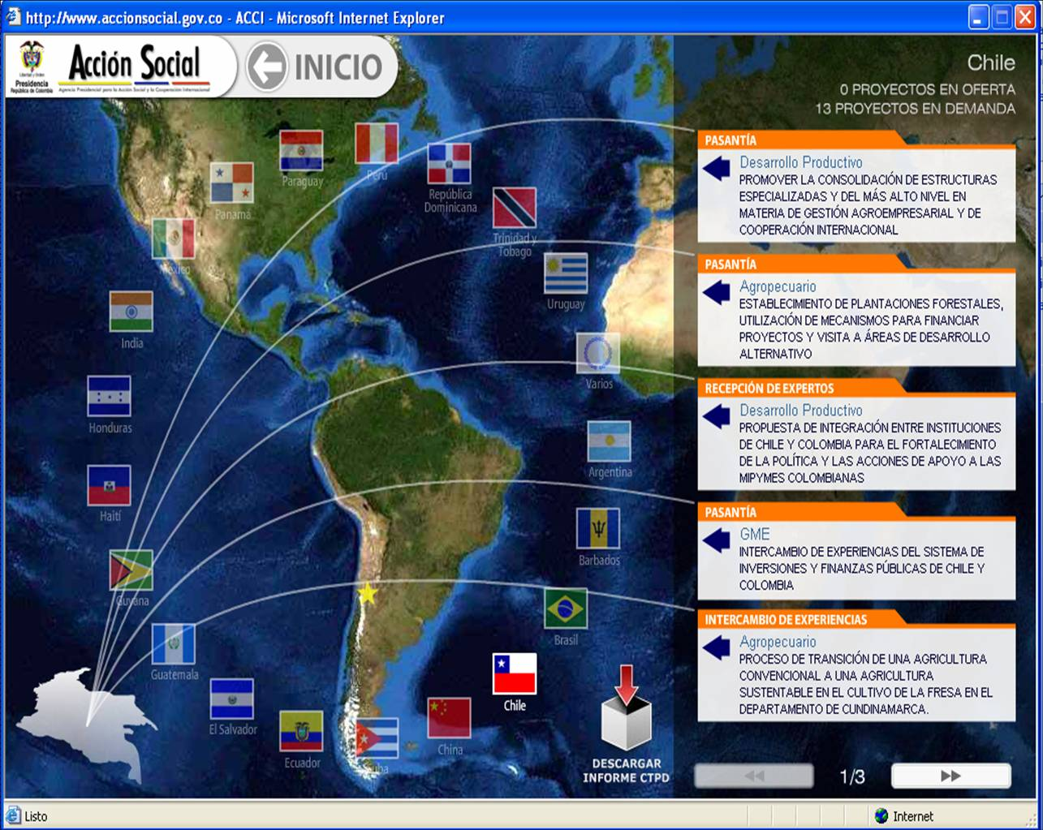
SSC
1. Bilateral
Regional Estrategies
Regional Dialogue Mechanism

Slide 7
ACTUAL SITUATION
Colombia - High Medium Rent Country – Second receptor of cooperation in Latin America and Caribbean.
Colombia like donor in SSC and Triangular.
Colombia recognize the different partners and actors – National Estrategy.
The new development vision require a better system.

Slide 8
CHALLENGES
Improve coordination between national and subnational institutions, NGOs and APC Colombia.
Improve regional distribution.
Strengthen capacities.
Strengthen SSC.
Produce better information.
M&E based on results.
Mutual accountability.

Slide 9
SYSTEM REQUIREMENTS
APC COLOMBIA
ODA
Other Donors
SSC & T
APC Budget
BSC
DONORS
WEB
NATIONAL & SUBNATIONAL INSTITUTIONS
NGOs, PRIVATE SECTOR, ACADEMY

Slide 10
SYSTEM CHALLENGES
Results information – ODA and SSC (knowledge cost )
Detailed information by region and beneficiaries
Disbursement by proyect and region
Paris (Busan) Indicators.
Match national indicators information with International cooperation.
Align with donor system.
Match SSC information with the beneficiaries
Obtain an share information with other partners.
Share the system with national and subnational institutions.

Slide 11
WHAT WE NEED
IATI Support – Standard, Learn Lections, Good experiences.
Share Knowledge about technology builded for IATI
System Diagnostic – what the country need?.
New system architecture – Software and hardware
Implementation

Slide 12
MUCHAS GRACIAS
www.apccolombia.gov.co

